Slide 1

Large title of the presentation The polar regions play a key role in the Earth’s system
Name of the author
Institution origin
www.website.cl

Slide 2
POLAR RESEARCH INFRASTRUCTURE NETWORK
Verónica Willmott Puig
www.eu-polarin.eu

Slide 3

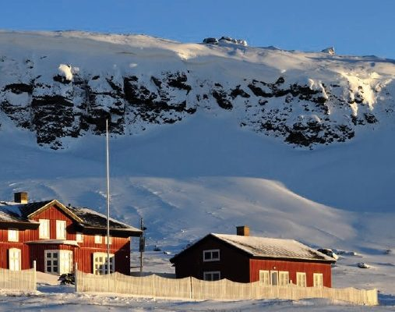
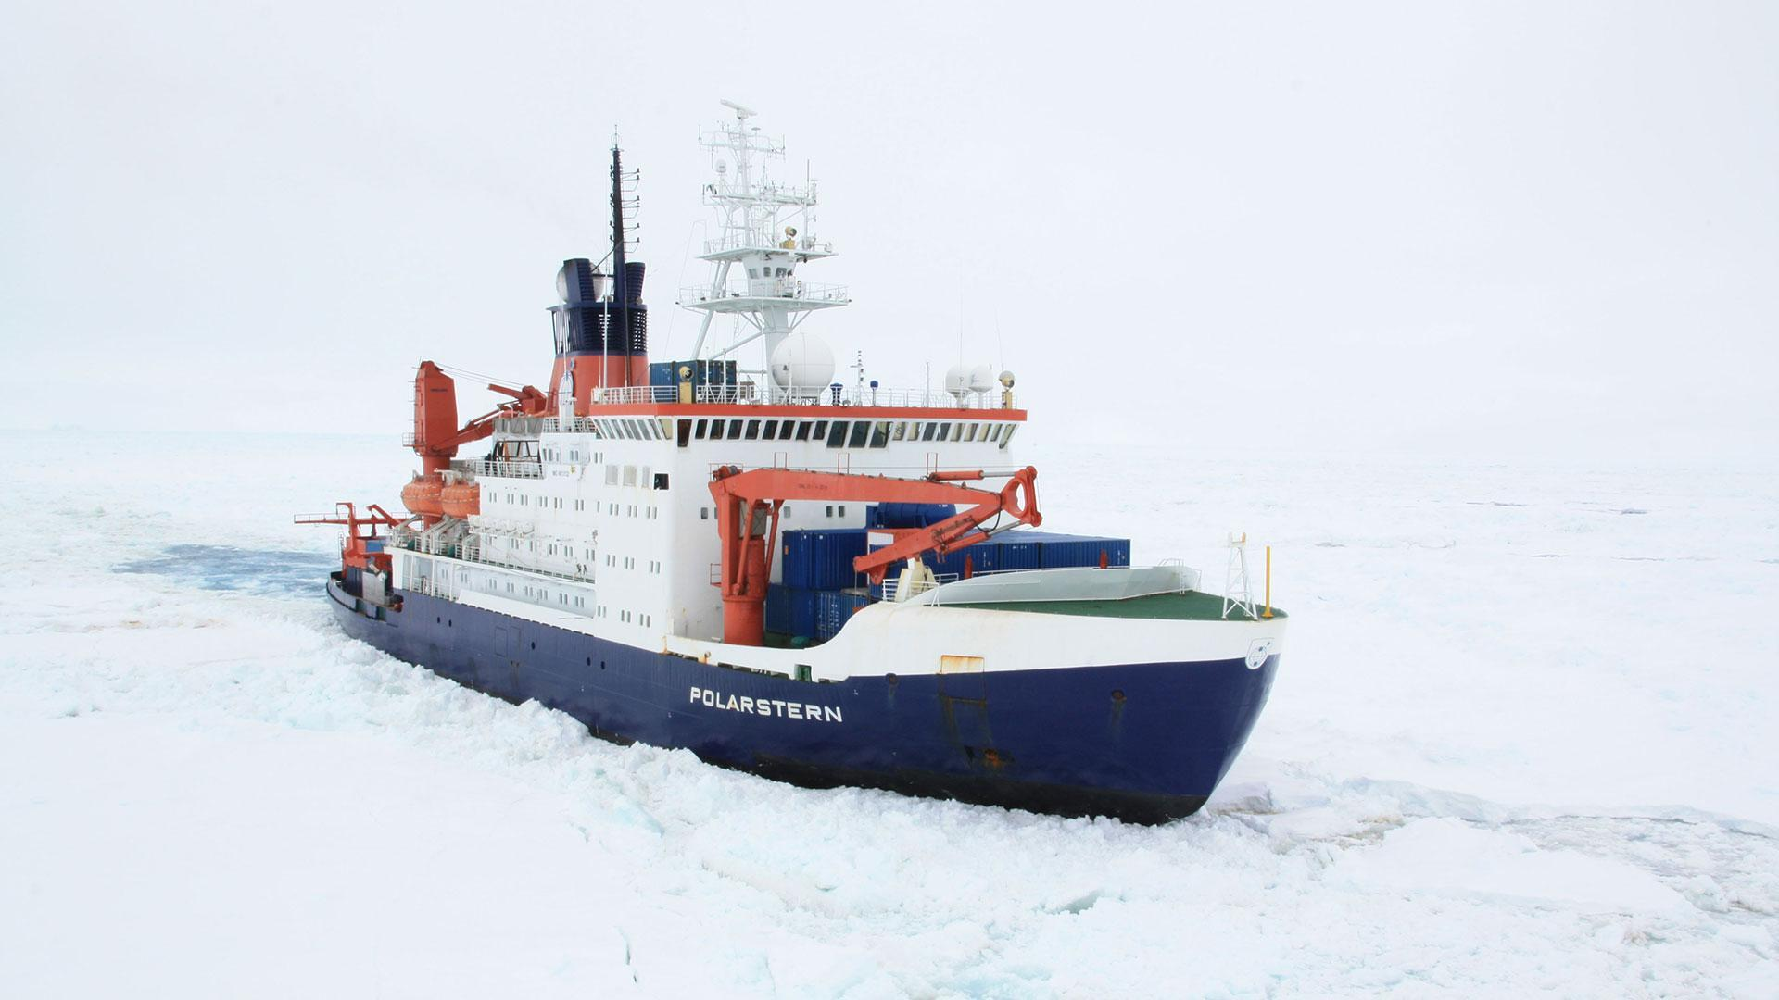
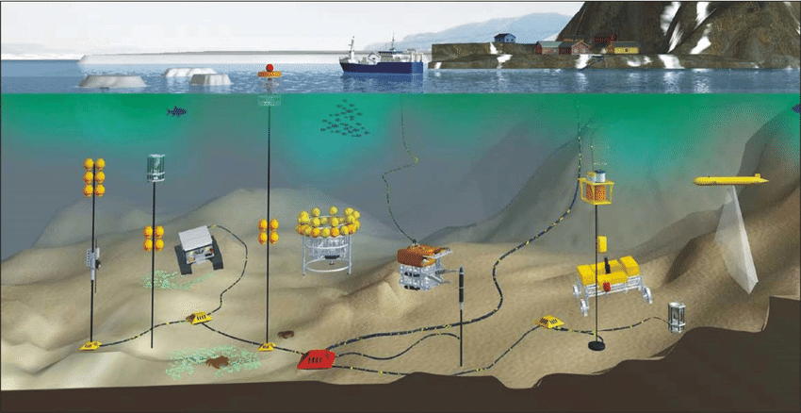
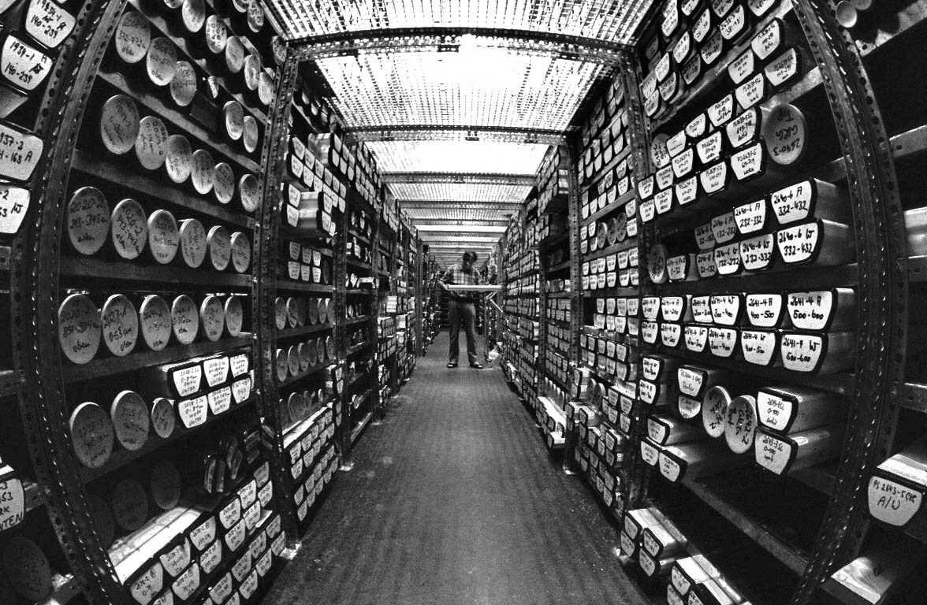
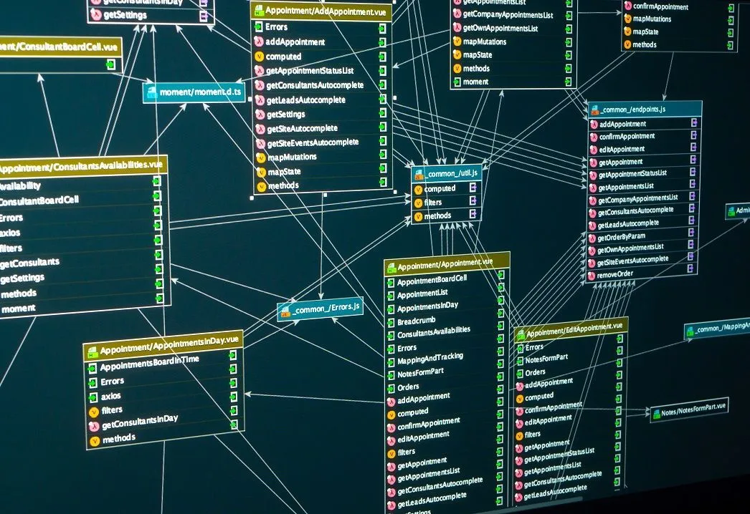
POLARIN: POLAr Research Infrastructure Network
Funded under:
HORIZON-INFRA-2023-SERV-01-01: Research infrastructure services to enable R&I addressing main challenges and EU priorities
Topic: For RI services for sustainable Arctic/polar regions
Coordinator:
52 partners
Budget: M14,6€
March 2024 – February 2029
38
Research stations
12
Polar vessels
18
Observatories
4 Ice and sediment core repositories
7 Data infrastructures
Notes:
RI (Research Infrastructures)

Slide 4
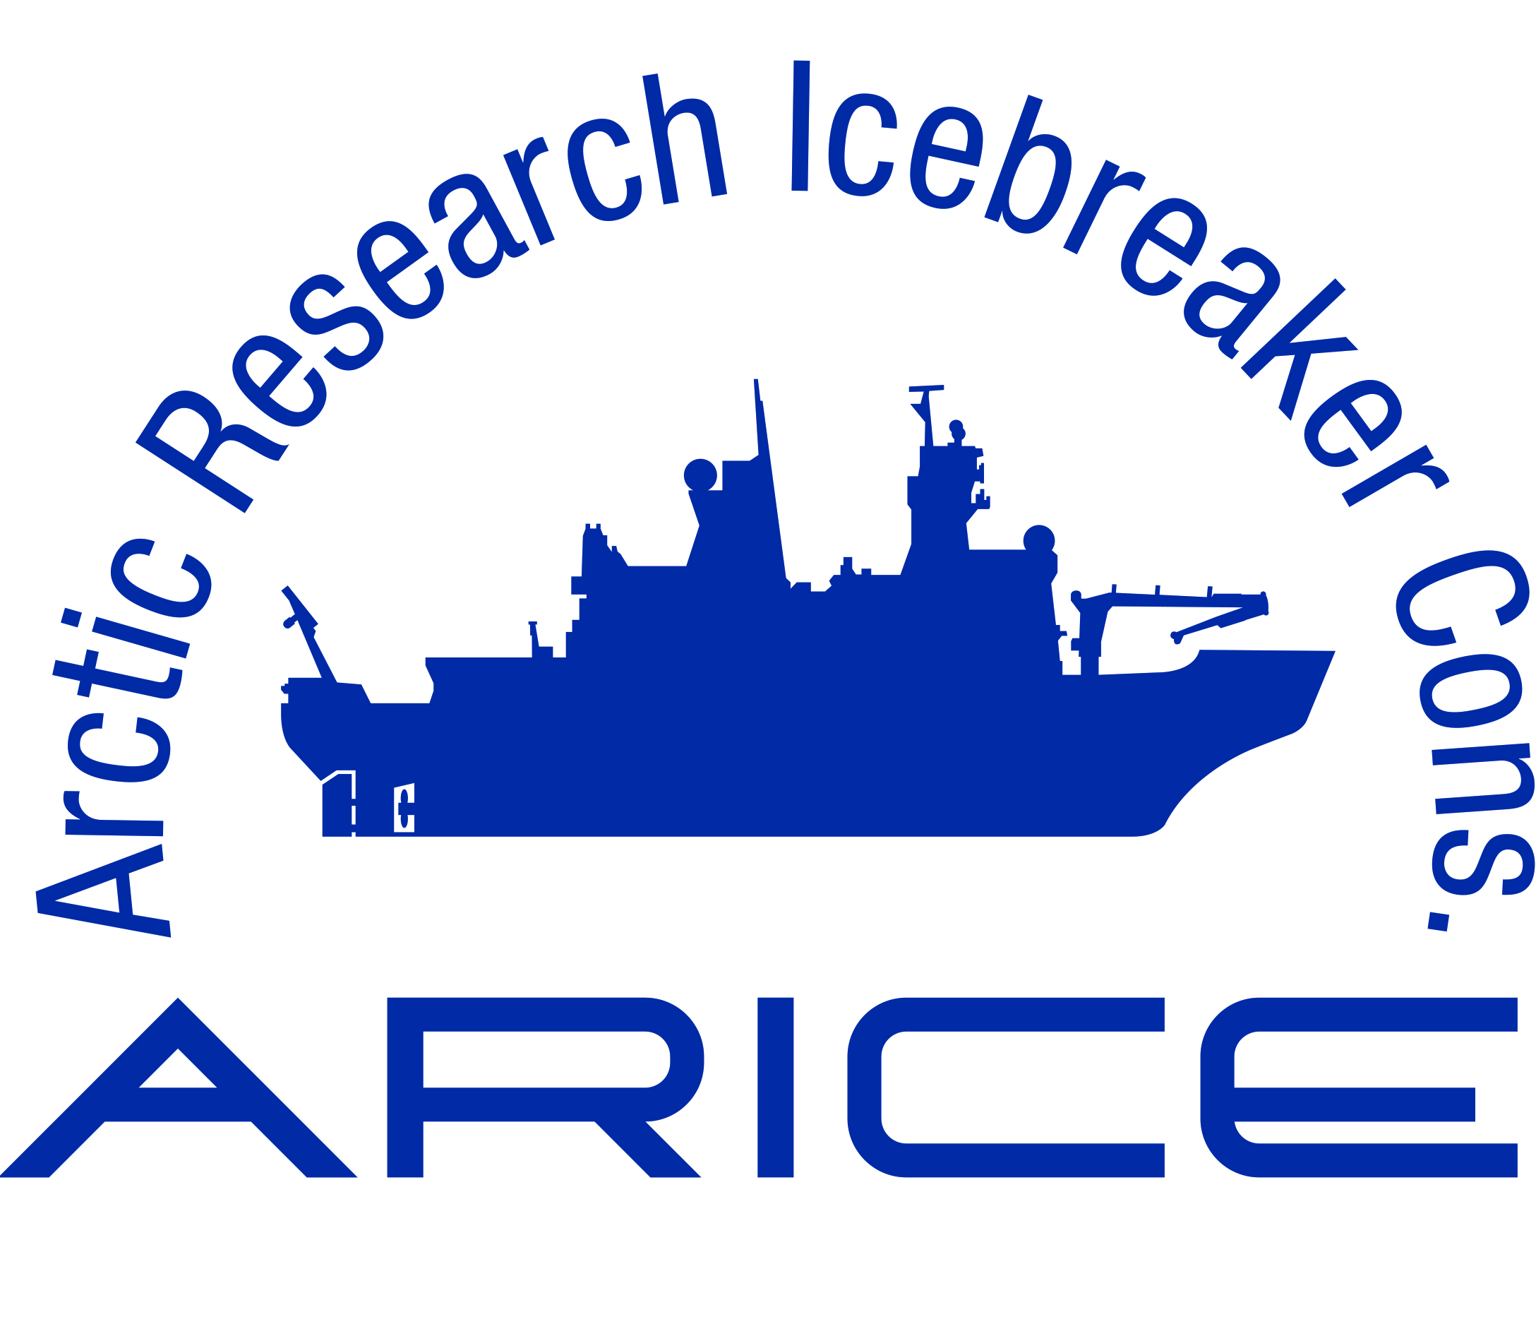


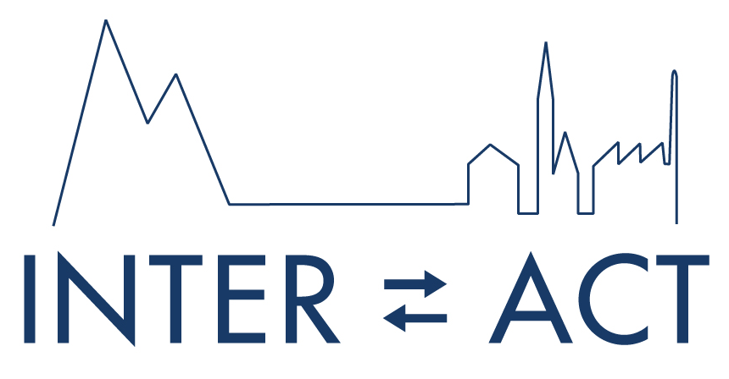

Background
2024-2029
2024-2029
2009-2023
2011-2024
2018-2022
2024-2028
2024-2029
38
Research stations
12
Polar vessels
18
Observatories
4 Ice and sediment core repositories
7 Data infrastructures
Notes:
RI (Research Infrastructures)

Slide 5
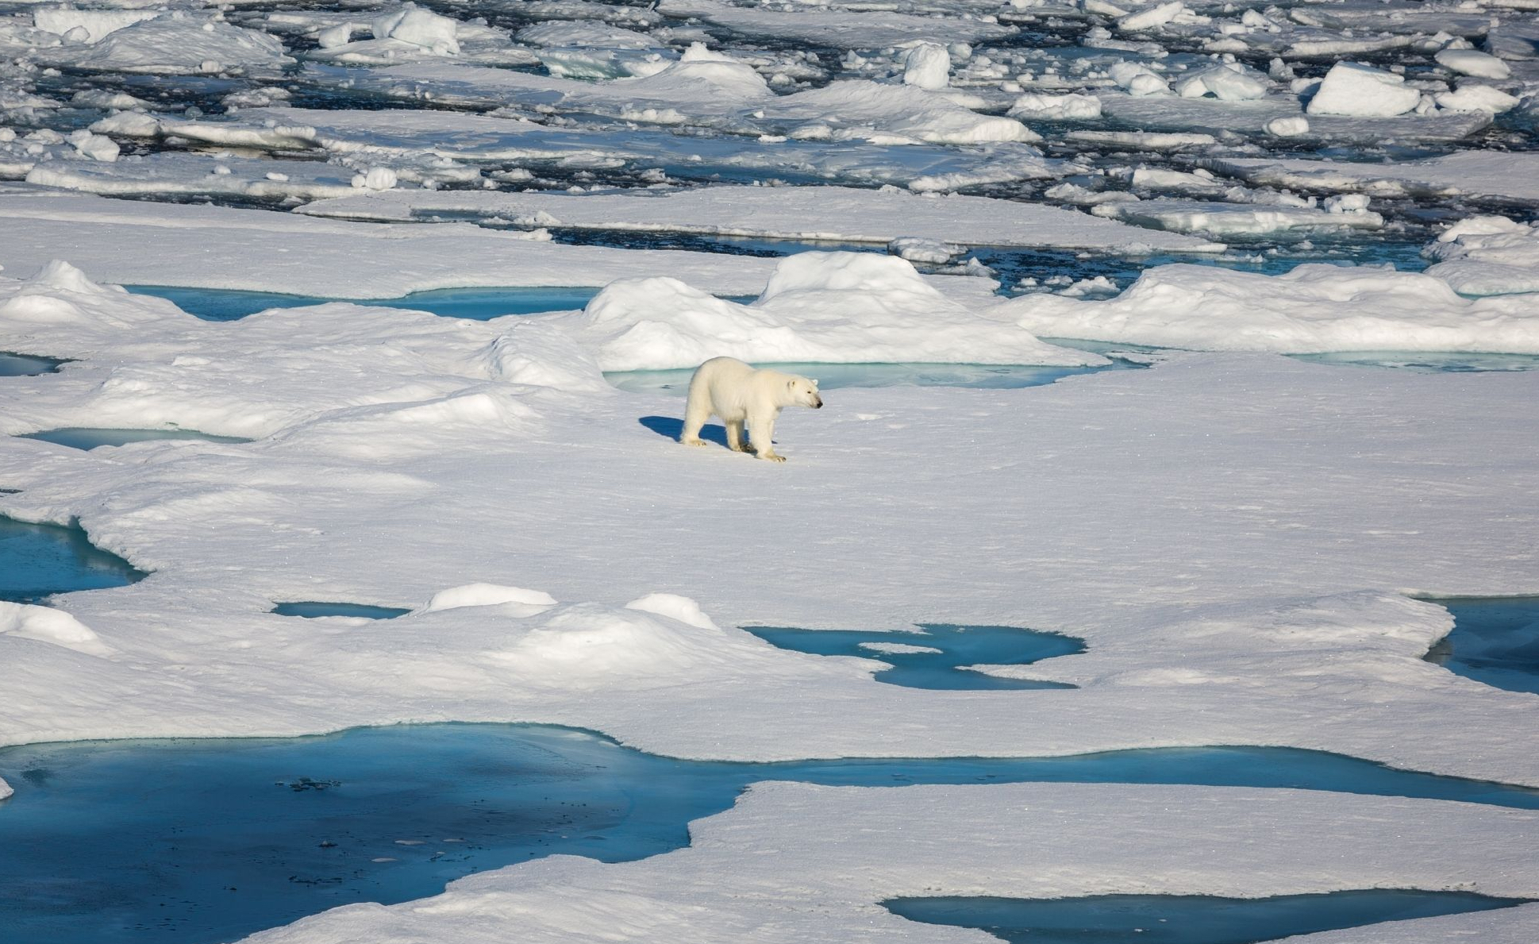
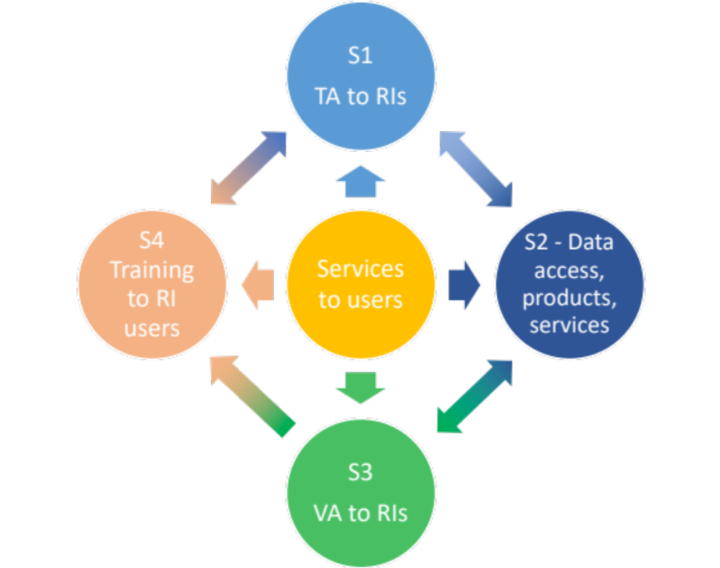
Overall aim
To provide efficient and customised RI services to address the scientific challenges of the polar regions, including access to a wide portfolio of complementary and interdisciplinary top level RIs.

Slide 6
Overall aim
Sea level, glacier stability and melt
Sea ice and Polar Oceans
To provide efficient and customised RI services to address the scientific challenges of the polar regions, including access to a wide portfolio of complementary and interdisciplinary top level RIs.
(paleo) climate processes
Key research challenges
Carbon balance and permafrost
Atmosphere dynamics
Polar ecosystems and biodiversity

Slide 7
Improve online services, data access and interoperability
Ensure that the new generations are trained to exploit the leading edge RIs
Integrate and combine the access to Arctic and Antarctic RI
Polarin will:
Notes:
RI: Research infrastructures

Slide 8


























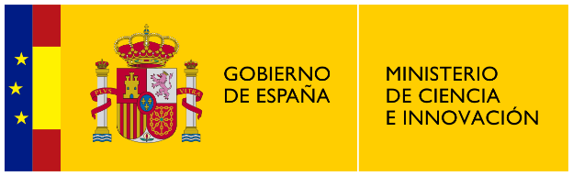


























POLARIN Consortium

Slide 9
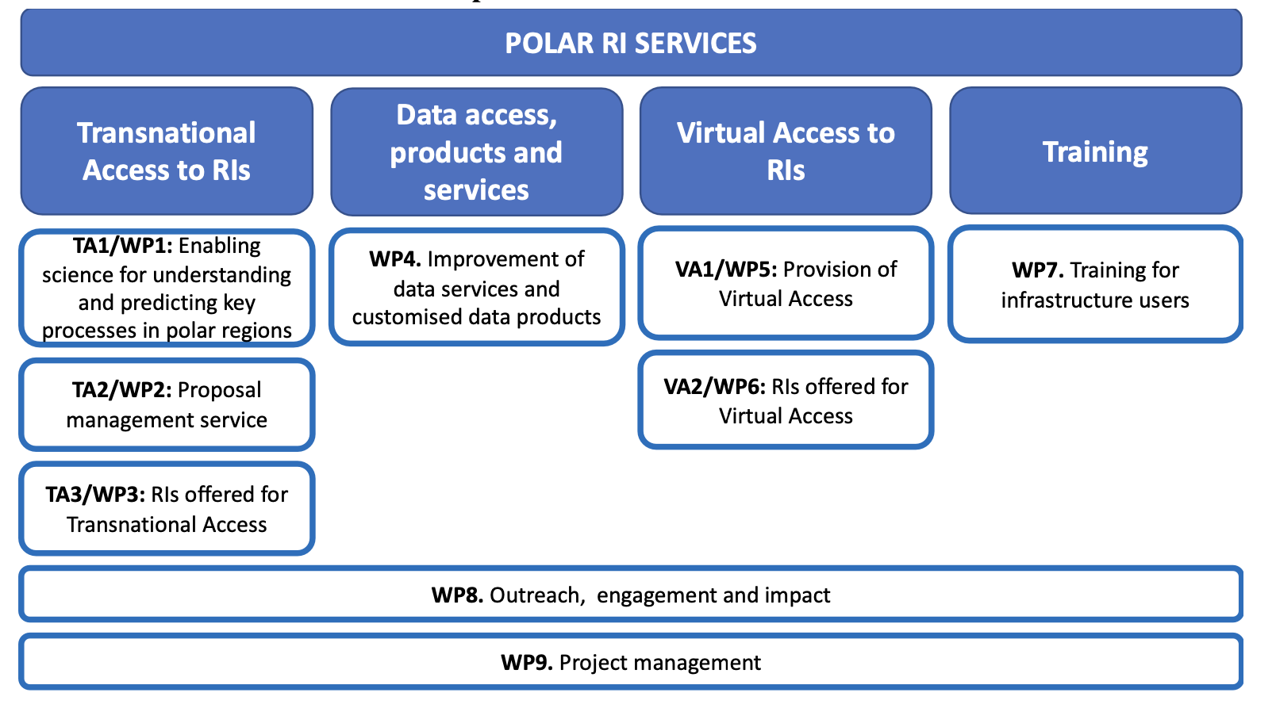
Overall structure of the work plan

Slide 10
POLARIN RESEARCH INFRASTRUCTURE
Access integration to 64 research infrastructures in both poles
38
Research stations
12
Polar vessels
18
Observatories
4 Ice and sediment core repositories
7 Data infrastructures
Notes:
RI (Research Infrastructures)

Slide 11
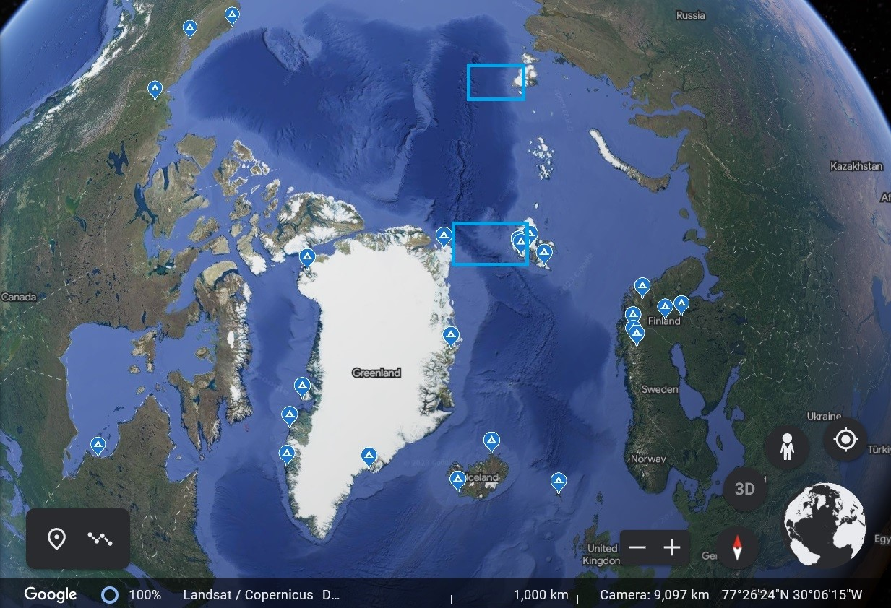
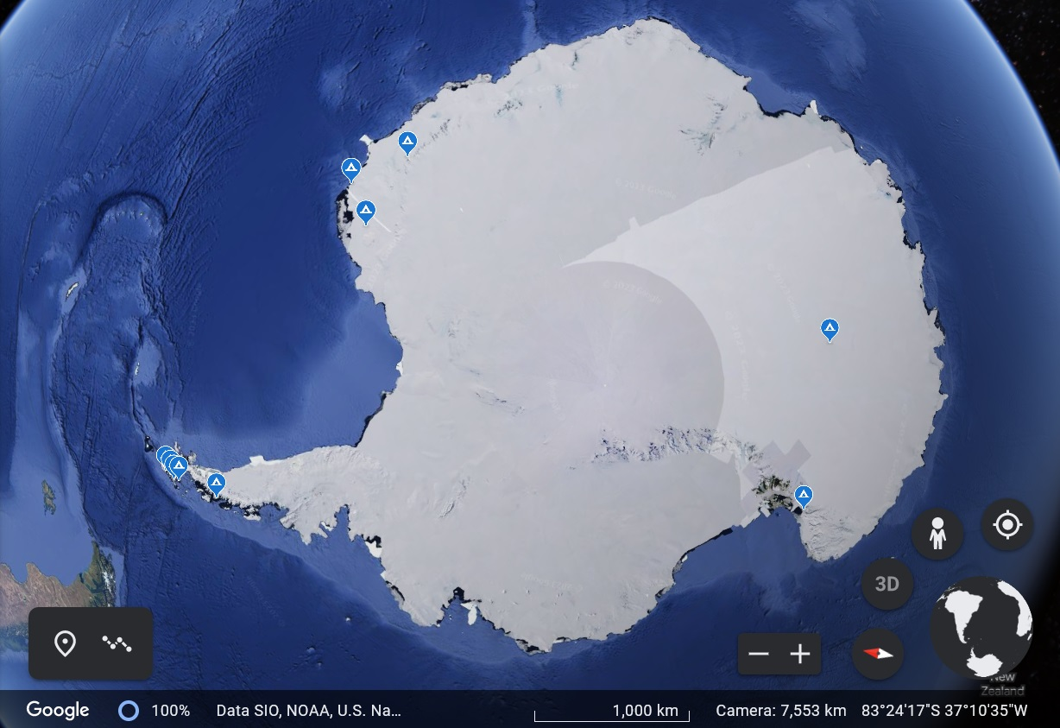
POLARIN INFRASTRUCTURE
38
Research stations
27 Arctic stations
11 Antarctic stations
12
Polar vessels
18
Observatories
4 Ice and sediment core repositories
7 Data infrastructures
Notes:
RI (Research Infrastructures)

Slide 12
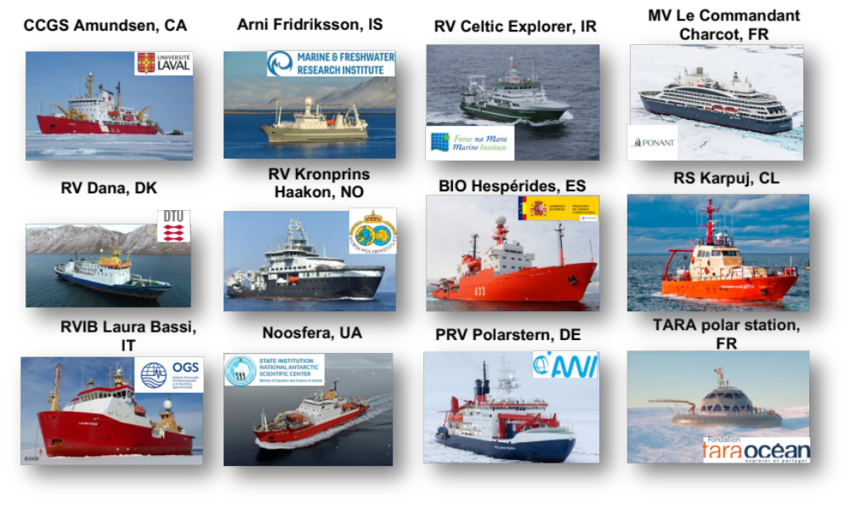
POLARIN INFRASTRUCTURE
12
Polar vessels
18
Observatories
4 Ice and sediment core repositories
7 Data infrastructures
Notes:
RI (Research Infrastructures)

Slide 13
POLARIN INFRASTRUCTURE
1 deep-sea observatory (FRAM)
2 observational networks (GIOS and Greenland Ecosystem Monitoring)
15 key observatories associated to research stations
18
Observatories
4 Ice and sediment core repositories
7 Data infrastructures
Notes:
RI (Research Infrastructures)

Slide 14
POLARIN INFRASTRUCTURE
AWI: Ice core repository
AWI: Sediment core repository
BAS: Polar Sediment Core Facility
UiT: Core repository and geological laboratories
4 Ice and sediment core repositories
7 Data infrastructures
Notes:
RI (Research Infrastructures)

Slide 15
POLARIN INFRASTRUCTURE
Arctic Biodiversity Data Service (CAFF)
ARICE Data infrastructure
Italian Arctic Data Center (CNR)
INTERACT data portal
Italian National Antarctic Data Center (CNR)
POSEDA (GFZ)
SIOS Data Management System
7 Data infrastructures
Notes:
RI (Research Infrastructures)

Slide 16
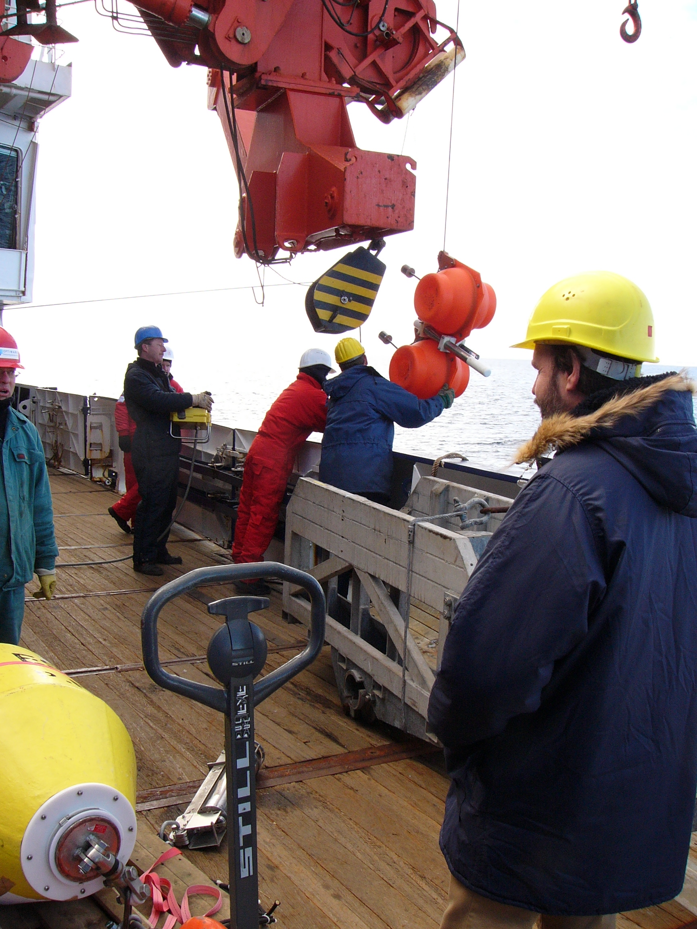
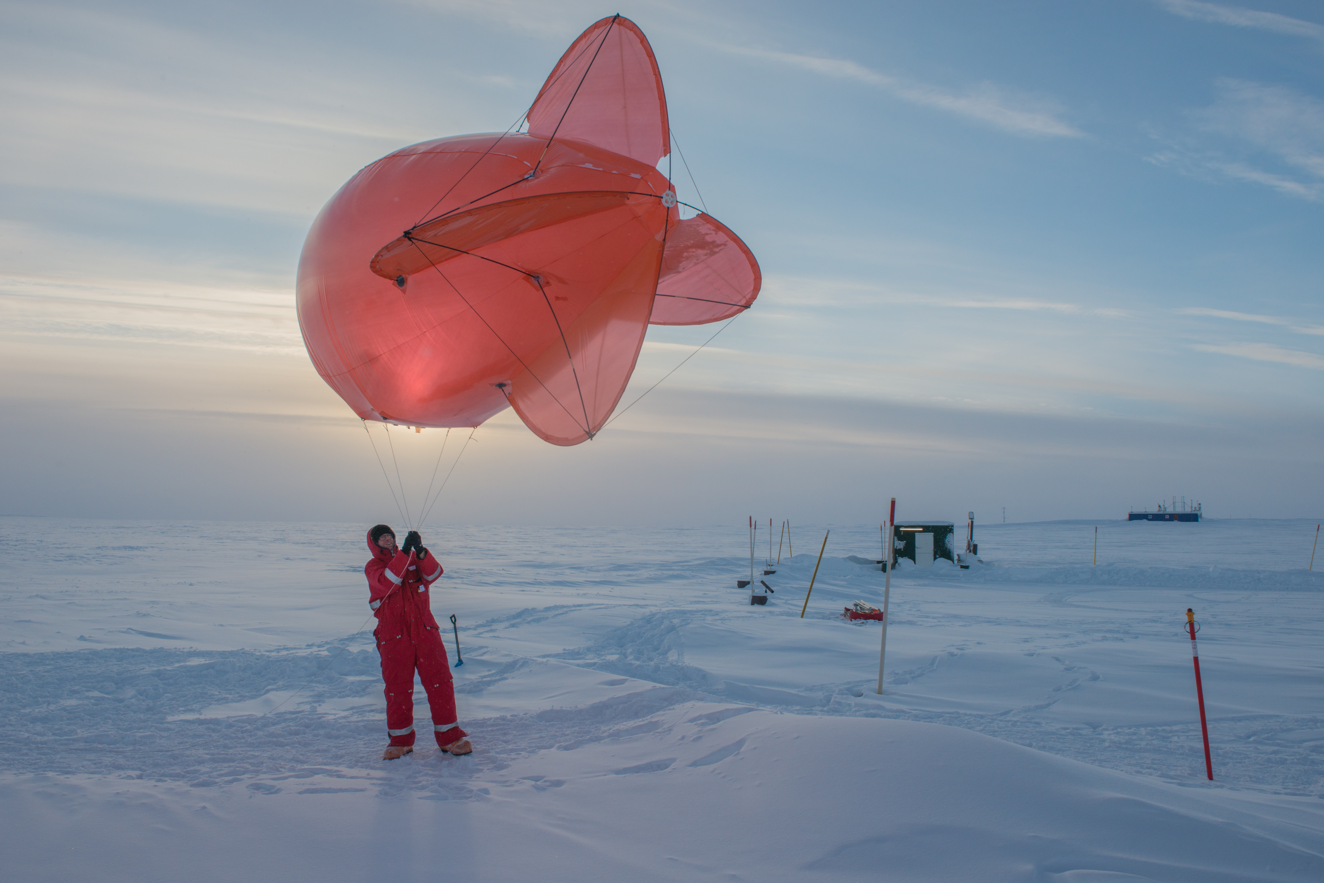

TYPES OF ACCESS TO RI
Transnational Access
In person
Remote
Virtual access
Notes:
virtual access (VA) through a single-entry portal to 7 data infrastructures, 2 observational networks and 10 research stations and their associated observatories in both polar regions

Slide 17
Transnational Access
In person
Remote
Proposal based, Challenge driven
Access to RIs from other countries
International cooperation
Externally evaluated
If granted, access to RI and travel expenses are covered by the project
Notes:
virtual access (VA) through a single-entry portal to 7 data infrastructures, 2 observational networks and 10 research stations and their associated observatories in both polar regions

Slide 18
Virtual Access
Virtual access
Open access to (new) data, databases and data services
Notes:
virtual access (VA) through a single-entry portal to 7 data infrastructures, 2 observational networks and 10 research stations and their associated observatories in both polar regions

Slide 19
Objectives
Enable science for understanding and predicting key processes in polar regions
Provide efficient challenge-driven transnational access (TA) to top level RIs in the polar regions
Improve data services and provide customised data products
Provide virtual access (VA) to data and data services
Provide training for infrastructure users
Advertise RI services and engage RI users

Slide 20
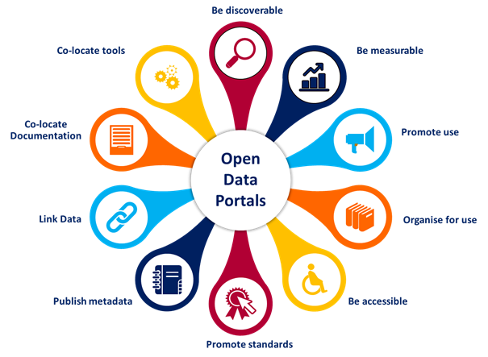
Data services and data products
POLARIN will concentrate its efforts on improving the data landscape and the consumption of data
A single-entry portal
VA to metadata, data and data services
Coordinate, harmonise, and optimise the implementation and integration of data services and products.
Create data products from environmental databases that can be directly used by researchers and decision makers.

Slide 21
Training for infrastructure users
Training for early career scientists and professionals
Training on data stewardship
Safety training
Notes:
Training for early career scientists and professionals to ensure that the new generations are able to fully exploit the services of the diverse RIs. It will include a series of online seminars dedicated to scientific equipment and tools, expedition planning and legal, safety and sustainability requirements to work in the polar regions. Target groups will be PhD students and postdoctoral researchers, technicians, and engineers.
Training on data stewardship to ensure that data sets are adequately preserved and documented, and that they remain accessible and usable to end users. The usefulness of data sets depends also on the ability of data providers and stewards to assess, demonstrate, and describe the quality of the information, and their ability to adopt community best practices and standards. POLARIN will organise a dedicated training on data stewardship as a series of online seminars and workshops to ensure that data sets are not only collected, but also curated and able to deliver accurate, reliable environmental data sets.
Safety training to ensure that infrastructure users are prepared to deal with emergency conditions on land and at sea. POLARIN will organise a safety training under Arctic conditions in compliance with the Polar Code for a group of users. The safety training will prepare for marine and land expeditions. It will be accompanied by online and written training material.

Slide 22
POLARIN ADVISORY BOARD
Jennifer Mercer
NSF
Former Chair of the Forum of Arctic Research Operators (FARO)
Juan José Danobeitia
CSIC
Former General Director of EMSO
Diego Fernández
ESA
Head of the Research and Development Section at the European Space Agency.
Nicolás Villacorta
Helmholtz
Juliet Hermes
SAPRI
Manager of the South African Antarctic Programme (SAPRI)
Policy Officer for European Research Infrastructures at the Helmholtz Association
Notes:
POLARIN has implemented an Advisory Board with relevant stakeholders to enhance the connection with international partners and organisations as well as with other European initiatives and projects.

Slide 23





Connection with other projects, forums, organisations
Notes:
POLARIN will connect and collaborate intensely with other projects, forums and organisations, such as our sister project AQUARIUS, funded in the same call, the Eu Polar Cluster, operator organisations, and the Earth Observation community that wants to support in situ data collection.
POLARIN, with such a vast infrastructure network, has the opportunity to contribute to initiatives planned in the next years.

Slide 24
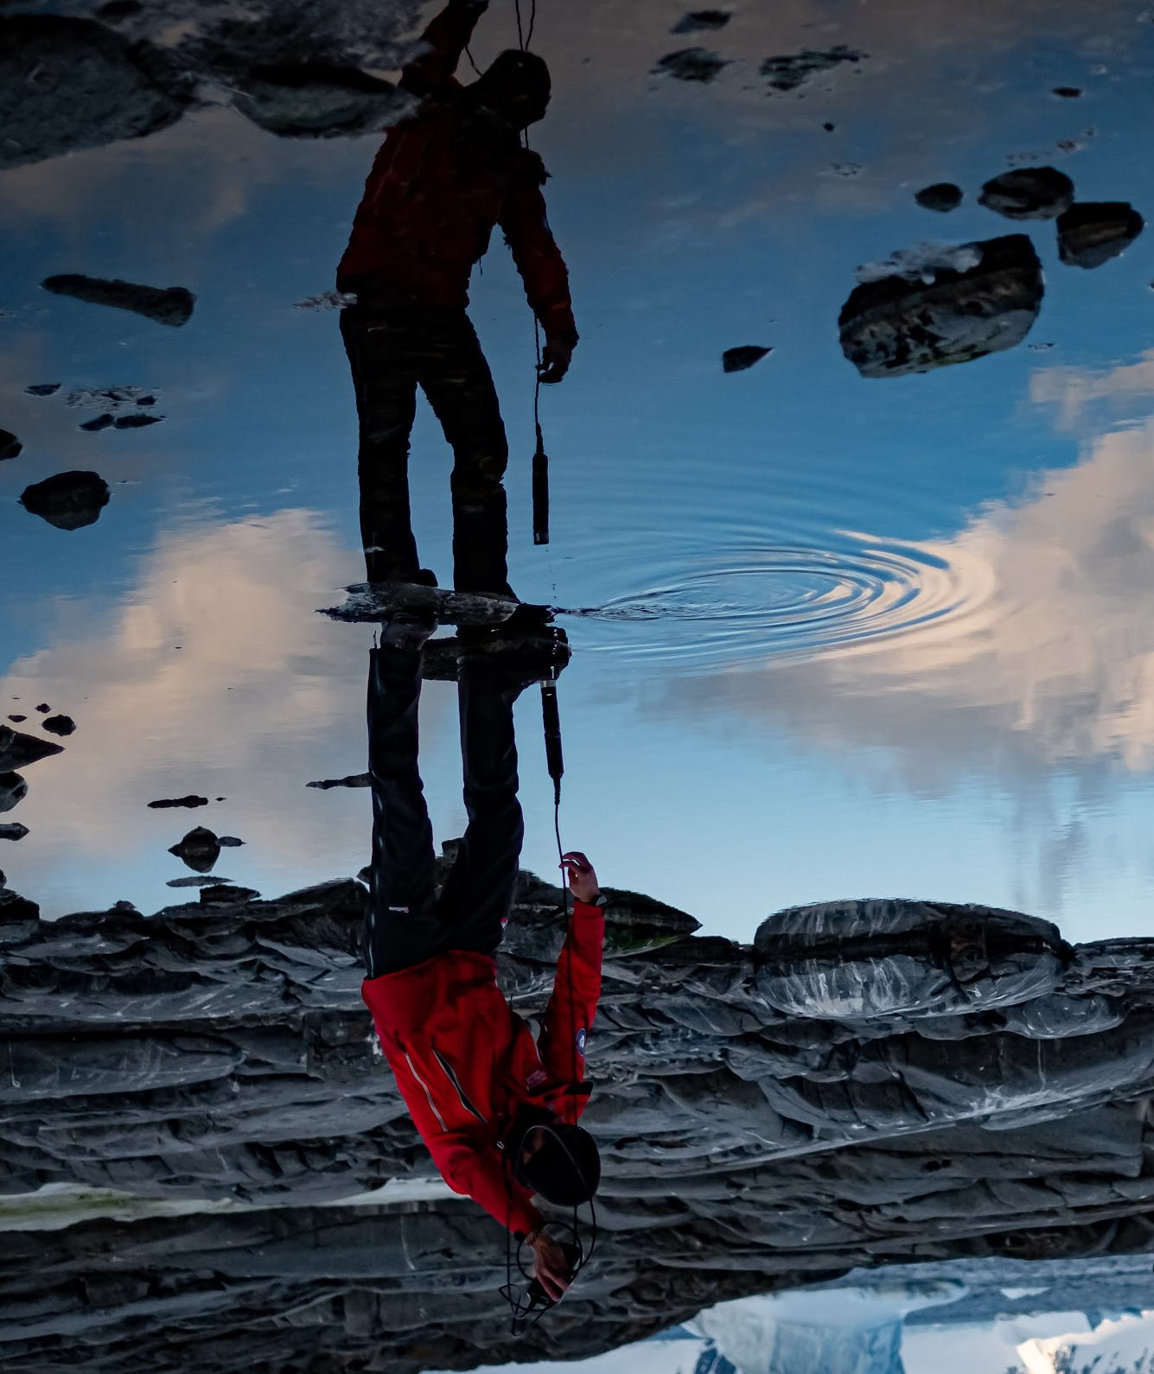
Contact Us
Nicole Biebow: Nicole.Biebow@awi.de
Verónica Willmott: Veronica.Willmott@awi.de

