Slide 1
POLARIN
Project Management
HORIZON-INFRA-2023-SERV-01-01
Kick-off meeting – 17-19 April 2024
Pierre QUERTENMONT, Project Officer
European Research Executive Agency

Slide 2



Outline
I.Monitoring & Reporting
Technical Reporting
Financial Reporting
Audits
Amendments
II.Cross-cutting aspects
Impact
Communication, Dissemination & Exploitation
Open Science
Policy Feedback
Ethics
III.Extra Resources

Slide 3
Role Distribution
DG Research and Innovation
-> Definition of Policies
-> Drafting the Work Programme
Research Executive Agency (REA)
‘Reforming European Research & Innovation and Research Infrastructures’, Unit C4
-> Implementation of calls for proposals
-> Grant Management
Coordinator
-> Monitor that the action is implemented properly
-> Act as the intermediary for all communications with REA
-> Distribution of payments

Slide 4
I. Monitoring and Reporting
Technical Reporting
Financial Reporting
Audits
Amendments

Slide 5

Monitoring Project Implementation
Technical: compliance with the Description of the Action
Financial: compliance with the cost eligibility rules
Other (non-financial) obligations: compliance with cross-cutting GA obligations
Notes:
The monitoring usually covers 3 aspects: technical, financial and non-financial (TNA/VA)

Slide 6

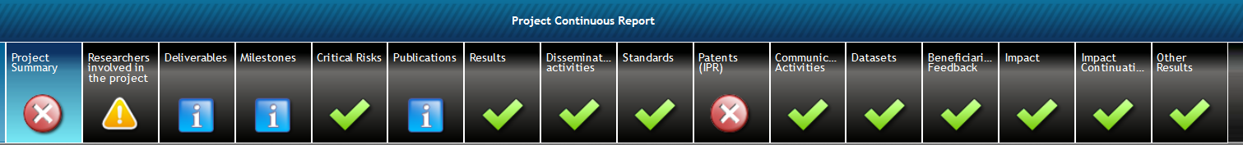
Project reporting types
Beneficiaries must continuously report on the progress of the action (e.g. deliverables, milestones, outputs/outcomes, critical risks, indicators, etc), in the Portal Continuous Reporting tool and in accordance with the timing and conditions set out in the Grant Agreement
In addition, Beneficiaries must provide periodic reports to request payments, in accordance with the schedule and modalities set out in the Grant Agreement

Slide 7
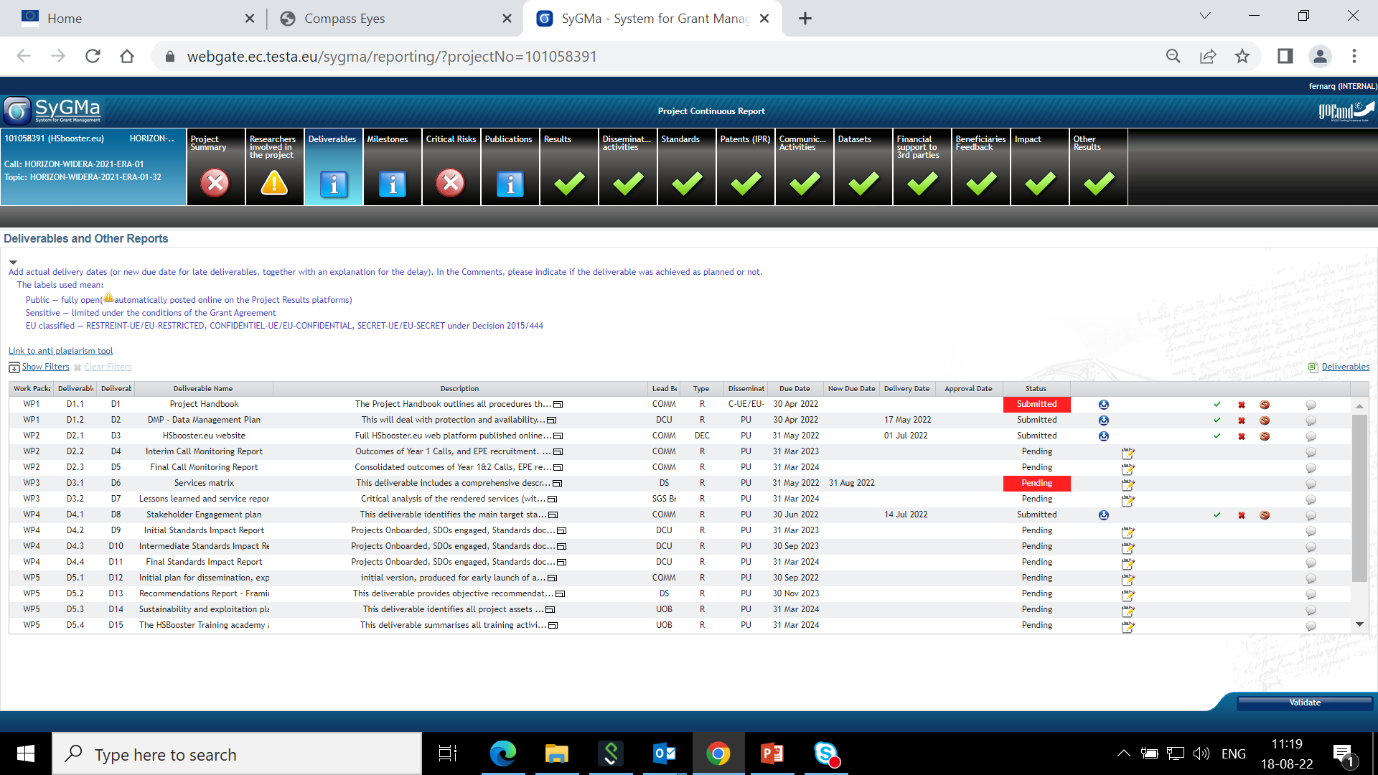
Continuous Reporting – Deliverables
Deliverables marked as Public will be automatically published in Cordis - Be particularly attentive to their quality
If one deliverable will be delivered with delay - Get in touch with REA PO

Slide 8
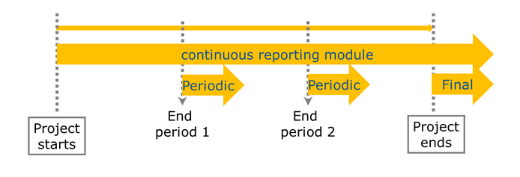
Project reporting types

Slide 9
Periodic Report: Overview
WHEN
60 days after reporting period end
WHAT
Periodic Report
HOW
via Portal
(1) Technical report
By Coordinator with contributions from Consortium
Part A : structured tables with project information, generated automatically from Continuous Reporting
Part B: narrative description of the work carried out during the reporting period (uploaded as PDF)
(2) Financial report
Individual Financial Statement for each Beneficiary
Explanation of the Use of Resources and information on subcontracting
Certificates on the Financial Statements (CFS)*
(*) Requested EU contribution to costs ≥ EUR 430 000.
Special threshold for beneficiaries with a systems and process audit: requested EU contribution to costs ≥ EUR 725 000.00
Notes:
* What was done and achieved?
* Which problems were encountered?
* How can progress so far be assessed?
* Were there any deviations or corrective actions?

Slide 10
Periodic reporting: Reviews
Reviews planned at the end of final reporting period
(within 1 months after submission of reports) - GA article 25
Present the work carried out, main achievements and use of resources
Participation of Coordinator & WP leaders (minimum)
REA Project Officer assisted by external expert(s)
Notes:
1 month after submission of the report or 3 months after end of the reporting period

Slide 11
Periodic Reporting: Process
End of reporting period
Revisions and explanations
End of reporting and payment
Within 60 days
DELIVERABLES submitted
Periodic REPORT
submitted (technical and financial)
Submission of revised version of reports (technical and financial)
ALL documents received, correct and accepted
Comments from
Project Officer and Financial Officer – clarifications and modifications may be requested
More than one iteration may be necessary
Initiation payment
Review meeting*
Review report submitted
*A review meeting might not be necessary, to be decided with PO

Slide 12
Trans-National Access (TNA) activities 1/2
TNA available to external users:
  in person (‘hands-on’),
  remote scientific services: reference materials or samples, the remote access to a high-performance computing facility, etc.
Open specific calls to invite researchers to apply for access
Documentation needed to support/justify the amount of access reported
  records of the names, nationalities, and home institutions of the users, nature and quantity of access provided
Selection of researchers/research teams
  independent peer-review evaluation
Notes:
in person (‘hands-on’), when the user visits the infrastructure to make use of equipments
remote scientific services, such as the provision of reference materials or samples, the remote access to a high-performance computing facility
The research infrastructures must promote equal opportunities in advertising the access and take into account gender issues when defining the support provided to visitors.

Slide 13
Trans-National Access (TNA) activities 2/2
The research team, or its majority, must work in countries other than the country(ies) where the infrastructure is located
  exception JRC, ERICs and legal entities with international membership
Third countries access permitted up to max cumulative access of 20% of the total amount
The EU financial support covers the access costs incurred by the access provider in providing access to the selected researchers, as well as the travel and subsistence costs incurred in supporting visits to the infrastructure of these researchers (duration limited to 3 months)
Notes:
The duration of stay at a research infrastructure must normally be limited to three months, unless otherwise provided for in the proposal.
ESRF is considered a legal entity with international membership
Third party vs linked third party/affiliated entities (see GA part B- Third parties involved in the project –including use of third party resources)
Third parties : in-kind contribution, subcontractors, a party that contribute to the actions but do not sign the grant agreement, they are different from
Linked third parties/affiliated entities sign the GA and appear in Compass under the specific beneficiary
Associated partners contribute without costs

Slide 14
Virtual Access (VA) activities
Provided to users complying with RI’s access policy, no formal selection process
  e.g. access to databases available via Internet, or data deposition
VA measured through units of access clearly defined in the GA and must be periodically assessed by an external board.
The EU financial support covers the access costs incurred by the infrastructure, including the technological and scientific support

Slide 15
Financial reporting: single submission & single rejection
Technical report and all Financial Statements to be submitted by the Coordinator as a "single package"
If a beneficiary does not include its related financial statement in a periodic report, the costs will be considered 'zero' for this reporting period but the beneficiary can declare its costs with the next financial report (for the next reporting period)
Full package rejected, if one document requires changes or corrections
“One iteration only” principle, if correction of the submitted package is required
Payment will be processed on the basis of the information available after the first resubmission; no further opportunities to correct mistakes or provide additional information (i.e. corresponding costs will be rejected); except for final payment
Notes:
One iteration principle has to be considered against more complex projects for which additional iterations might be necessary. Likewise, a second iteration would be also allowed where the (provisional) rejection of ill-justified costs would generate a significant impact on the cash flow of the project.
Following a case by case assessment, costs rejected could be claimed by the beneficiary in the next reporting period (by adding proper justification).

Slide 16

Financial Statement: Horizon Europe 1/2
HE C. Purchase costs
C.1 Travel and subsistence (column C1)
C.2 Equipment (column C2)
C.3 Other goods, works and services (column C3)
HE A. Personnel costs
A.1 Employees (or equivalent)
A.4 SME owners and natural person beneficiaries
A.3 Seconded persons
A. 2 Natural persons with direct contract
Simplified calculation from H2020
Daily rate x Nr of day-equivalents worked (to the nearest half day)
Daily rate = annual personnel costs for the person ÷ 215
Notes:
Simplified calculation from H2020: Daily rate x number of day-equivalents worked (to the nearest half day).
- Daily rate = annual personnel costs for the person ÷ 215

Slide 17
Financial Statements: Horizon Europe 2/2
D.1 Financial support to third parties
D.5-D.8 Specific cost categories:
D.5 PCP/PPI procurement costs/D.6 Euratom Cofund staff mobility costs/ D.7 ERC additional funding/ D.8 ERC additional funding (subcontracting, FSTP and internally invoiced goods and services)
HE D. Other cost categories
HE D. Other cost categories
D.2 Internally invoiced goods and services
D.3 Transnational access to research infrastructures unit costs
D.4 Virtual access to research infrastructures unit costs

Slide 18

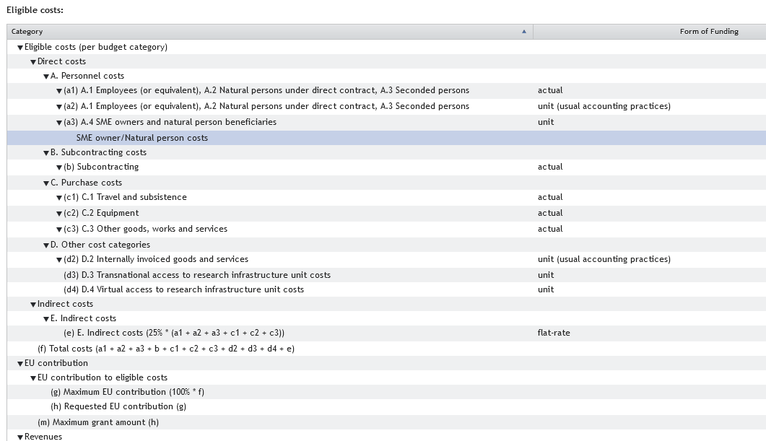
HE Financial Statement: online layout
Notes:
SME owners: unit costs at a daily fixed rate set out in Annex 2a
Cost explanations: i) mandatory explanation on adjustments (if applicable); ii) no more in-kind contributions against payment (free-of-charge only and described in Annex I) and no more separate column for “Costs of in-kind contributions not used on premises”;
New column “Revenues” in the FS to declare any income generated by the action (H2020 Receipts);
Grant reductions (art. 28 MGA) screen integrated in Sygma screens at final payment step;
Updated Financial Statement layout: changes in costs categories labelling and numbering.

Slide 19
Subcontracting vs Contracting
Subcontracting - GA art.9.3
can be used to implement certain action tasks described in Annex 1
Contracting
can be used for purchasing goods, works and services which are necessary to implement the action tasks, but not directly linked to them.
may cover only a limited part of the action
if applicable, the tasks to be implemented and the estimated cost for each subcontract must be set out in Annex 1
if applicable, they should be set out in Annex 1
the total estimated costs of subcontracting per beneficiary must be set out in Annex 2
the total estimated costs for contracting should be declared in Annex 2

Slide 20
Financial reporting – eligibility of costs
(art.6 GA)
ELIGIBLE COSTS
Actually incurred by the beneficiary
Incurred during the action
Connected to the action
Identifiable and verifiable - accounting
Compliant with national law
Reasonable financially sound
Tips:
Be transparent
Treat all costs according to your usual accounting practice
Check for exceptions beforehand!
Ask: PO, FO
INELIGIBLE COSTS
Identifiable taxes and duties
Deductible VAT
Interest owed / Bank charges
Possible future losses charges
Exchange
losses
Excessive / reckless expenditure
From other EU project
Tips:
Non-deductible VAT is an eligible cost
Ask: PO, FO
Costs incurred during suspension are ineligible
Notes:
Standard checks at interim and final payments (actual and unit costs)
Costs are reasonable, necessary, based on the work reported; the resources were used according to the DoA. Any significant deviation is explained in the narrative part;
Expenses are consistent with the principle of sound financial management (economy, efficiency and effectiveness);
In-kind contributions and names of third parties are clearly reported; foreseen in and in line with the DoA;
Subcontracted tasks are described with reference to the DoA (if not, simplified approval procedure can apply); costs budgeted and declared do not significantly differ; costs are satisfactorily explained;
Purchase costs are explained if >15% of personnel costs. Travel and subsistence are not major costs;
CFS are provided; their costs are claimed under purchase costs; the standard template is used; any exception is explained and the auditor has stated an amount (if not, ask to quantify an amount).

Slide 21

Use of Resources
Personnel - actual or unit costs
Number of PM broken down per WP
Amounts and description, if in-kind contribution from third parties
Subcontracting
Actual costs paid for subcontracts (usually in Annex 1) +Third parties (non-financial resources made available free of charge by third parties) + Art.9.2 of the GA
Breakdown of total + explanation + if foreseen in Annex 1
Details to be provided, if not foreseen
Explicit approval from PO during payment processing
Other direct costs
Actual costs incurred for: Travel & subsistence, Equipment, Costs of other goods and services, Costs of large research infrastructures
Explanation needed ONLY if amount > 15% of personnel costs
Cost, description, WP, if foreseen in Annex 1, explanation if not
Amounts and description, if in-kind contribution from third parties
Notes:
Personnel costs must be reported in line with the beneficiary's usual practices. Deviations on personnel per work package must be justified in the technical report. Justification is also necessary in case average personnel costs are significantly higher or lower than planned.
The nature of the subcontracted service (web creation, translation services, etc…), and the name of the subcontractor must be included in explanation provided. The beneficiary needs to confirm best value for money and absence of CoI. Unplanned subcontracting can be directly submitted, upon approval, at reporting stage .
Travel costs: specification of its nature (travel, meeting, conference, representation event), the number of people participating in it, the destination and date(s) of the reported costs. equipment costs: confirmation to be included that only depreciation costs were declared.

Slide 22
Certificates of the Financial Statements (CFS)
Only at the final reporting (or beneficiary termination) and if a beneficiary/affiliated entity requests a total of EUR 430 000 or more as reimbursement of actual costs and unit costs calculated according to its usual cost accounting practices
    Scanned copy (PDF) together with Financial Statement submitted in the system; original remains at the beneficiary (might be audited!)
  Costs declared for audited periods (if the audit letter of conclusion has been sent) are excluded from the EUR 430 000 threshold.
For beneficiaries with an approved System and Process Audit (SPA), the threshold is raised to EUR 725 000
  CFS must be issued by a qualified external auditor (or public bodies by a competent independent public officer), using the CFS template on the Funding & Tender Portal

Slide 23
Payments
Pre-financing
80% of maximum grant amount
All Payments
Linked to the submission of complete and correct report, deliverables and financial statements
Limit to 90% of the maximum grant amount
Final payment
Interim payments
Final balance and release of guarantee fund
Paid within 90 days from receiving the full technical and financial report
5% guarantee fund
Notes:
Pre-fin at 80% when 2 RPs

Slide 24
Financial management: some advice
Personnel Costs: keep time records of the hours worked on the action (if not working full time on an EU project)
Meetings: collect participants’ signatures (especially if you reimburse or claim travel costs)
Any subcontracting?
  If you need a subcontract which is not planned in the Description of Action, ask approval to the REA Project Officer beforehand, as this may require an amendment to the Grant Agreement
If one partner overspends, it is up to the Coordinator, in cooperation with the Consortium to decide internally how the EU contribution will be distributed (i.e. full amount if the overspending is due to anticipated work, or only the budget share agreed for the reporting period)

Slide 25
The unhappy path…
Article 28 – Reduction of the grant
  Improper implementation/breach of obligations
  May occur at payment of balance or after with pre-information letter
Article 30 — Suspension of payments
  Suspicion of substantial errors, irregularities, fraud or serious breach of obligations
  Contradictory procedure before suspending a payment
Article 31 — Suspension of implementation of the action
  Costs not eligible during the time of suspension
Article 32 —Termination
  Grant Agreement – effective date triggers final periodic reporting
  Beneficiary – effective date triggers "termination report" + calculation of balance for beneficiary

Slide 26
Audits
Keeping records: keep a clear account of the project activities during the reporting period (GA article 20)
Beneficiaries must keep records and other supporting documentation up to 5 years in order to prove the proper implementation and the costs declared as eligible.
Can be carried out during the entire lifetime of the project, by the European Commission, not later than 2 years after the payment of the balance.
Types of audits: financial and/or technical audits

Slide 27
Amendments
Amendment needed if:
Change of the coordinator’s bank account for payments
Addition/removal of linked third party
Change of action’s title, acronym, duration, reporting periods
Change of Annex 1 (description of action)
Change of Annex 2 estimated budget
Change of coordinator or its legal status
Change of dissemination status of a deliverables (PU→SEN or SEN→PU)
Budget transfer is allowed between beneficiaries and among existing budget categories without filing an amendment
Action to be implemented as described in Annex I
If the change is significant, an amendment to the GA is needed
TIP
Always contact the REA PO (Coordinator – PO) to discuss the typology and impact of change
Notes:
Cases where amendment IS NOT necessary:
No significant changes in the action (including budget transfers).With regard to budget transfers, beneficiaries can ask for an ex post approval by the granting authority to accept costs which have been incurred but where not planned in the estimated budget. For such an ex post approval, they must declare the costs in question in the periodic report, flag and justify them.
New subcontracts. New subcontracts can be introduced and approved at reporting stage, provided that related info is given to the Project, flagging the change in the periodic report.
New in-kind contributions. New third parties providing in-kind contribution can be introduced and approved at reporting stage, provided that related info is given to the Project Officer, flagging the change in the periodic report.
Modifications of TNA unit costs. Beneficiaries are requested to report any changes for TNA unit costs via an email and to provide a comparative table of changes. TNA unit costs can be modified upon approval by the Project Officer.
Cases where amendment IS needed:
Duration of the project: extension are not accepted. The only exception being "force majeure" (e.g. natural catastrophes).
Change a beneficiary (partial takeover)
New cost category added requires an amendment. Not needed only if the costs categories were initially included in the Annex 2 to the GA.

Slide 28
II. Cross-cutting aspects
Impact
Communication, Dissemination & Exploitation
Open access
Policy Feedback
Ethics

Slide 29
HORIZON EUROPE : Impact-driven Framework Programme
IMPLEMENTATION
Strategic Plan
Work Programme
Proposal template
Project reporting
IMPACT TRACKING & EVALUATION
Monitoring Key Impact Pathways
Management & Implementation Data
Interim and ex-post evaluation
IMPACT DESIGN
Intervention logic
Clusters, destinations, missions

Slide 30



HORIZON EUROPE LEGISLATION: three types of impact, tracked with Key Impact Pathways
1. Creating high-quality new knowledge
Scientific
Impact
2. Strengthening human capital in R&I
3. Fostering diffusion of knowledge and Open Science
4. Addressing EU policy priorities & global challenges through R&I
Societal
Impact
5. Delivering benefits & impact via R&I missions
6. Strengthening the uptake of R&I in society
Economic/
Technological
Impact
7. Generating innovation-based growth
8. Creating more and better jobs
9. Leveraging investments in R&I

Slide 31
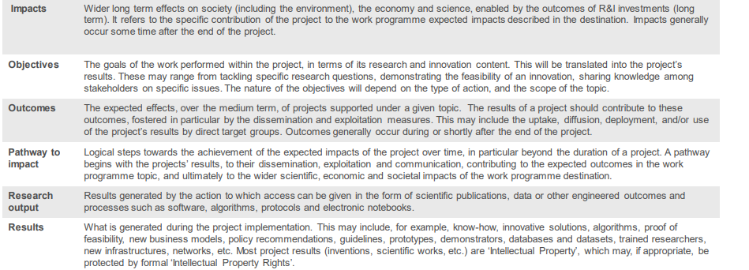
Glossary of terms
LONG TERM
MEDIUM TERM
SHORT TERM
Notes:
The terms need to be properly used by applicants and experts need to check this:
3 main concepts with very different timing

Slide 32

Project’s pathway towards impact
Specific contribution that projects can make to the expected outcomes and impacts set out in the Work Programme
Project’s pathway towards impact
WP EXPECTED OUTCOME (described in topic)
WP IMPACT
(described in Destination)
Project Results
Effects
PROJECT’S CONTRIBUTION TO THE EXPECTED OUTCOME
PROJECT’S CONTRIBUTION TO THE EXPECTED IMPACT
…know-how, innovative solutions,
proof of feasibility, new business models, policy recommendations, guidelines, prototypes, demonstrators,
databases and datasets, networks, etc.
‘Intellectual Property’
Wider long-term effects on:
Society (including the environment)
Economy
Science
enabled by the outcomes of R&I investments.
…uptake, diffusion, deployment, and/or
use of project’s results
by direct target groups.
During project implementation
Shortly after the end of the project
Some time after the end of the project
Notes:
We define the Pathway to impact the Logical steps towards the achievement of the expected impacts of the project over time, in particular beyond the duration of a project.
A pathway begins with the projects’ results, that are shared through dissemination, exploitation and communication, then contributing to the expected outcomes in the work programme topic, and ultimately to the wider societal, economic and scientific impacts of the work programme destination.
Results are the outputs generated during the project which can be used and create impact,
The DoA includes a narrative explaining how the project’s results are expected to make a difference in terms of impact, beyond the immediate scope and duration of the project. The narrative normally includes the following components:
The unique contribution that the project results would make towards (1) the outcomes expected in the topic, and (2) the wider impacts, in the longer term, expected in the respective destination to which the project was submitted.
An indication of the scale and significance of the project’s contribution to the expected outcomes and impacts, should the project be successful.
Requirements and potential barriers - arising from factors beyond the scope and duration of the project - that may determine whether the desired outcomes and impacts are achieved (e.g. other R&I work within and beyond Horizon Europe; regulatory environment; targeted markets; user behaviour).
In the periodic report participants describe the progress of the project towards delivering scientific impact, based on its objectives and towards delivering impact in any of the following fields (if applicable): scientific, economic, societal or industrial production or processes. They also report on changes to the expected impacts presented in the DoA (if any) and the effects on the project/need for adaptations.

Slide 33
Results
Research Communities
MS, EU Policymakers
Result means any tangible or intangible effect of the action, such as data, know-how or information, whatever its form or nature, whether or not it can be protected, as well as any rights attached to it, including intellectual property rights…
Research Roadmaps
Data
Policy Recommendations
Publications
Reports
Project Results
Software
Platforms (Collaboration)
Key results are the outputs generated during the project which can be used and create impact, either by the project partners or by other stakeholders
Prototypes
Skills and Knowledge
Project results can be reusable and exploitable (e.g. inventions, prototypes, services) as such, or elements (knowledge, technology, processes, networks) that have potential to contribute to further R&I.
Pre-Standards
Educational Materials
Codes of Conduct
Industry, Innovators
Civic Society, Citizens
Notes:
RESULTS
…know-how, innovative solutions, proof of feasibility, new business models, policy recommendations, guidelines, prototypes, demonstrators,
databases and datasets, networks, etc. ‘Intellectual Property’ may be protected by formal IPR

Slide 34
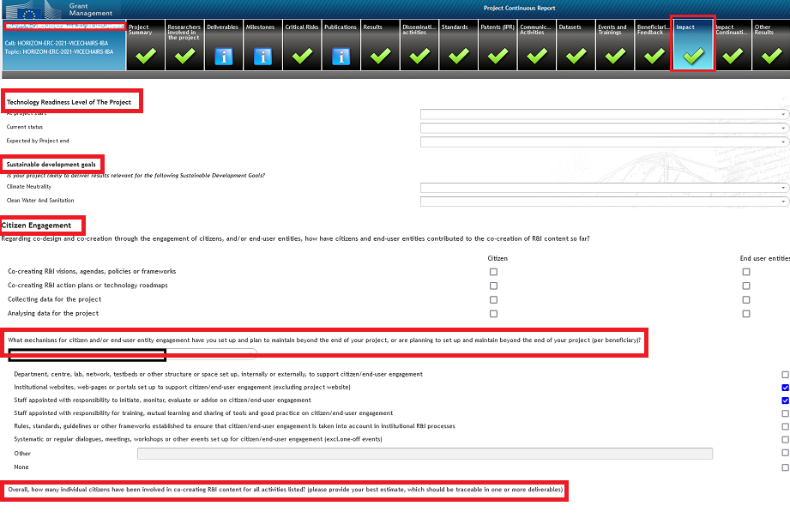
Reporting on Impact: Impact questionnaire (1/3)
NEW in HE reporting: questionnaire to be used for the monitoring and evaluation of HE Programme performance + indication on progress of the project
Included in different SyGMa tabs
Impact
Impact Continuation
Beneficiaries feedback
Important: quality of the data
For each beneficiary

Slide 35
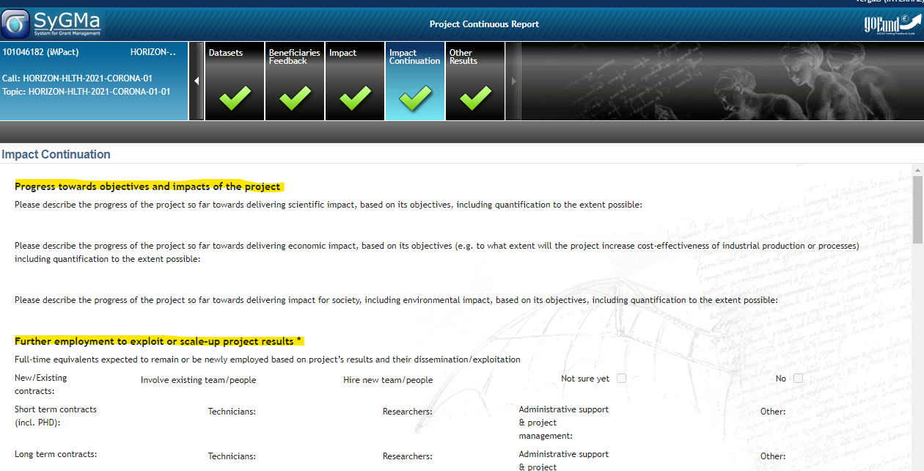
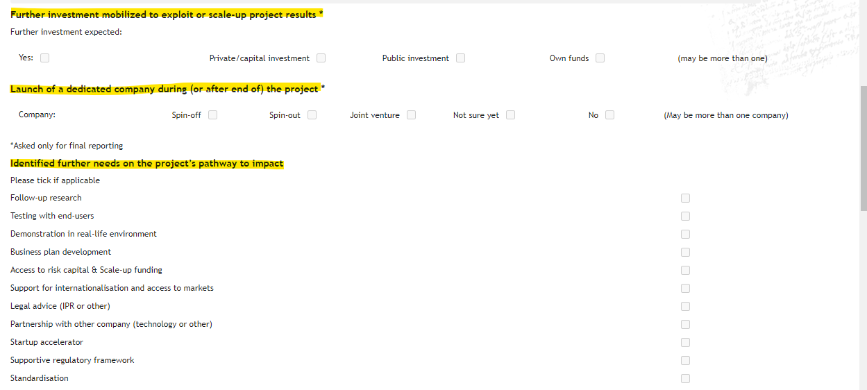
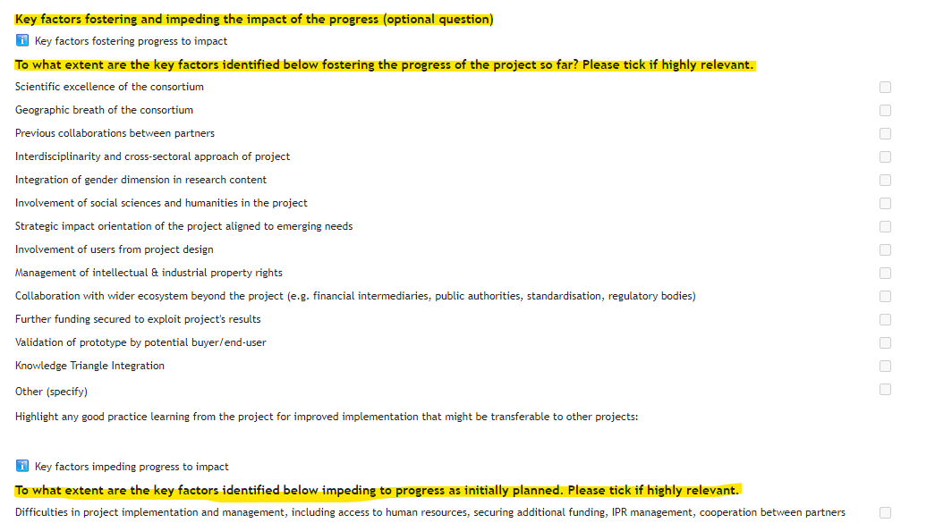
Reporting on Impact: Impact questionnaire (2/3)

Slide 36
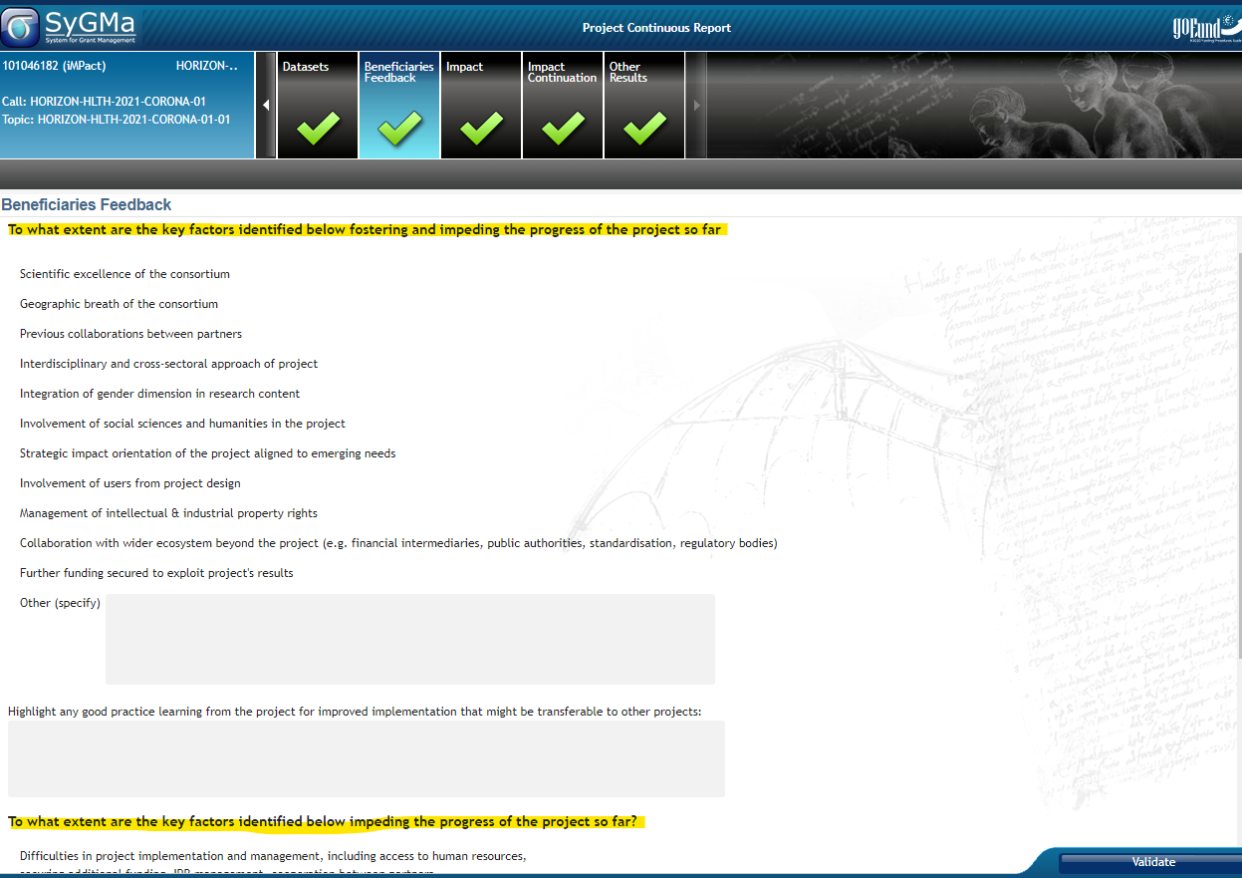
Reporting on Impact: Impact questionnaire (3/3)

Slide 37



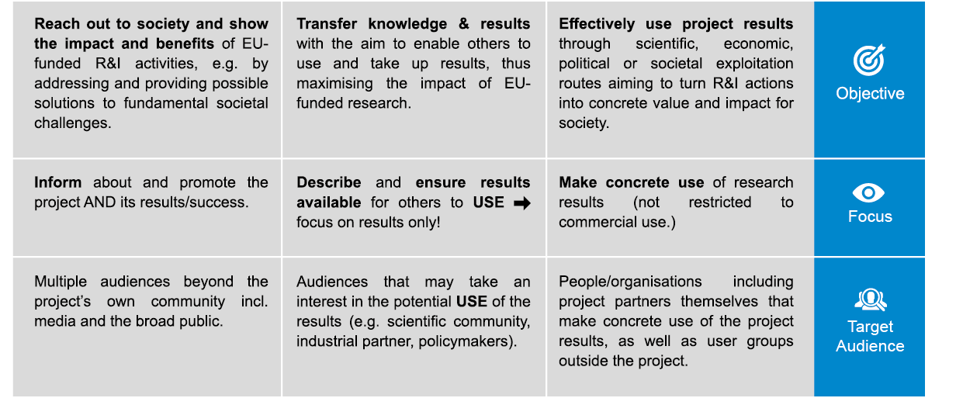
Communication, dissemination & exploitation
Communication
Dissemination
Exploitation
*D@E plan is a mandatory deliverable in HE
Notes:
Communication, dissemination and exploitation activities are an integral part of Horizon projects to help maximise the impacts of EU research & innovation funding
D@E plan is a mandatory deliverable
Note that further rules will come on the use of X/Twitter by consortium and paid content –to be updated

Slide 38
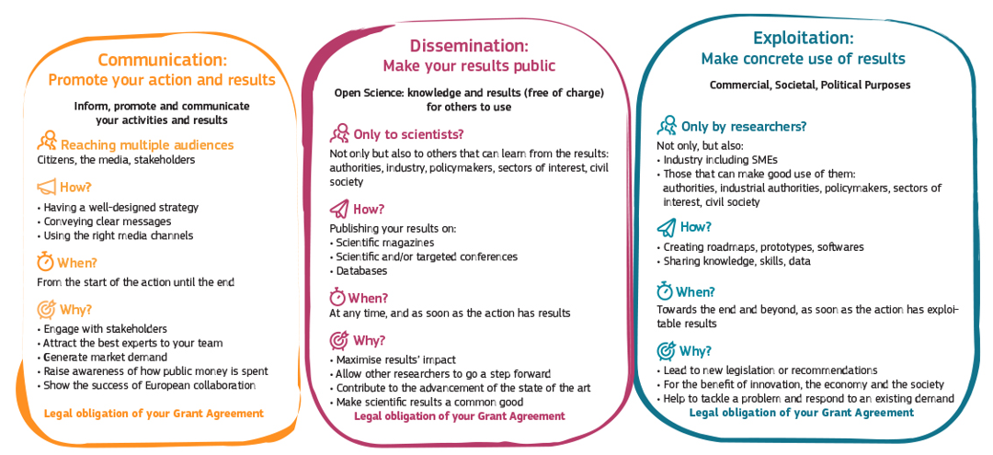
In a nutshell

Slide 39
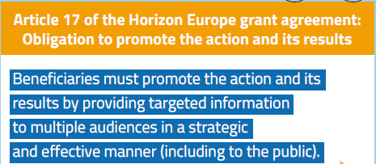
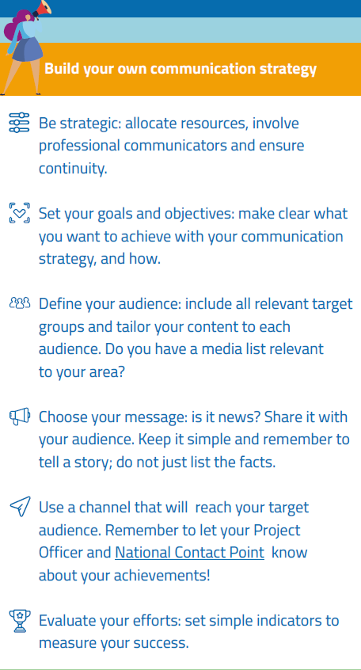
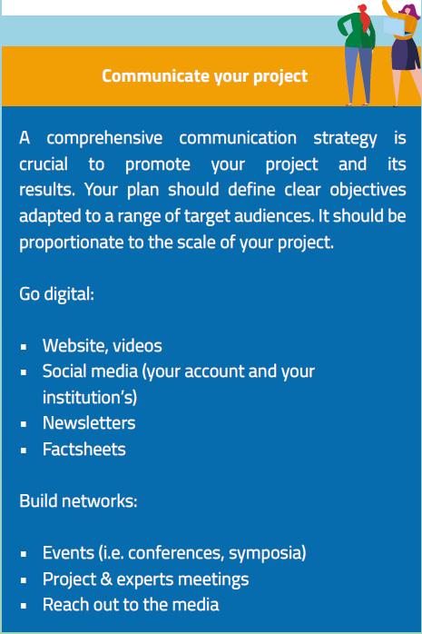
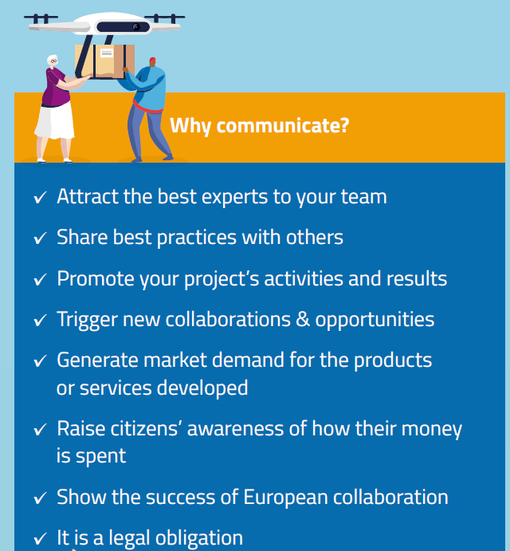
Communicating with impact

Slide 40



Acknowledgement of EU Funding
Use the European flag (emblem), not the European Commission logo
Disclaimer (GA art .17.3) must be added in any publication/output
”Funded by the European Union. Views and opinions expressed are however those of the author(s) only and do not necessarily reflect those of the European Union or the Agency. Neither the European Union nor the granting authority can be held responsible for them.”
Notes:
Grant name/acronym and number should NOT be included in the acknowledgment
As specified on
Communicating your project — Acknowledgement of EU funding - Online Manual - Funding Tenders Opportunities (europa.eu)
Acknowledgement of EU funding
Beneficiaries of EU funding must display the EU flag and funding statement ("Funded by the European Union" or "Co-funded by the European Union") in all their communication and dissemination activities and any infrastructure, equipment, vehicles, supplies or major result results funded by the grant.
The EU flag and funding statement must be displayed in a way that is easily visible for the public and with sufficient prominence.
EU funding must moreover be acknowledged in all types of public outputs (including patent applications, EU standardisation of results), media contacts and other public statements.

Slide 41
Dissemination & Exploitation – New in HE
Part of the Key Impact Pathway to demonstrate the contribution to the impact on society
Improvements on the proposal/reporting template to introduce more specific language on D&E
Emphasis on continuous reporting on D&E (even after the end of the project)
Encouragement of third party exploitation (where appropriate)
Introduction of incentives for exploitation

Slide 42

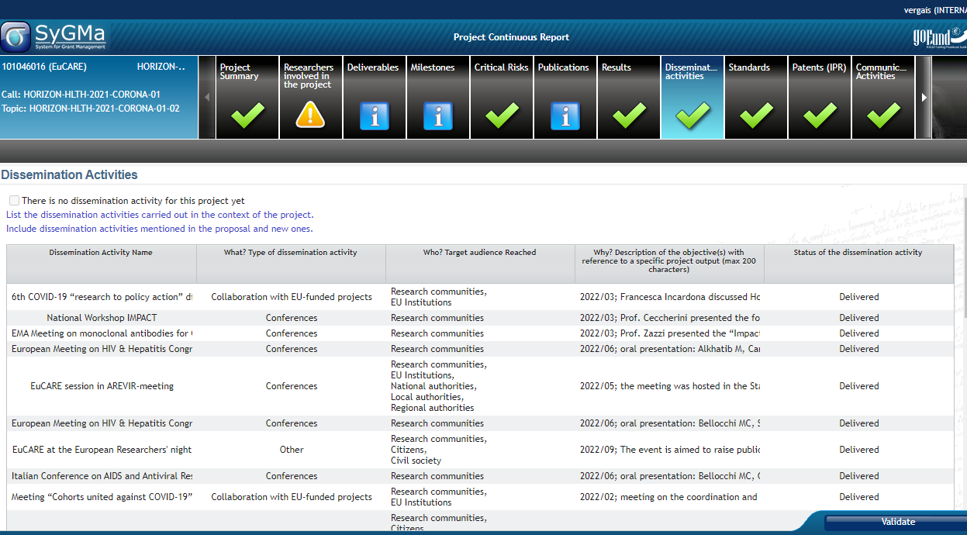
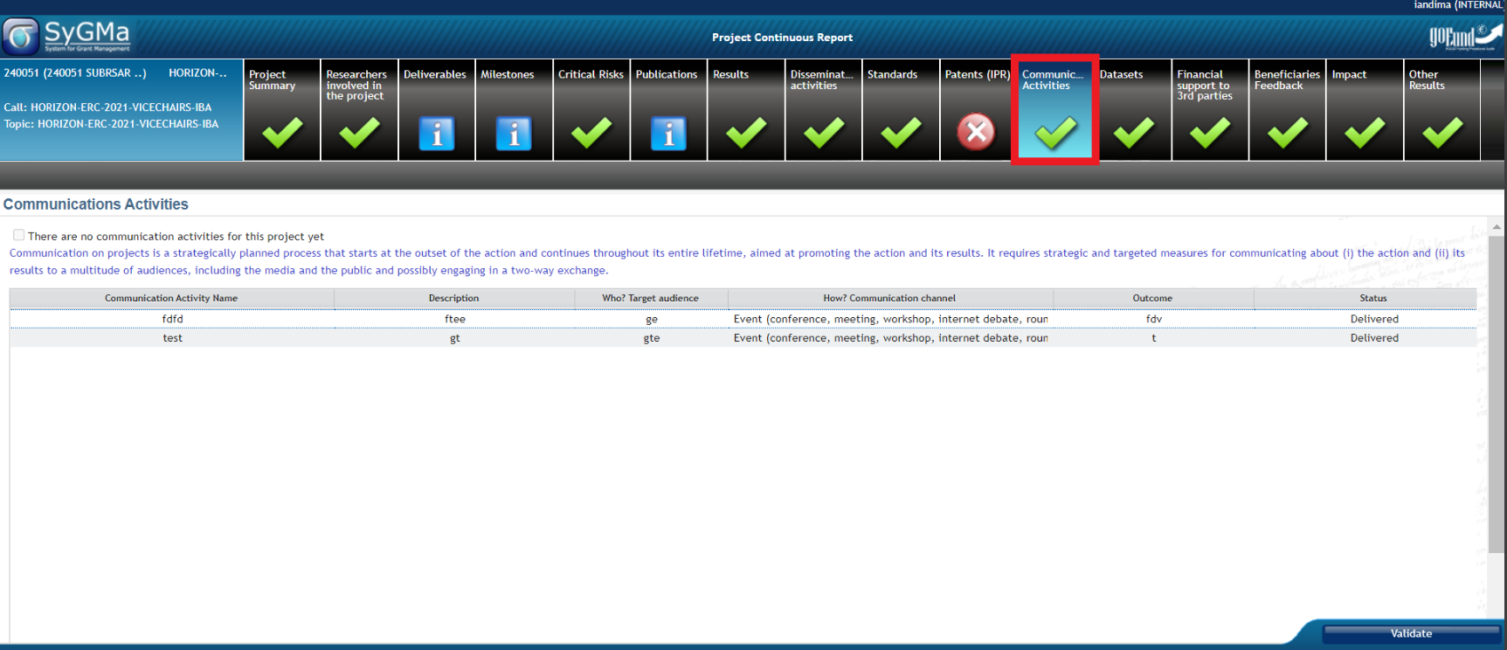
Reporting on communication, dissemination and exploitation
New in HE: shift to a more qualitative rather than quantitative approach on reporting communication, dissemination and exploitation activities
Describing the activities, their purpose, the target audience and their status (pending, completed etc).
List main communication, dissemination and exploitation activities; especially the ones for which they you charged costs to the project
Notes:
A first version of the ‘plan for the dissemination and exploitation including communication activities’ is included in the DoA (normally section 2.2). A more detailed ‘plan for dissemination and exploitation including communication activities’ must be provided as a mandatory project deliverable within 6 months after signature date. This plan shall be periodically updated in alignment with the project’s progress.
In addition, participants must report all dissemination and communication activities (those mentioned in the DoA and new ones) carried out in the context of the project via the CRM (Dissemination activities and Communication activities sections respectively). In addition, they also need to report on the IPRs that result from the project (via the CRM IPR section).
What we check:
Whether the participants have disseminated project results (foreground) and have communicated project activities and results as planned in the DoA (e.g. through publications, a page for the project on social media, press-releases, a website, video/film, etc.).
Whether they have included a reference to EU funding.
Whether the plan for the exploitation and dissemination of the results has been updated and implemented as described in the DoA, in particular as regards intellectual property rights.
The effectiveness of the measures planned.
When the plan for exploitation and dissemination provides for exploitation primarily in non-associated third countries, whether the participants have explained how that exploitation is still in the EU interest and if it is acceptable.

Slide 43
IPR and Background
  Background: any tangible or intangible input — from data to know-how, information or rights — that exists before the grant is signed and that is needed to implement the action or to exploit its results (e.g. database rights, patents, prototypes, cell lines, etc.).
  Participants must give each other mutual access to the background that is necessary for the project implementation
  Beneficiaries are advised to agree in writing on background before the grant is signed, to ensure that they have access rights to what is needed for implementing the action, including exploiting its results.

Slide 44
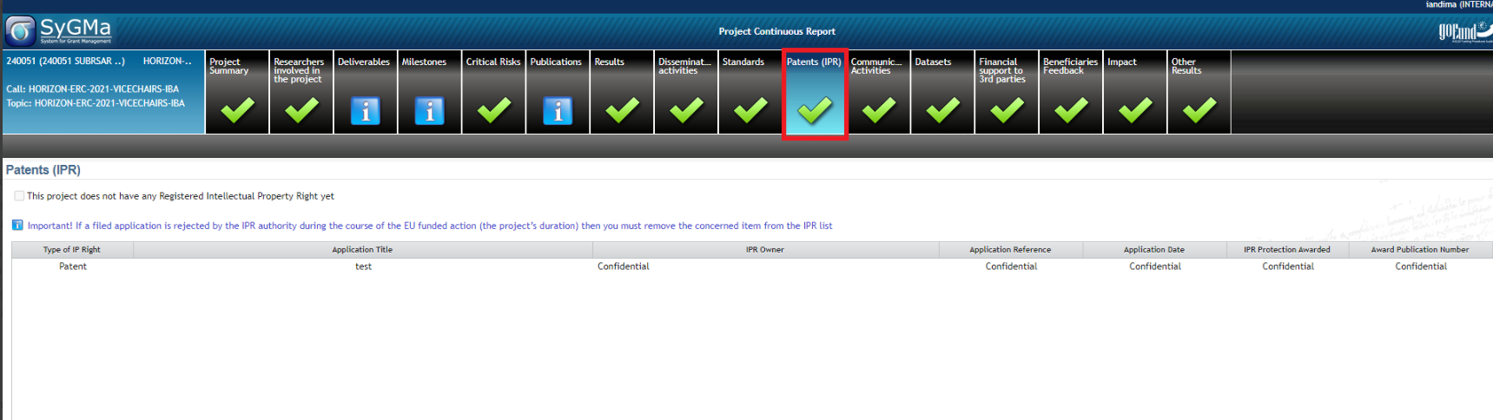
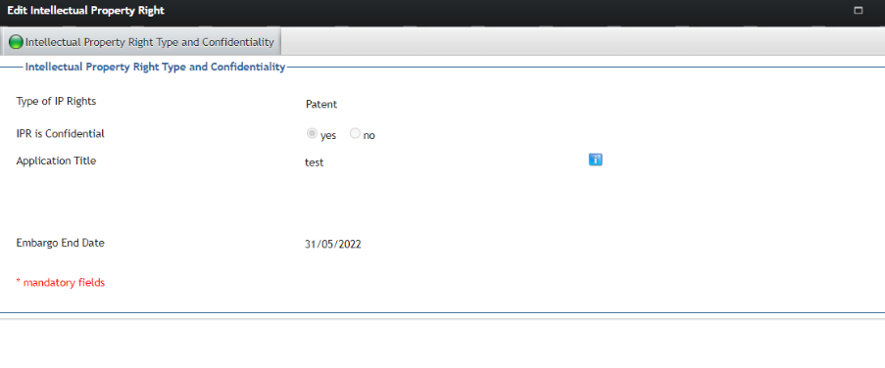
SyGMa IPR tab
For European Patent Office, data are automatically fetched by encoding the reference

Slide 45
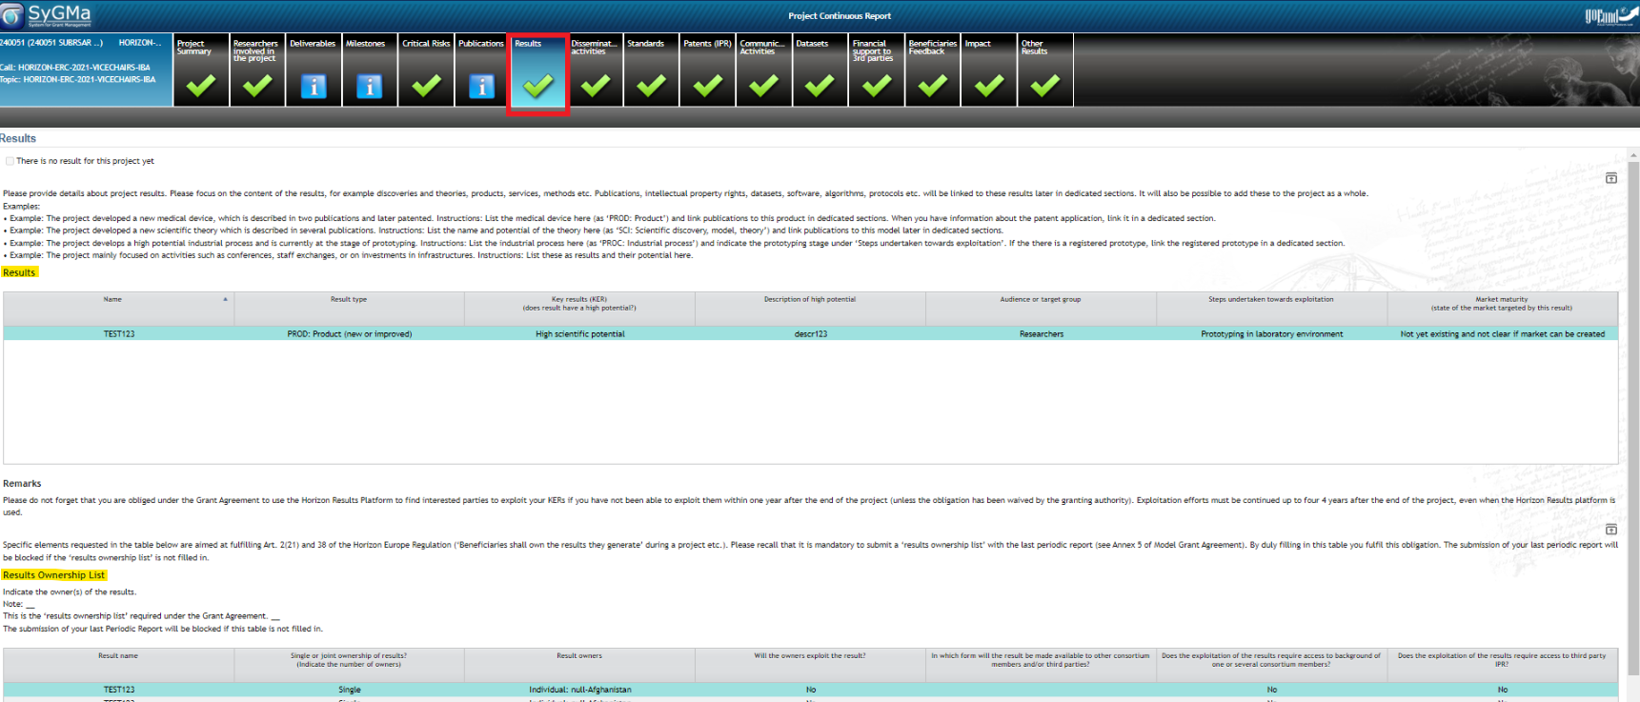
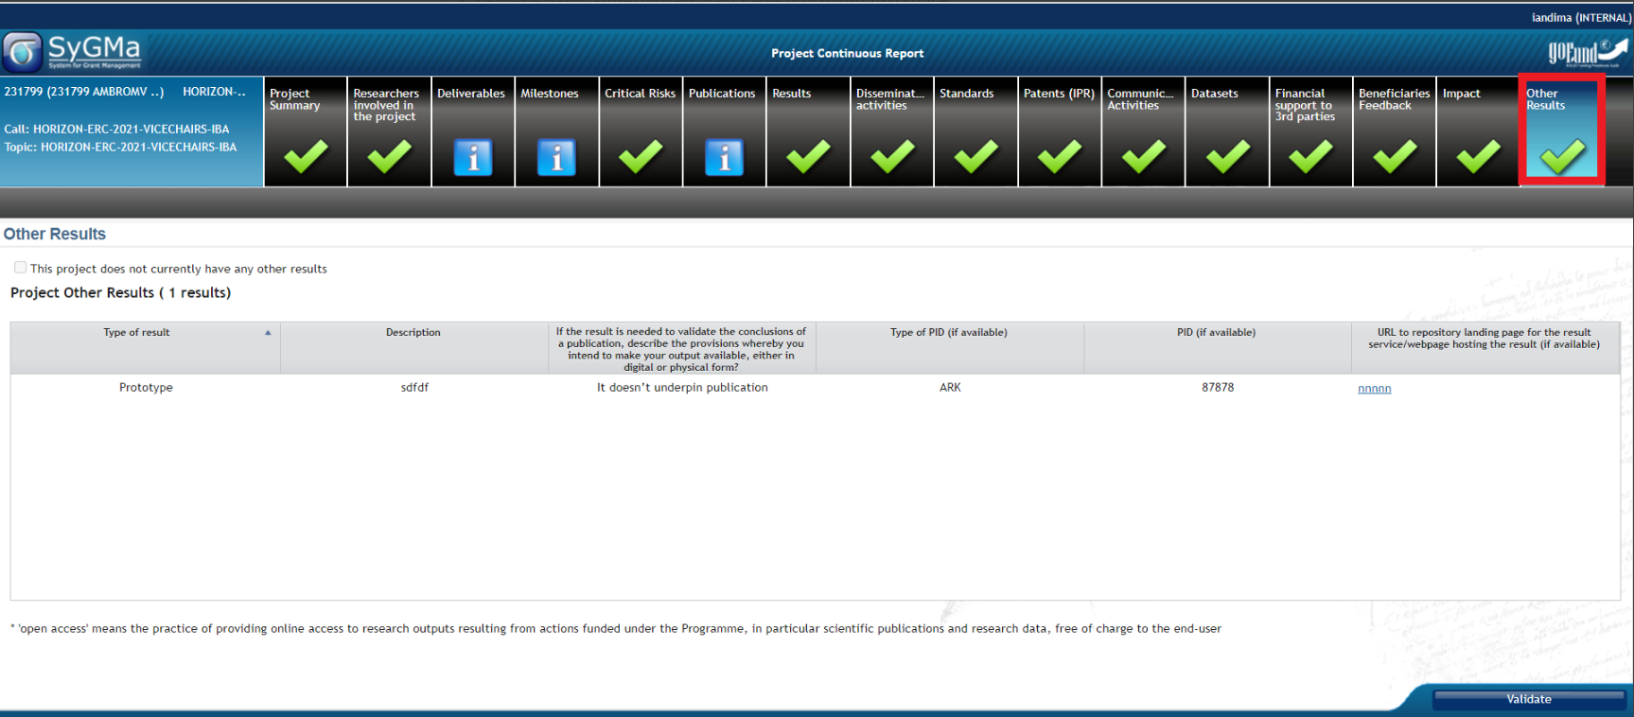
Reporting on project results
NEW in HE: obligation to report on project Results (content focused)
Name and type of the results + if they are Key Exploitable Results (KER) + audience or target group, steps undertaken towards exploitation and market maturity..
For Key Exploitable Results: use of Horizon Results Platform is mandatory in cases the beneficiary has not been able to exploit them within a year after the end of project (obligation may be waived –if justified- by granting authority upon request of beneficiary)
Elements of the Results Ownership List (ROL) (Art. 2(18) and 34 of the Horizon Europe Regulation - ‘Beneficiaries shall own the results they generate’ during a project etc.). Mandatory with the last periodic report.
Notes:
The Results table is the place where participants report on their results, focused on their content, for example discoveries and theories, products, services, methods etc.
These results may also produce publications, intellectual property rights, datasets, software, algorithms, protocols etc. that are encoded in separate tables, i.e. Publications, Datasets, IPR, Standards, Other results (for Software, Workflows, Prototypes, Protocols), which are part of the ‘open science artefacts’, if relevant.

Slide 46
Results and Other results in SyGMa
Examples:
The project developed a new medical device, which is described in two publications and later patented. Instructions: participants list the medical device in the results table (as ‘PROD: Product’) and add publications to this product in dedicated sections. When participants have information about the patent application, they add it in a dedicated section.
The project developed a new scientific theory which is described in several publications. Instructions: participants list the name and potential of the theory in the results table (as ‘SCI: Scientific discovery, model, theory’) and add publications to this model in publications section.
The project develops a high potential industrial process and is currently at the stage of prototyping. Instructions: participants list the industrial process n the results table (as ‘PROC: Industrial process’) and indicate the prototyping stage under ‘Steps undertaken towards exploitation’. If the there is a registered prototype, they add the registered prototype in the IPR section.
The project mainly focused on activities such as conferences, staff exchanges, or on investments in infrastructures. Instructions: participants list these as results and their potential in the results table.
The Results table is the place where participants report on their results, focused on their content, for example discoveries and theories, products, services, methods etc.
These results may also produce publications, intellectual property rights, datasets, software, algorithms, protocols etc. that are encoded in separate tables, i.e. Publications, Datasets, IPR, Standards, Other results (for Software, Workflows, Prototypes, Protocols), which are part of the ‘open science artefacts’, if relevant.

Slide 47
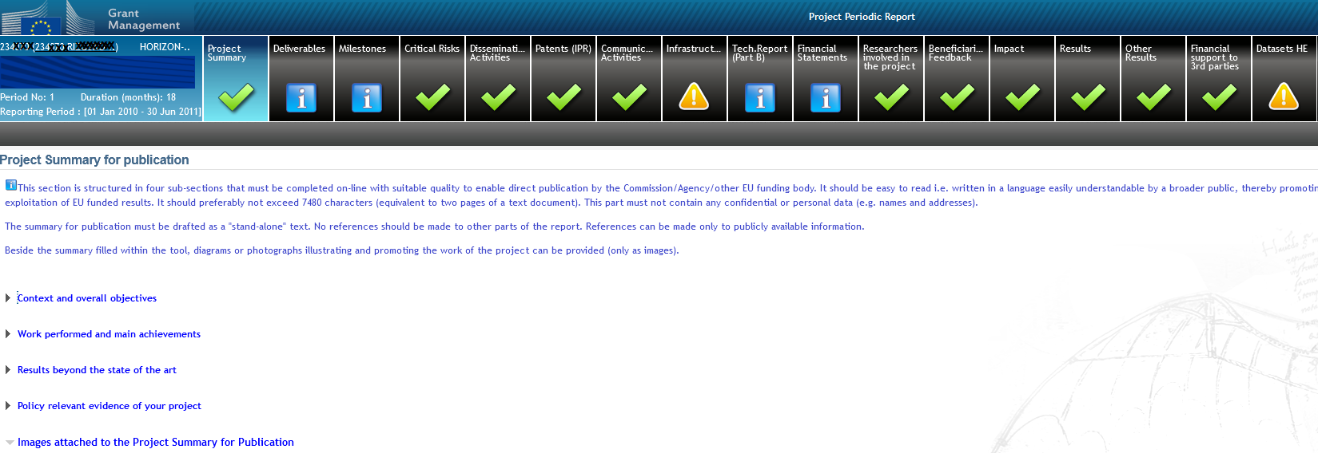
Project Summary
This summary is automatically published in CORDIS and it is prefilled with proposal abstract
Participants should adapt it as the project produces results (always with PUBLIC information)
Check the text is in simple language, understandable to externals (not a copy of some technical paper or a list of publications).
The fields 'work performed' and 'results beyond state of art' should also contain short descriptions intended for wider audience.
A new question has been added in comparison to H2020 on the 'policy relevance': this text is intended to indicate the relevance of project to the policy objectives of the call (policy feedback to DGs)

Slide 48

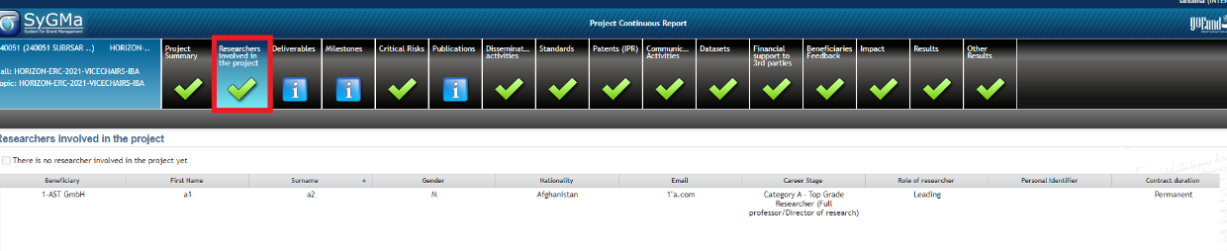
Researchers
NEW in HE: include the list of researchers involved in their project at proposal stage.
List of researchers can be updated in real time in Sygma
Indicator on follow-up of the researchers' careers for the evaluation of HE Programme
Only researchers as defined in the Frascati manual should be encoded + those whose salary is covered by other sources, but still contributing to project’s activities
Justification needed if researcher(s) not participating or removed (especially if considered crucial at the time of the evaluation of the proposal)
Notes:
For associated partners: the coordinator should add the respective information (APs do not have access to our tools). Same for affiliated entities, it is the linked beneficiary that should provide the information.

Slide 49
Most common omissions and good practices
Communicate/disseminate (Annotated Grant Agreement, art 17)
  More publicity you are giving to the results, more impact you have
  Cite the grant in articles, presentations, etc..
Changes in the work plan / budget
  communicate to the PO and in the deviation section of the report
Deliverables/reports on time (art 21)
TNA – special section in reporting
Financial reporting – keep all records (art 20)
Grants are as a rule not extended

Slide 50
How can REA support you?
Has your project won an important scientific award? Have you made a ground-breaking discovery and are featured in the press?
Don’t forget to inform your project officer!
REA’s Communication team can help promote by:
  Highlighting & multiplying your news and results through our own and the Commission’s social media channels (please tag us!)
  Proposing your project’s success story for inclusion in the European Commission’s free-of-charge communication channels.

Slide 51
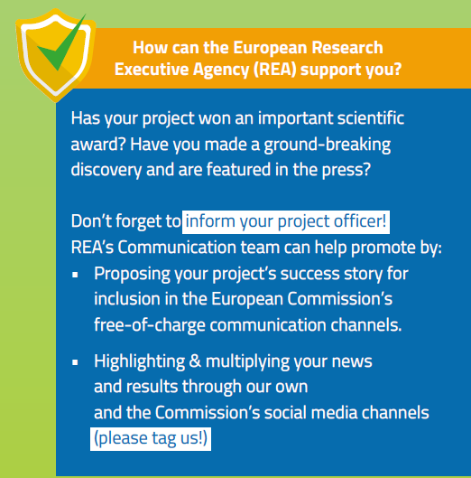

Towards increased impact
Notes:
Has your project won an important scientific award? Have you made a ground-breaking discovery and are featured in the press?
Don’t forget to inform your Project Officer!
REA Communication team can help promote by:
• Highlighting & multiplying your news and results through our own and the Commission’s social media channels (please tag us!)
• Proposing your project’s success story for inclusion in the European Commission’s free-of-charge communication channels.

Slide 52
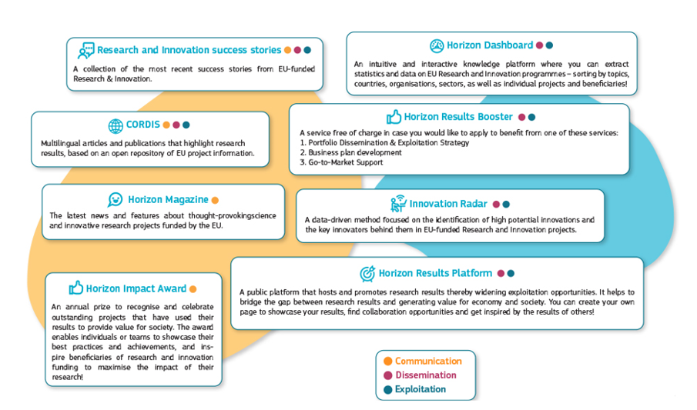
Free-of-charge European Commission dissemination tools

Slide 53



What’s in it for you
Visibility
Reputation
Knowledge
Opportunities
Notes:
Increases the visibility of project activities
Enhances reputation
Supports the spread of knowledge and allows knowledge to be built upon
Opens up other funding sources and maybe business opportunities

Slide 54

Open Science
Open science (OS) is an approach based on open cooperative work and systematic sharing of knowledge and tools as early and widely as possible in the process, including active engagement of society.
Open science practices include:
Early and open sharing of research (for example through preregistration, registered reports, pre-prints, or crowd-sourcing)
Research output management including research data management (RDM)
Measures to ensure reproducibility of research outputs
Providing open access to research outputs (e.g. publications, data, software, models, algorithms, and workflows) through deposition in trusted repositories
Participation in open peer review
Involving all relevant knowledge actors including citizens, civil society and end users in the co-creation of R&I agendas and contents (such as citizen science)

Slide 55

Open access to publications (1/2)
Beneficiaries must ensure open access to peer-reviewed scientific publications relating to their results. In particular, they must ensure:
  at the latest upon publication, deposition of the Author Accepted Manuscript or Version of Record in a trusted repository + immediate open access via the repository under a Creative Commons Attribution license (CC BY) or equivalent (Creative Commons Attribution Non Commercial/Non Derivatives licenses or equivalent are allowed for long-text formats)
  No embargo periods are accepted (for green open access)
  information via the repository about any research output/tools/instruments needed to validate the conclusions of the scientific publication
Metadata must be open under a Creative Commons Public Domain Dedication (CC 0) or equivalent, in line with the FAIR principles and provide information about the licensing terms and persistent identifiers, amongst others.

Slide 56
Open access to publications (2/2)
Beneficiaries (or authors) must retain sufficient intellectual property rights to comply with the open access requirements
Publication in venue of your choice but publication fees are reimbursable only if publishing venue is full open access (publication fees in hybrid venues are not reimbursed, even if some of the articles are open access)
Do not place the journal's DOI in the field of the repository (even if gold access); double check the provided links (including the repositories)
Login to OpenAIRE and verify your project publications; it provides also an interface to immediately upload a copy to Zenodo repository
Acknowledgement of EU funding must be present
Consider the option to publish at no costs in Open Research Europe, the European Commission open access publishing platform

Slide 57

Research data management (1/2)
Beneficiaries must manage the digital research data generated in the action responsibly, in line with the FAIR (“Findable”, “Accessible”, “Interoperable”, Reusable”) principles and:
  establish + regularly update a data management plan (‘DMP’) for generated (and/or collected) data
  as soon as possible and within the deadlines set out in the DMP, deposit the data in a trusted repository (federated in the EOSC if required in the call conditions) + ensure open access under CC BY, CC 0 or equivalent, following the principle ‘as open as possible as closed as necessary’
  provide information via the repository about any research output/tools/instruments needed to re-use or validate the data
Metadata must be open under CC 0 or equivalent (to the extent legitimate interests or constraints are safeguarded), in line with the FAIR principles and provide information about the licensing terms and persistent identifiers, amongst others.
Notes:
Proper Research Data Management (RDM) is mandatory for any Horizon Europe project generating or reusing research data, as a key part of Horizon Europe's open science requirements.

Slide 58
Research data management (2/2)
Exceptions to open access to research data. Data may be kept closed if:
providing open access is against the beneficiary’s legitimate interests, including regarding commercial exploitation;
it is contrary to any other constraints, such as data protection rules, privacy, confidentiality, trade secrets, Union competitive interests, security rules, intellectual property rights or would be against other obligations under the Grant Agreement.

Slide 59
Trusted repositories under Horizon Europe
Trusted repositories are either certified repositories (e.g. CoreTrustSeal, nestor Seal DIN31644, ISO16363) and/or disciplinary/domain repositories that are commonly used/endorsed by the research communities (e.g. ELIXIR deposition databases).
General-purpose repositories and institutional repositories are, in general, also acceptable.
Trusted repositories share essential properties:
  Mechanisms to ensure integrity and authenticity of contents.
  Offer clear information about their policies/services.
  Provide broad, and ideally open access to content (consistent with legal and ethical constraints).
  Assign PIDs, ask for detailed metadata in a standardized (e.g. Dublin Core) and machine-readable way.
  Ensure mid- and long-term preservation of contents, expert curation, quality assurance.
  Meet national and/or international security criteria

Slide 60
Open Research Europe
Why Open Research Europe?
Support our open access policy and beneficiary capacity to adhere to it and also enables publishing post-grant
Leading by example in operationalising open science principles within scientific publishing and enabling the European Research Area
Contribute to transparency and cost-effectiveness and explore sustainable open access publishing business models
What is Open Research Europe?
A peer-reviewed publishing platform. Not a repository. Post-publication peer-review model. First you publish, then review takes place. Publication and review reports open access under CC BY licenses. Optional service for our beneficiaries at no cost to them.
More on Open Research Europe

Slide 61
Key points on open science in Horizon Europe
Beneficiaries must manage the digital research data generated in the action responsibly, in line with the FAIR (“Findable”, “Accessible”, “Interoperable”, Reusable”)- M6
Establish + regularly update a data management plan (‘DMP’) for generated (and/or collected) data
Ensure open access ‘as open as possible, as closed as necessary'
Useful resources
Horizon Europe Annotated Model Grant Agreement (Annex 5, section 2 -pg 154)
Horizon Europe Data Management Plan Template (under reference documents of the Funding and Tenders portal).

Slide 62
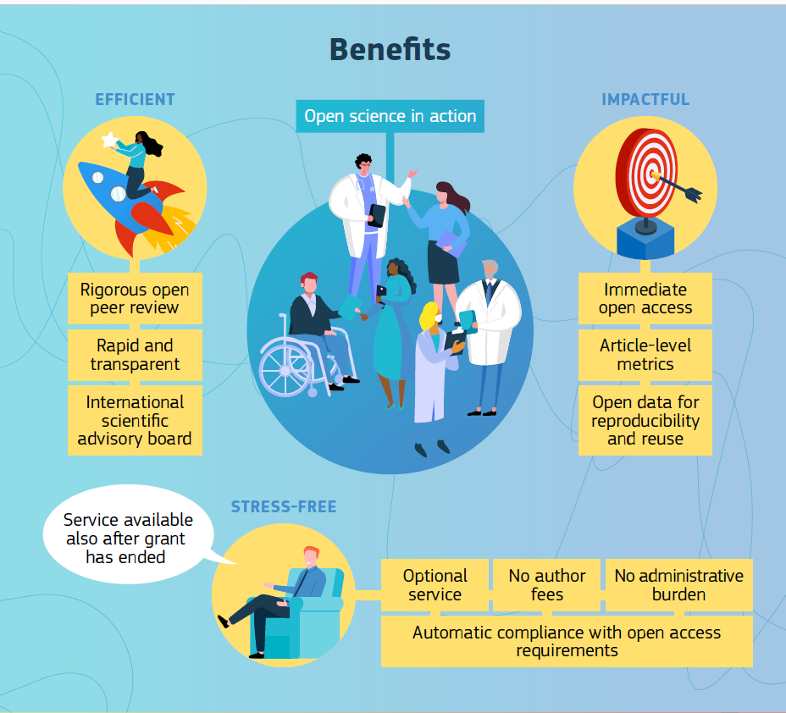

Slide 63
Ethics in Horizon Europe
Integral part of research from beginning to end
  Participation in Horizon Europe requires compliance with the highest standards of research ethics and integrity, and with EU, national and international law.
  Horizon Europe regulation 2021/695 (Articles 18 and 19) & Grant Agreement (Art 14, Annex 5): guiding principles and general obligations (including ineligible activities and specific rules e.g. in case of hESC/hE).
Before starting an action task raising ethical issues, the beneficiaries must have obtained all approvals or other mandatory documents needed for implementing the task, notably from any (national or local) ethics committee or other bodies.
The documents must be kept on file and submitted by the coordinator to the granting authority upon request.
  Please pay uttermost attention and contact the PO, whenever you modify activities with potential ethical issues, such as collect or process "personal data" (e.g. name, e-mail address,...), involve volunteers (informed consent procedure required), exchange data between EU – non-EU countries.

Slide 64
Ethics Appraisal in the Project Life Cycle
Call deadline
GAP invitation
Grant signature
Project end
Ranking
Submission Evaluation (merit) GA preparation Project execution
Self-assessment
Screening
Ethics Checks/Reviews
Assessment
All proposals
Main / reserve list
proposals
Selected projects

Slide 65
Implementing ethics: Check or Review
(ethics issues cleared)
Ethics Check / Review might be requested
    When: it is important to reassess the global situation or specific ethics issues during the implementation of the project, or when the ethics self-assessment does not contain all necessary elements.
    Ethics WP/Deliverables: no specific deliverables, although the PO may have set one or more deliverables during GAP to allow submission of supporting ethics documents and/or information to check/review (clearance).
  Difference between check and review
    Ethics Check: internal check by the project officer or REA ethics correspondent who may be supported by external ethics experts.
    Ethics Review: more elaborate and in-depth procedure carried out by REA with up to 5 external ethics experts (formerly known as 'Ethics Check' in H2020).
    The choice between Ethics Check and Ethics Review reflects the size of the grant and the seriousness/complexity of the ethics issues.

Slide 66
Implementing ethics: Advisor or Board
(ethics issues conditionally cleared)
Appointment of an external, independent ethics Advisor / Board
    When: It is necessary for the project to be advised by one or more independent experts.
    Ethics WP/Deliverables: yes, for appointment and regular ethics reporting by the ethics Advisor/Board (conditional ethics clearance).
    Advisor/Board members must be totally independent and free from any conflict of interest.
    The Advisor/Board members get paid for their services (via e.g. a service contract).
    The Coordinator must grant ethics Advisors/Board members with access to the relevant documents needed to perform their duties. It is advised to build a collaborative relationship with ethics Advisors/Board members (see section 9.2 of How to complete ethics self assessment).
    Obligation to send independent report(s) to Agency. Each report represent a deliverable and must be submitted at the month set by the PO during GAP, the appointment of the Ethics Advisor/Board members being the first deliverable.

Slide 67
Implementing ethics: specific requirements (conditional clearance)
Specific Ethics Requirements are formulated:
    If serious/complex ethics issues are identified, then ethics requirements may be included in the ethics summary report.
    Ethics WP/Deliverables: if specific deliverables are set; they may include ethics supporting documents, additional information or clarifications (conditional ethics clearance).

Slide 68
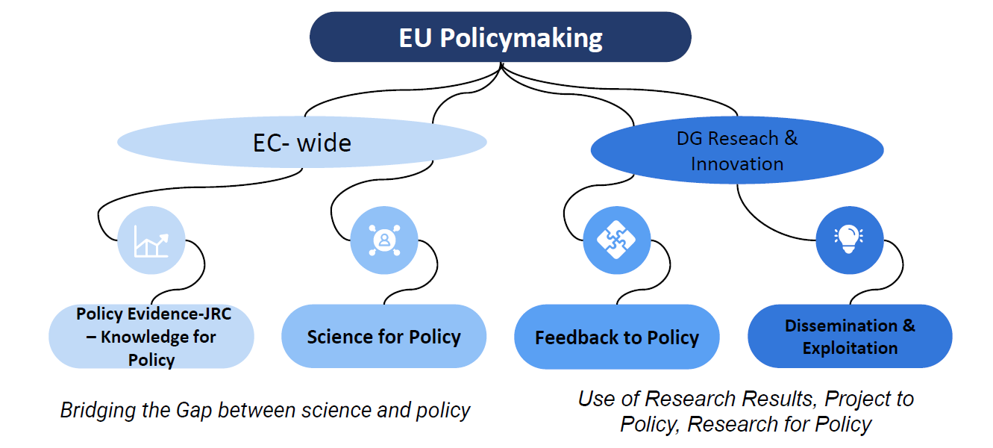
Policy feedback 1/2
A mechanism through which your project results feed into current and/or future policy-making
Necessary for evidence-based policy design, implementation & evaluation
Monitor the achievement of policy objectives and the impact of existing policies / legislation
Identify gaps, opportunities and potential synergies for future policy design

Slide 69
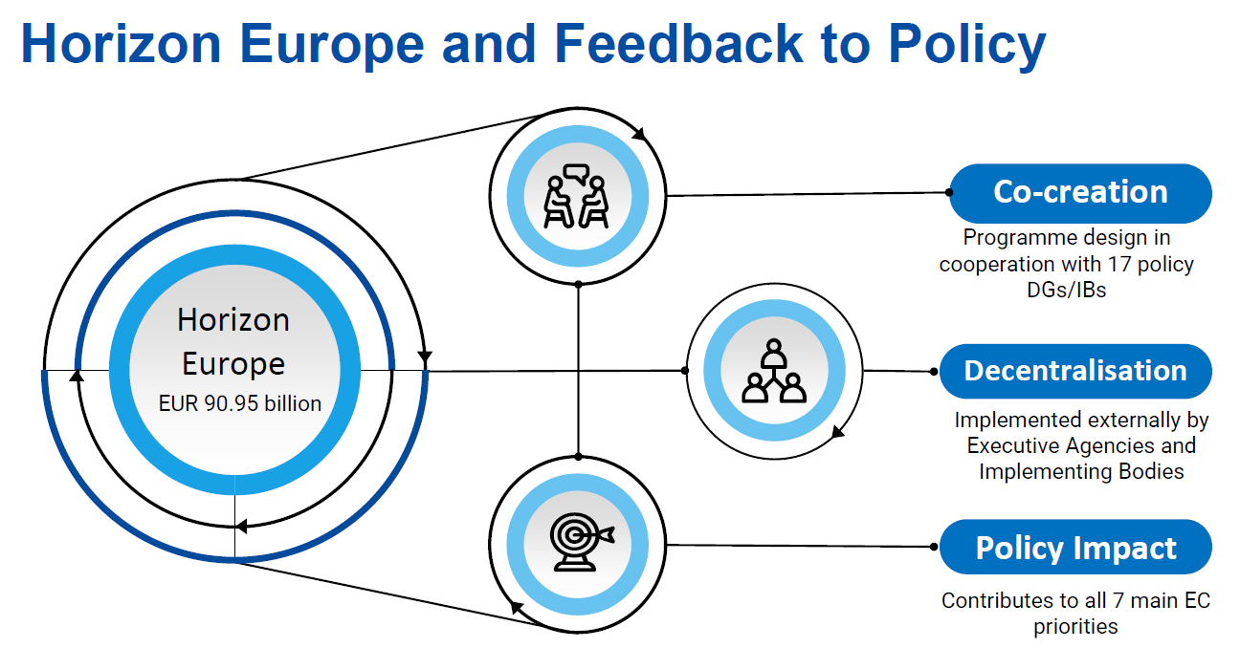
Policy feedback 2/2
What’s in it for you
you actively feed into EU policy discussions
Type of policy feedback activities
policy brief as a mandatory deliverable (see next slide)
you interact with similar projects
you promote your own project
ad hoc requests e.g. for monitoring purposes
partake in cluster events

Slide 70
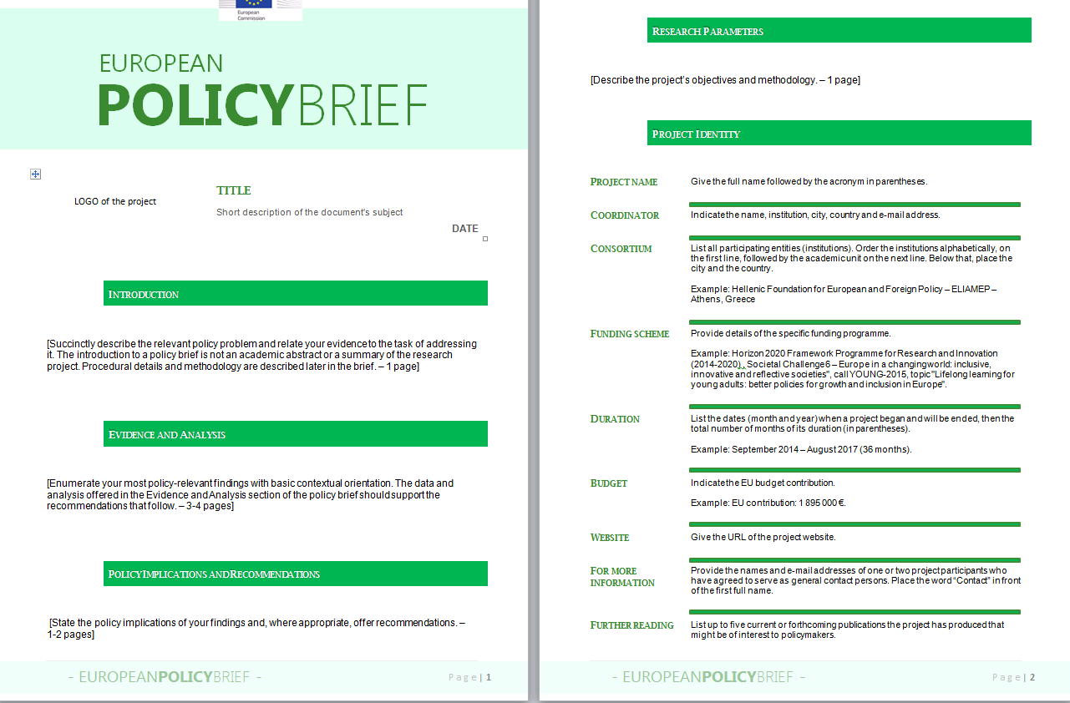
Policy Briefs
Main elements
Adapted to each specific project
Supports knowledge transfer
Supports the EC in monitoring achievements & impact
Basis for reflection on potential recommendations/best practice
Means for ensuring evidence-based policy making within HE
Can be based on a template provided by REA
  4 key aspects to be addressed:
    Evidence and Analysis
    Policy implications and recommendations
    Sustainability and legacy
    Project objectives and methodology
Add reference to specific deliverables of the GA
EXAMPLE

Slide 71
III. Extra Resources

Slide 72
Useful resources
  HE Annotated Model Grant Agreement
  Horizon Europe Annotated Model Grant Agreement (p.154 ff for open science)
  Guidance on social media for EU funded R&I projects
  Horizon Europe – Funding Programme for Research and Innovation
  Factsheet ‘Open Science in Horizon Europe’
  Communication on ‘A new ERA for Research and Innovation’
  Pact for Research and Innovation in Europe

Slide 73
HE Online Manual
https://webgate.ec.europa.eu/funding-tenders-opportunities/display/OM/Online+Manual
Grant management
Keeping records
Amendments
Continuous Reporting (NEW)
Reports & payment requests
Deliverables & milestones
Dissemination & exploitation
Communicating your project
Acknowledgement of EU funding
Checks, audits, reviews & investigations
Horizon Europe Data Management Plan Template (under reference documents of FTOP)

Slide 74







Keep in touch
ec.europa.eu/info/research-and-innovation_en
europeancommission
rea.ec.europa.eu
@EuropeanCommission
@REA_research
EUTube
European Research Executive Agency (REA)
EU Spotify

Slide 75

Thank you
© European Union 2020
Unless otherwise noted the reuse of this presentation is authorised under the CC BY 4.0 license. For any use or reproduction of elements that are not owned by the EU, permission may need to be sought directly from the respective right holders.
Notes:
Update/add/delete parts of the copy right notice where appropriate.
More information: https://myintracomm.ec.europa.eu/corp/intellectual-property/Documents/2019_Reuse-guidelines%28CC-BY%29.pdf

