Slide 1
Financial and Administrative Aspects
Martina Schrage + Maria Eden
AWI
www.eu-polarin.eu

Slide 2

Content
Important Documents
Budget Details
Payments
Financial Reporting
?
Alfred-Wegener-Institut / Reinhard Sibberns

Slide 3

1. Important Documents
The two important contractual documents are:
Grant Agreement
        Contract between EU and POLARIN Partners
        Regulates funding rules, reporting towards EU, etc.
        and includes also budget and work plan
POLARIN
consortium
Consortium Agreement
Contract among POLARIN Partners
Regulates project internal communication and cooperation
(e.g. voting rights, organisation of meetings, disputes)
Notes:
The Grant Agreement is the „working document“ for the project with project description, work plan, budget tables and also the funding rules of the EU.
It was formed from parts of the proposal. Please do not work with the proposal from 2023 anymore. There were several changes!
The Consortium Agreement is a contract just among the partners.

Slide 4
1. Important Documents
The two important contractual documents are:
Grant Agreement
        Contract between EU and POLARIN Partners
        Regulates funding rules, reporting towards EU, etc.
        and includes also budget and work plan
Consortium Agreement
Contract among POLARIN Partners
Regulates project internal communication and cooperation
(e.g. voting rights, organisation of meetings, disputes)
Can be found on NextCloud
Notes:
Link to NextCloud folder: https://nextcloud.awi.de/s/Mc27YwgSbgbAzGx
Our colleagues are currently working on the POLARIN website with a “members only” area to access relevant documents. As soon as that is established, the NextCloud folders will be moved there.
The GA can also be downloaded directly from the EU protal:
Got to https://ec.europa.eu/info/funding-tenders/opportunities/portal/screen/home,
Sign in with your account
Go to “My projects”,
Go to POLARIN and click on “Actions” and “Manage Project”,
Go to “Document Library”
Download “Grant Agreement”
You don‘t see POLARIN under your list of projects? Please contact Martina (martina.schrage@awi.de) or Maria (maria.eden@awi.de) to grant you access.

Slide 5
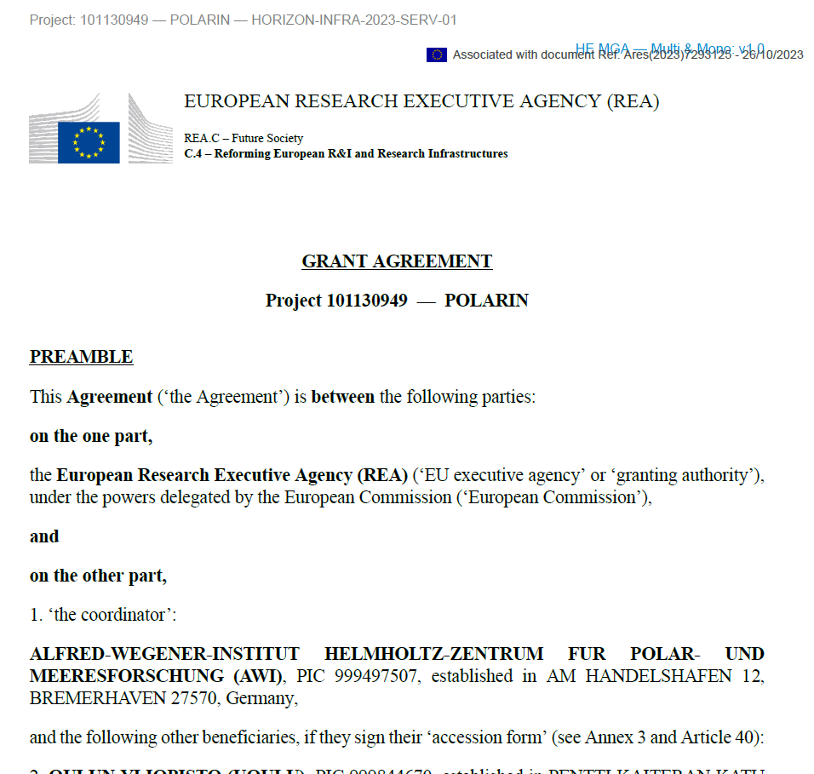
Good to Know –
Grant Agreement
(GA)
How to find your way
through the 261 pages?
Notes:
The Grant Agreement (GA) is a huge document with 261 pages. Here a quick guide, which information can be found where

Slide 6
Good to Know - GA
How to find your way through the Grant Agreement (GA)?
Large document with 261 pages:
Page 10-15 General Information
Page 16-73 Legal Basis (rules)
Page 79-97 Work Plan (detailed work description)
Page 98-99 Person Month per Partner and WP
Page 100-129 Deliverables, Milestones and Critical Risks
Page 130-135 List of Research Infrastructures
Page 138-174 General project description, impact, etc.
Page 175 GANTT Chart (Time line)
Page 176-185 Budget tables
Page 186-191 Ethics, Abbreviations
Page 192-193 Budget Overview
Page 197 Unit costs for Research infrastructures
Notes:
Overview

Slide 7
Good to Know - GA
Relevant for Scientific Work
Page 10-15 General Information
Page 16-73 Legal Basis (rules)
Page 79-97 Work Plan (detailed work description)
Page 98-99 Person Month per Partner and WP
Page 100-129 Deliverables, Milestones and Critical Risks
Page 130-135 List of Research Infrastructures
Page 138-174 General project description, impact, etc.
Page 175 GANTT Chart (Time line)
Page 176-185 Budget tables
Page 186-191 Ethics, Abbreviations
Page 192-193 Budget Overview
Page 197 Unit costs for Research infrastructures
Notes:
Relevant for Scientific Work

Slide 8
Good to Know - GA
Budget Information
Page 10-15 General Information
Page 16-73 Legal Basis (rules)
Page 79-97 Work Plan (detailed work description)
Page 98-99 Person Month per Partner and WP
Page 100-129 Deliverables, Milestones and Critical Risks
Page 130-135 List of Research Infrastructures
Page 138-174 General project description, impact, etc.
Page 175 GANTT Chart (Time line)
Page 176-185 Budget tables
Page 186-191 Ethics, Abbreviations
Page 192-193 Budget Overview
Page 197 Unit costs for Research infrastructures
Notes:
Budget Information

Slide 9
Good to Know - GA
Rules and regulations
Page 10-15 General Information
Page 16-73 Legal Basis (rules)
Page 79-97 Work Plan (detailed work description)
Page 98-99 Person Month per Partner and WP
Page 100-129 Deliverables, Milestones and Critical Risks
Page 130-135 List of Research Infrastructures
Page 138-174 General project description, impact, etc.
Page 175 GANTT Chart (Time line)
Page 176-185 Budget tables
Page 186-191 Ethics, Abbreviations
Page 192-193 Budget Overview
Page 197 Unit costs for Research infrastructures
Notes:
Rules and regulations = EU funding rules

Slide 10
Good to Know - GA
Rules and regulations
Page 16-73 Legal Basis (rules)
Lays down for example the rules for eligibility of costs
(e.g. how to calculate the personnel costs)
We recommend the “Annotated Grant Agreement”, with a lot of explanations:
https://ec.europa.eu/info/funding-tenders/opportunities/docs/2021-2027/common/guidance/aga_en.pdf
Notes:
The funding rules are not always self explaining. The EU offers the “Annotated Grant Agreement” as guidance document (https://ec.europa.eu/info/funding-tenders/opportunities/docs/2021-2027/common/guidance/aga_en.pdf )
If you have any doubts about the financial rules, we recommend the explanations about:
Article 6 Eligible and ineligible costs (page 36 ff)
Especially:
Article 6.2.A Personnel costs (page 45) – on page 49 you find a short explanation, how to calculate the personnel costs you can claim for your work in POLARIN
Article 6.2.B Subcontracting (page 70)– Subcontracting is, if an external contractor carries out relevant parts of the work plan. Please note that this needs to be included in your planned budget before the costs incur. If you plan to subcontract parts of your work, please contact us beforehand!!!
Article 6.2.C purchase costs (page 74) – rules for travel cost, consumables, equipment etc.
Article 6.2.D.X Access to research infrastructure costs (page 103) – rules for the unit costs you can claim for the use of your infrastructure. Please note that the unit costs rates were defined in the POLARIN Grant Agreement (Annex 2a on page 197 of the POLARIN GA). If the unit costs rates for your infrastructure are not correct, please contact us asap!

Slide 11
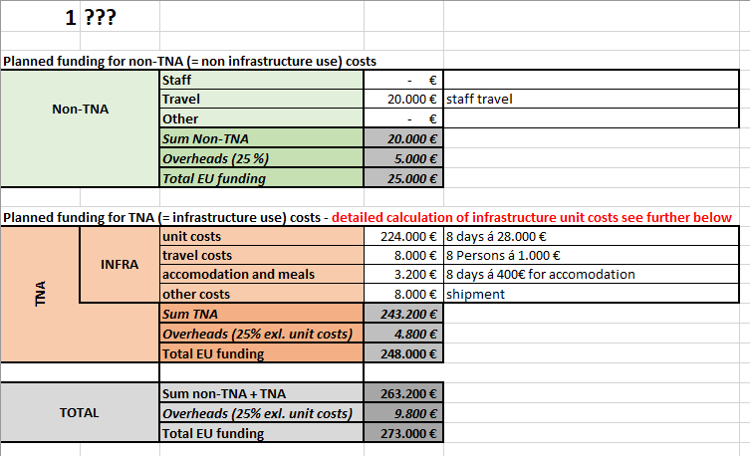
2. Budget details
Information about your budget can be found in:
Budget tables in GA and
Budget overview sent by Maria:
Notes:
All the budget information can be found in the tables in the Grant Agreement.
As these tables are sometimes confusing, therefore we prepared an Excel Budget Overview for each partner. This was sent to you via email by Maria in February 2024

Slide 12
2. Budget details
Non-infrastructure part like:
Travel of staff to project meetings
Personnel cost of staff for tasks not directly linked to TNA and VA
Infrastructure part including:
Trans-National-Access (TNA)
Virtual Access (VA)
Notes:
We divide the budget into the green non-infrastructure part and the orange infrastructure part.
The green non-infrastructure part includes all cost, which are not directly related to the use of your infrastructure. These are for example:
Travel costs of your staff to meetings
Personnel costs of your staff in the Work Packages 1, 2, 4, 5, 7, 8, 9
Other cost related to the Work Packages 1, 2, 4, 5, 7, 8, 9
The orange infrastructure part includes the costs for the provision of your infrastructure to external users in WP3 (Provision on TNA) and WP6 (Provision of VA):
- Transnational Access (TNA) costs for external visitors coming to your station/ship/infrastructure including:
- reimbursement for the use of your station/ship/infrastructure. This is usually as unit costs (daily rate) – see next slides
- travel costs of the visitors from the home town of the visitors to your infrastructure
- accommodation & meals for the journey to your infrastructure and, if not included in the unit costs, also during the stay at your infrastructure
- shipment of samples, equipment or what else the visitors need
Virtual Access (VA) costs for generating and providing data/information to externals:
- Personnel costs in WP 6 (RIs offered for virtual access)
- other costs linked to the provision of VA

Slide 13
2. Budget details
Two kind of cost categories:
Unit costs
Actual costs
Notes:
Costs can be claimed either as unit costs or actual costs. This has to be laid down in the budget plan.

Slide 14
2. Budget details
Unit costs:
Claimed based on a unit rate
Mainly cost for use of infrastructure
Unit rate calculated during proposal phase / revised at beginning of project
Unit rate is laid down in the GA (see GA budget tables or budget overview from Maria)
In the financial report: only number of users has to be claimed
But: keep documentation, how this rate was calculated in your files
Please let us know in case your unit costs are not correct!
Notes:
Unit costs are usually only foreseen for the use of infrastructure:
You can find the calculation of your unit costs in your Excel budget
The unit costs are usually calculated by:
Total cost for the infrastructure over the last two financial years / number of user days during this two years = unit rate per user day
Please let us know, in case the unit costs calculation is not correct or you have questions about it!
In your financial report, you simply declare:
Number of user days * the unit costs rate
There is no need to prove the real costs of the single user, if you use this unit costs rate.
However, please keep documentation of the unit costs rate calculation in your files. The EU might send an auditor to check.

Slide 15
2. Budget details
Actual costs:
Claimed as they actually incurred
Documentation needed e.g.:
  invoices for travel costs,
  salary slips and time sheets for personnel costs
Notes:
Most other costs are claimed as actual costs
You need to keep documentation of these costs (invoices, salary slips etc.)
You can claim only the costs, which really incurred and are directly linked to POLARIN

Slide 16
2. Budget details
Actual costs:
e.g. Mr. X actually travelled to meeting Y
Eligible costs (Article 6)
Actually incurred by beneficiary
01.03.2024 – 28.02.2029
Incurred over Action's duration
See Grant Agreement budget tables
Estimated in budget - Annex 2
Really relevant and linked to POLARIN
Related to Action
Keep time sheets, invoices etc in your records
Identifiable and verifiable
In compliance with national laws on taxes, labour and social security
Follow your usual accounting practice
Reasonable, financially sound
No reckless or excessive expenses
Notes:
Requirements for actual costs

Slide 17
2. Budget details
Keep records!
Costs categories (Actual costs) | Records needed
Personnel costs | Time sheets signed by the person working on the action Proof that the person worked for the organisation and was actually paid (payment slips, working contract or similar)
Travel costs and allowances | Invoices and receipts (including boarding passes, train tickets, etc.), meeting agenda and minutes
Other goods and services | Invoices - Ensure best value for money/lowest price
Notes:
Examples for the documents you need to keep for actual costs

Slide 18
2. Budget details – personnel costs
Actual personnel costs :
You can claim only the days/hours really worked on POLARIN
Keep documentation to record your hours/days on POLARIN
According to the EU rules, you just need to record the number of days per month, which you worked for the project (action).
You can use the offcial template for the EU:
https://ec.europa.eu/info/funding-tenders/opportunities/docs/2021-2027/common/temp-form/report/time-declaration_en.docx
But you can also use your own time sheet system.
Notes:
Official template to record working time on project (action):
https://ec.europa.eu/info/funding-tenders/opportunities/docs/2021-2027/common/temp-form/report/time-declaration_en.docx

Slide 19
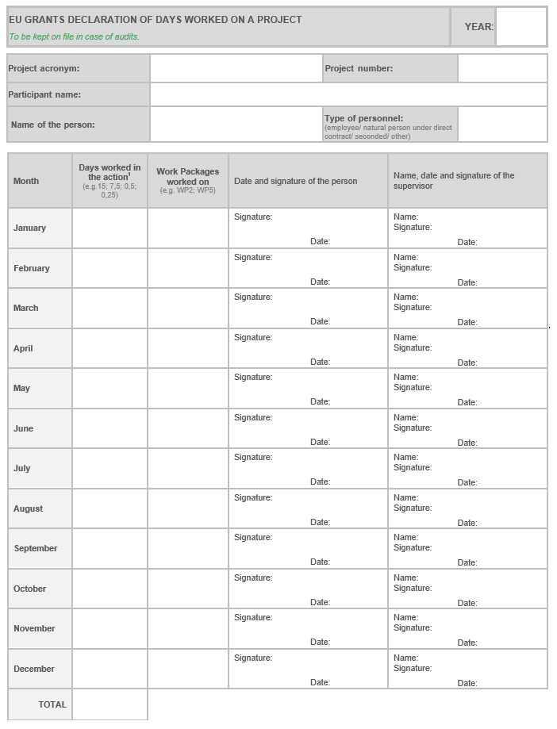
If you use your own time record system, make sure,
that it holds the necessary information as in the EU template:
Year
Project acronym = POLARIN
Project number = GA No 101130949
Participant name = Official name of your organisation, as in the POLARIN GA
Name of the person
Type of personnel: usually „employee“
Days worked for the project per month
In which work package (WP)?
Date + signature of the person workin on the project per month
Date + signature of the supervisor per month
Please note:
Two signatures from two different persons are required
Time sheets should be signed in a timely manner (soon after end of the month)
Total days per year
Notes:
Official template to record working time on project (action):
https://ec.europa.eu/info/funding-tenders/opportunities/docs/2021-2027/common/temp-form/report/time-declaration_en.docx

Slide 20
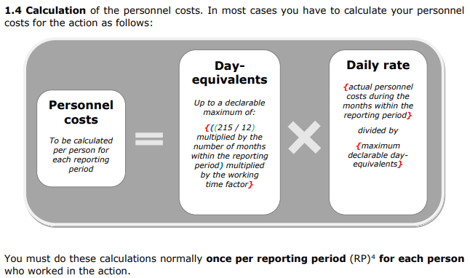
2. Budget details – personnel costs
Actual personnel costs :
At the end of the first reporting period (31.08.2025) you have to calculate the actual personnel costs for POLARIN:
= these are the costs you can claim in your financial report
Notes:
See detailed explanation in the “Annotated Grant Agreement” (https://ec.europa.eu/info/funding-tenders/opportunities/docs/2021-2027/common/guidance/aga_en.pdf ) page 50

Slide 21
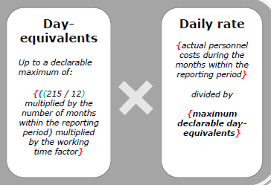
2. Budget details – personnel costs
Calculation of actual personnel costs for the financial report :
We will send more detailed guidance for reporting
at the end of the first reporting period (August 2025)
Total personnel costs for this person per year
/
215 days
=
Daily rate per year
Number of days worked on POLARIN as in your time records
But only max 215 days per year are allowed
Notes:
See detailed explanation in the “Annotated Grant Agreement” (https://ec.europa.eu/info/funding-tenders/opportunities/docs/2021-2027/common/guidance/aga_en.pdf ) page 50

Slide 22
3. Payments
Start of the project
01.03.2024
Prefinancing
48.33 %
1st interim report
Period 01.03.2024 – 31.08.2025
(18 month)
1st Interim payment
after report was accepted by the EC
Amount depends on costs claimed
2nd interim report
Period 01.09.2025 – 31.08.2027
(24 month)
2nd Interim payment
after report was accepted by the EC
Amount depends on costs claimed
3rd interim / final report
Period 01.09.2027 – 28.02.2029
(18 month)
Final payment
after successful project completion
15% (10% final payment + 5% Guarantee Fund)
Notes:
The EU funding will be paid in tranches to the coordinator (AWI) and distributed to the partners:
The pre-financing of 48.33% (= 7.05 Mio €) was transferred to AWI in March 2024. Transfer to partners is explained in the next slides
The interim and final payments are made after each reporting period, when the EU services have accepted the reports. The amount depends on the amount claimed in the financial reports.
Important: the EU will keep 10% of the EU funding plus 5% for the garantee fund for the final payment. These 15% will be paid out only after the project was completed and all documents and reports were accepted.

Slide 23
3. Payments
Prefinancing:
We received 48.33% of the total EC funding as pre-financing
Distributed as laid down in the CA:
Non-infrastructure budget
Infrastructure budget
48.33%
Paid out upon use of infrastructure
Paid out in April
Notes:
The pre-financing was divided into the non-infrastructure budget and infrastructure budget.
Slide 13 explains, which costs belong to the non-infrastructure and which to the infrastructure budget
A calculation table with the amount for each partner was circulated by email by Maria on 26/02/2024
The non-infrastructure part was paid out in April 2024.
The infrastructure part will be paid out upon use of the infrastructure.
Why? We made the experience in other infrastructure projects, that the actual use of the infrastructures is often not as planned. Some infrastructures are more frequently visited and others not. Some infrastructures cannot offer access as planned due to technical problems and others can offer more capacities. In these cases pre-financing had to be paid back and forwarded to the other partners which was complicated, time consuming and not efficient.

Slide 24
3. Payments
Infrastructure budget
Paid out upon use of infrastructure
Transnational Access
Virtual Access
After end user agreements were signed
Soon
Notes:
The infrastructure budget includes the Transnational Access (TNA) and Virtual Access (VA).
The TNA will be paid out upon use of the infrastructures.
The VA will be distributed soon, as this includes ongoing personnel costs for providing data sets or other information.

Slide 25
4. Financial Reporting
Each partner has to submit a financial report (costs statement) at the end of the reporting period
Submission via EU portal
Detailed guidelines will be circulated a few weeks before end of the reporting period
Notes:
Please be aware, that each partner has to submit a financial report (costs statement) after the end of each reporting period.
The first reporting period will end on 31.08.2025.
We will send out detailed guidelines how to submit this financial report via the EU portal towards the end of the reporting period.
But in the mean time: please keep records of all costs!

Slide 26


Contact Us
Financial and administrative management team:
Martina Schrage
martina.schrage@awi.de
Maria Eden
maria.eden@awi.de

