Slide 1

Highlights of POLARIN
YEAR 1: Main Achievements
Verónica Willmott
www.eu-polarin.eu
POLARIN 2nd General Assembly
1-2 April, 2025

Slide 2
POLARIN: POLAR RESEARCH INFRASTRUCTURE NETWORK
15M€ - Horizon Europe
52 partners
64 RIs
3 access modalities in both poles
Coordinator: AWI

Slide 3

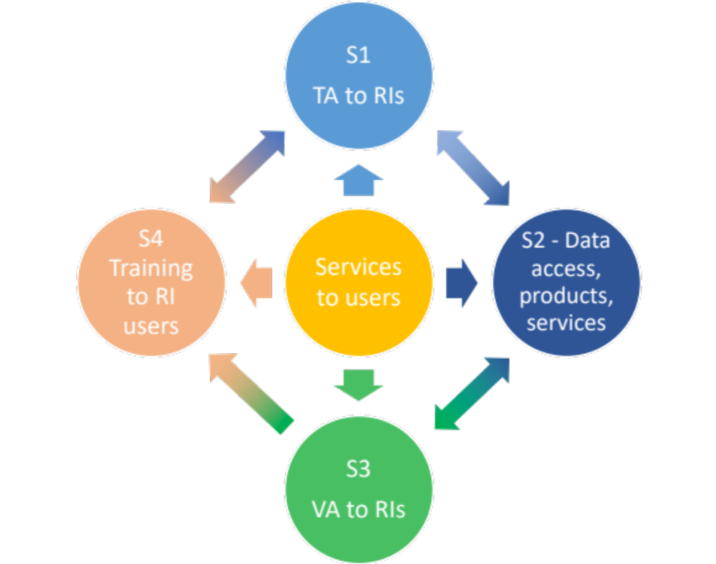
Overall aim
To provide efficient and customised RI services to address the scientific challenges of the polar regions, including access to a wide portfolio of complementary and interdisciplinary top level RIs.

Slide 4
1. Introduction
Purpose: Overview of key successes and milestones from POLARIN’s first year
Key successes
Milestones
Impact
Next steps
Overview

Slide 5

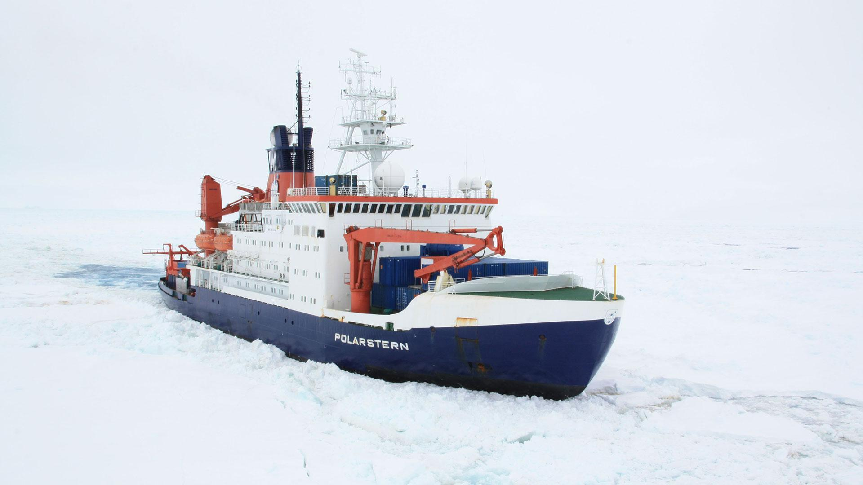
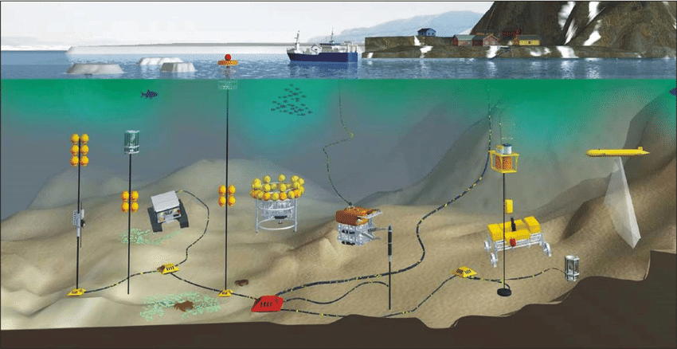
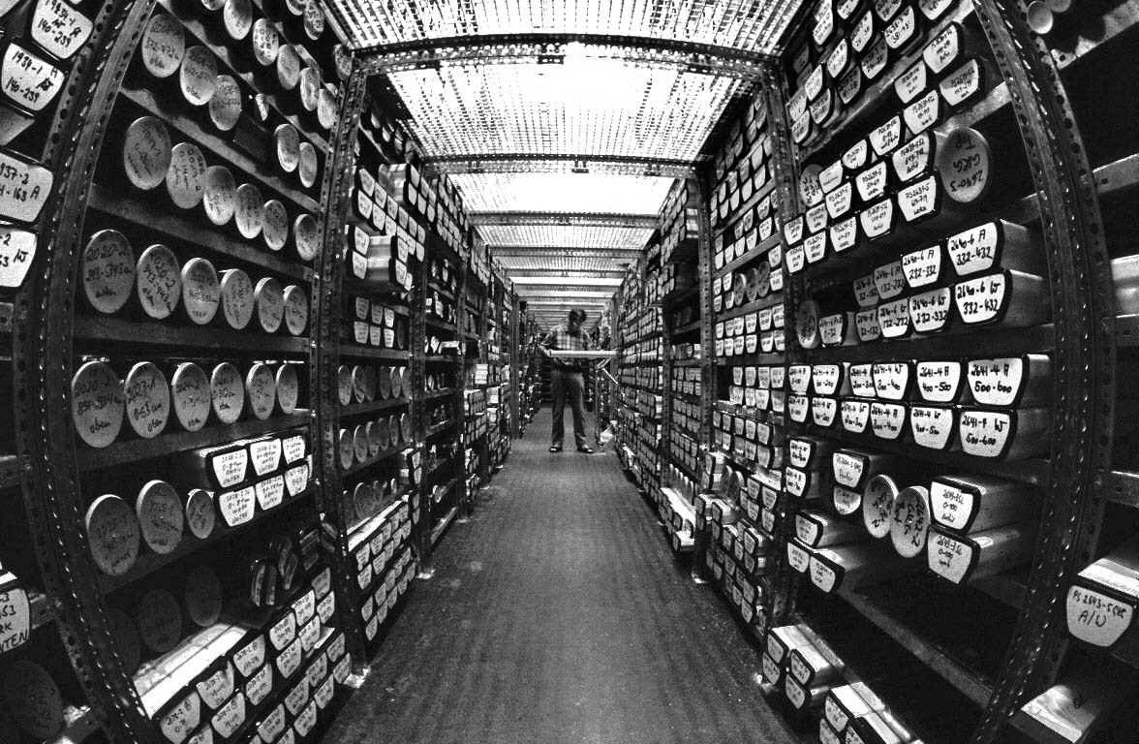
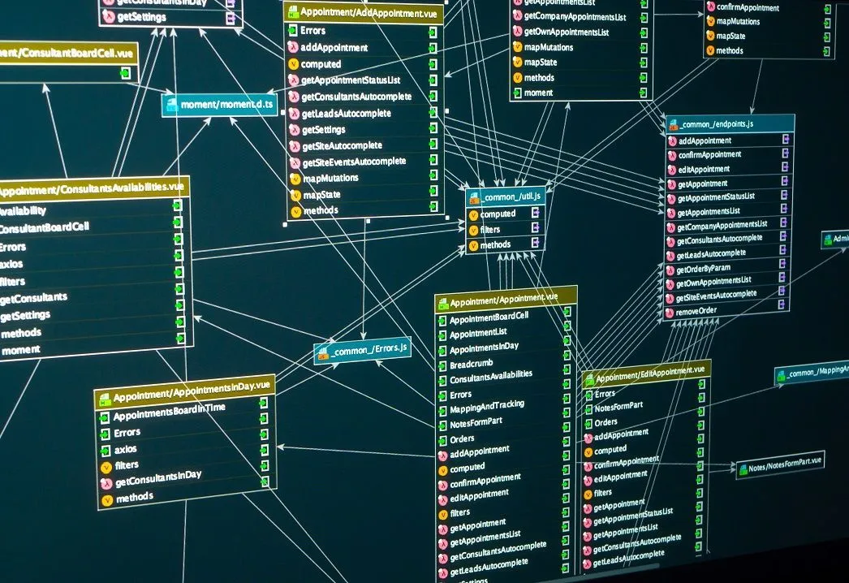
POLARIN RESEARCH INFRASTRUCTURE
Access integration to 64 research infrastructures in both poles
TRANSNATIONAL ACCESS (IN-PERSON OR REMOTE)
VIRTUAL ACCES
38
Research stations
12
Polar vessels
18
Observatories
4 Ice and sediment core repositories
7 Data infrastructures
FULLY FUNDED ACCESS TO RESEARCH INFRASTRUCTURES FOR RESEARCH PROJECTS ADDRESSING THE KEY RESEARCH QUESTIONS IN THE POLAR REGIONS
Notes:
RI (Research Infrastructures)

Slide 6
Methodology
POLARIN SERVICES
Integration
Assessment
Implementation
Scientific framework
POLARIN TAP (Transnational Access Platform)
Building Data portal
Planning training activities
Communication plan
Call opening
Implementing TA and VA
Data portal
Data products
Training activities
Communication/dissemination
Ambassador programme
Follow up of implementation
Assessment of TA, VA, Training activities, communication
Policy briefings

Slide 7
TA calls advanced to M8 (October 2024)
WP1
WP8
WP4
WP2
WP9
WP5
Timing of
1st TNA call
WP7
From M12 to M8

Slide 8
POLARIN TIMELINE years 2024-2025
Implementation
1st Call opening
10.2024
2nd Call opening
9.2025
01.03.2024
Kick off
04.2025
2nd GA
Webinars
For RI users
Integration
Implementing TNA
Jan 2024
May 2024
Sept 2024
Jan 2025
May 2025
Sept 2025
Jan 2026
Development:
POLARIN TAP
  Data management
  Data portal
  Training activities
Coordination for opening the 1st call
Data portal opening
Webinar for applicants
Proposal evaluation ended
03.2024
Webinar for applicants
Data access and Virtual Access
Ambassador programme
Communication-dissemination activities

Slide 9
Success in Transnational Access
1st POLARIN call opened in October 2024
High proposal volume: 96 proposals submitted– HIGH DEMAND!
36 recommended for access (negotiations ongoing)// 1341 units (3 projects pending)
Geographical Reach: Proposals from diverse international institutions
Next Steps: Access implementation

Slide 10
Success in Transnational Access
1st POLARIN call opened in October 2024
High proposal volume: 96 proposals submitted– HIGH DEMAND!
36 recommended for access (negotiations ongoing)// 1341 units (3 projects pending)
Geographical Reach: Proposals from diverse international institutions
Next Steps: Access implementation

Slide 11

Success in Communication and Outreach
Events & Conferences: POLARIN presented at multiple international meetings
Social Media Impact: Increased engagement and visibility online
Stakeholder Engagement: Strengthened connections with key polar research organizations
Public Outreach: Expanded awareness through website updates, newsletters, and outreach activities
Website
132K
3.98K
Impressions
Clicks
Newsletter : 4 in 2024
290
3.98K
Subscribers
Clicks
669
Followers

Slide 12
Milestones: Accomplished
TA to RIs
Training for RI users
M1. Scientific evaluation procedure (Sep 24)
M2. Initial definition of scientific priorities (Oct 24)
M3. Scientific evaluation of first call (Aug 25)
M4. Logistic evaluation procedure (Sep 24)
M5. Beta testing of INTERACCESS (Dec 24) Sept 24
M6. Launching 1st call for proposals (Feb 25) 1st Oct 24
M15. Introductory online seminar to POLARIN call 1 (Dec 24) 21. Oct 24
Data management and access to data
M9. POLARIN web data portal implemented – (Feb 25) in progress
M10. Machine interfaces to catalogue established – (April 25) March 25

Slide 13

Key Impact of POLARIN Year 1
Scientific Impact: Strong demand for access to research infrastructures, with 96 proposals submitted in the first call
Operational Impact: Provided streamlined access to polar research infrastructures
Collaborative Impact: Strengthened partnerships across nations, institutions and research networks
Public and Stakeholder Engagement: Increased visibility through participating in events, outreach activities, website, newsletters and social media

Slide 14



Challenges & Opportunities
2 poles approach
Timing calls in between seasons
Number of disciplines /experts /SLP members
High demand
Limited funding
Challenging evaluation
High interest from polar operators
More partners willing to join the consortium
Notes:
(if needed)
Main challenges encountered (framed constructively)
Strategies or solutions to address these
Opportunities for improvement or innovation

Slide 15
Next steps: Upcoming Milestones
TA to RIs
Training to RI users
M7. Launching 2nd call for proposals
(planned Sept 2025)
M13. First training course for POLARIN TA-users on optimal use of POLARIN RI’s in progress
Data management and access to data
Project management
M9. POLARIN web data portal implemented - in progress
M11. VA portal established - in progress
M12. First guidelines on the handling of data collected on transnational access- in progress
M17. Mid-term retreat and internal evaluation of POLARIN’s achievements and progress (Apr 26)

Slide 16




Collaboration & Key Interactions
European Space Agency (ESA)
Joint effort to define key data needs for satellite calibration.
Potential impact on improving polar remote sensing capabilities.
AQUARIUS Project
Shared activities, e.g., joint booth at EGU2025.
Synergies in research infrastructure access.
EU Polar Cluster
Collaboration within the broader network of EU-funded polar research initiatives.
Shared knowledge exchange and outreach activities.
Large scale initiatives
Supporting the Antarctica InSync initiative.
Offering RIs in the frame of InSync in the 2025 TNA call.

Slide 17


Contact Us
Nicole Biebow: Nicole.Biebow@awi.de
Verónica Willmott: Veronica.Willmott@awi.de

