Slide 1

PERIODIC REPORTING
Martina Schrage
www.eu-polarin.eu
POLARIN 2nd General Assembly
1-2 April, 2025

Slide 2
1. Budget Status
Budget
Overall budget 14,588,114.00 EUR
We will only be reimbursed for the Costs we actually claim during the Financial Reports!
Payments
We received 48,33% of the overall budget as Pre-Financing
7,050,435.50 EUR

Slide 3
1. Budget Status
Distribution of prefinancing 7,050,435.50 EUR
Non-infrastructure budget
VA budget
EUR
Infrastructure budget
48.33%
48.33%
48.33%
3,176,458.08 EUR
Paid out in April 2024
475,612 EUR
In progress
3,398,365.42 EUR
Will be paid out upon use of infrastructure

Slide 4
2. Periodic Reporting - Schedule
Reporting Periods
Deadlines for Submission of Reports
  Beneficiaries to Coordinator 30 days
  Coordinator to EU 60 days
Reporting via EU Funding & Tenders Portal
1
Month 1-18
2
Month 19 - 42
01.09.2025 – 31.08.2027
3
Month 43 -60
01.09.2027 – 28.02.2029
01.03.2024 – 31.08.2025

Slide 5
2. Periodic Reporting - Schedule
First reporting after end of first reporting period 31/08/2025
Detailed guidelines will be sent by AWI in July 2025
Webinar & regular open hours to call in will be scheduled in August & September to support you
Be prepared for first reporting in September 2025
Each partner has to prepare and submit its own Financial Report via EU portal
Deadline to prepare your 1rst financial report: 30/09/2025

Slide 6
2. Periodic Reporting - How to start?
Please check your planned budget and work plan in the Grant Agreement and its Amendment (contract)
Documents can be found in the Intranet.
Where to find the budget in the relevant document?
Planned person months (PM) per partner: p. 27-28
List of Research Infrastructures: p. 60
Details of planned costs per partner: p.107-116
Overview of total planned budget per partner: p.123-124
Unit Costs for Research Infrastructures: p. 125

Slide 7
3. What has to be reported?
Two types of costs:
actual costs / unit costs
to be reported differently!

Slide 8
4. Actual Costs – Eligible Costs
Claimed as they actually incurred
e.g. Mr./Mrs. X actually travelled to meeting
Eligible costs (Article 6 GMGA)
Actually incurred by beneficiary
01.03.2024 – 28.02.2029
Incurred over Action's duration
See Grant Agreement budget tables & Amendments
Estimated in budget - Annex 2
Really relevant and linked to POLARIN
Related to Action
Keep time sheets, invoices etc in your records
Identifiable and verifiable
In compliance with national laws on taxes, labour and social security
Follow your usual accounting practice
Reasonable, financially sound
No reckless or excessive expenses

Slide 9
4. Actual Costs – Records Needed
Be prepared – Keep records for claiming actual costs!
Cost categories | Records needed
Personnel costs Days (hours) really worked on POLARIN | Time sheets signed by the person working on the action and his/ her supervisor Proof that the person worked for the organisation and was actually paid (payment slips, working contract or similar)
Travel costs and allowances | Invoices and receipts (including boarding passes, train tickets, etc.), meeting agenda and minutes
Other goods and services | Invoices – Ensure best value for money/ lowest price

Slide 10
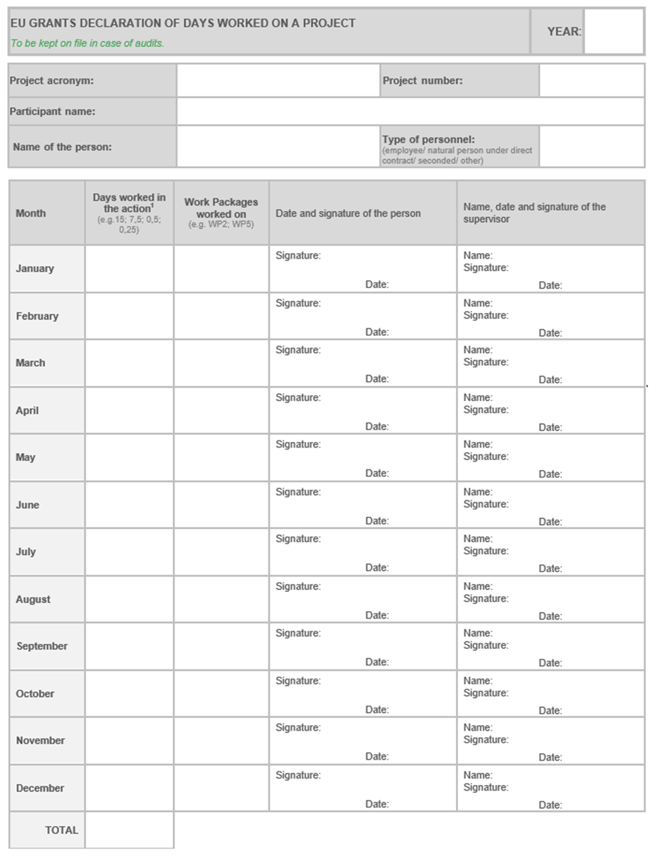
4. Actual Costs - Time Records
If you use your own time record system, make sure,
that it holds the necessary information as in the EU template:
Year
Project acronym = POLARIN
Project number = GA No 101130949
Participant name = Official name of your organisation, as in the POLARIN GA
Name of the person
Type of personnel: usually „employee“
Days worked for the project per month
In which work package (WP)?
Date + signature of the person workin on the project per month
Date + signature of the supervisor per month
Please note:
Two signatures from two different persons are required
Time sheets should be signed in a timely manner (soon after end of the month)
Total days per year

Slide 11
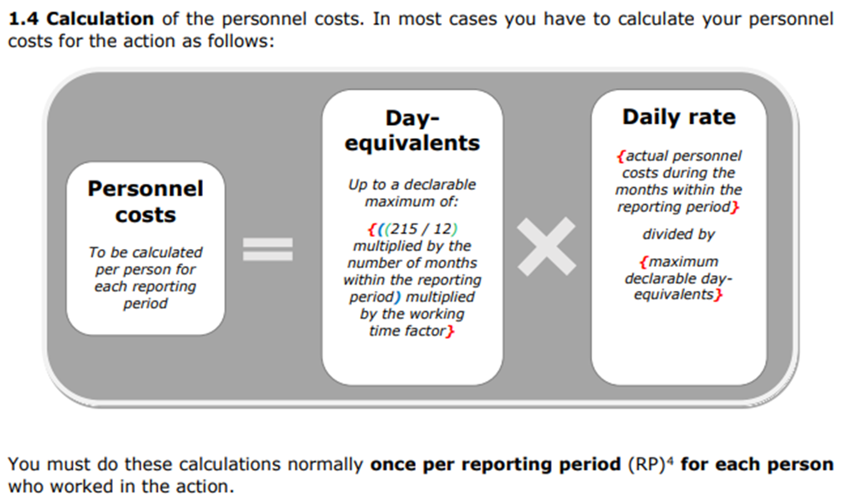
4. Actual Costs – Calculation PC
The actual personnel costs for POLARIN have to be calculated :
= these are the costs you can claim in your financial report
We will send more detailed guidance for reporting at the end of the first reporting period (August 2025)

Slide 12
4. Actual Costs – Eligible Travels
Travel costs have to be directly related to POLARIN!
Eligible trips:
attending POLARIN project meetings and workshops
attending conferences and workshops to present POLARIN (e.g. oral or poster presentation)
Just attending a conference, without presenting anything, is usually not eligible.

Slide 13
5. Unit Costs
Claimed based on a unit rate
Mainly costs for use of infrastructure
Unit rate calculated during proposal phase / revised at beginning of project
Unit rate is laid down in the GA/Amendment (see budget tables or budget overview in the excels)
In the financial report: only number of access units (e.g. user days) has to be claimed
But: keep documentation, how this rate was calculated in your files
Notes:
Unit costs are usually only foreseen for the use of infrastructure:
You can find the calculation of your unit costs in your Excel budget
The unit costs are usually calculated by:
Total cost for the infrastructure over the last two financial years / number of user days during this two years = unit rate per user day
In your financial report, you simply declare:
Number of user days * the unit costs rate
There is no need to prove the real costs of the single user, if you use this unit costs rate.
However, please keep documentation of the unit costs rate calculation in your files. The EU might send an auditor to check.

Slide 14
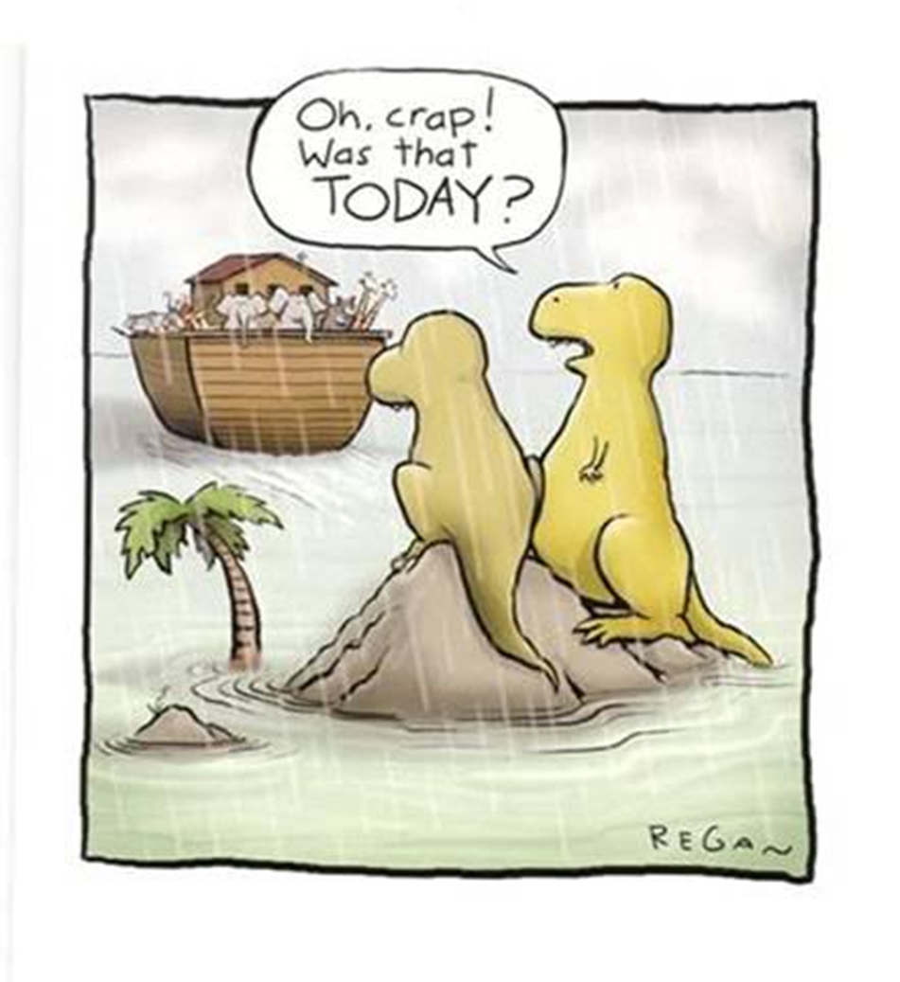
6. Respect the Deadlines
Please be in time with reporting!
No Financial Report –
No Reimbursement Payment
Please do not hesitate to contact us in case of administrative/financial/legal questions or problems!

Slide 15


Contact Us
Martina Schrage: martina.schrage@awi.de
Verónica Willmott: Veronica.Willmott@awi.de

