Slide 1
Project implementation: User Contracts and Financial Aspects of Transnational Access
Verónica Willmott
Martina Schrage
Vanessa Spadetto
Hannele Saavela
www.eu-polarin.eu
POLARIN 2nd General Assembly
1-2 April, 2025

Slide 2
Project implementation process: from selected to reimbursed
Negotiation
Access dates
Implementation
Reimbursement
User group leader reporting
Travel/ shipment costs associated to the access
Travel costs
Access report
Travel expenses
Access costs
Signature of user contracts
Access provider reporting
Approval of access costs

Slide 3
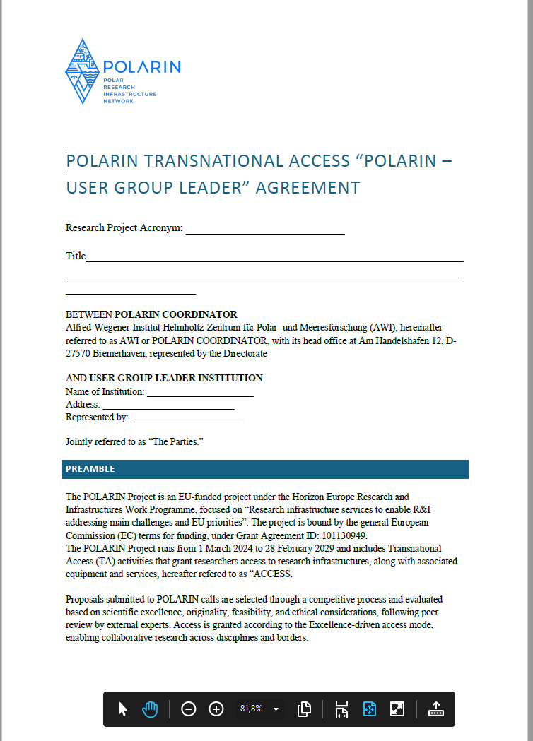
1. Negotiation
Access dates: defined by the RI operator
User Group Leader – POLARIN contract: Mandatory for all User Group Leaders
Defining
General funding an access conditions
Travel, logistics, and shipment costs directly associated to the access
Liability
Scientific data
Acess reporting
Cancellation or suspension
Negotiation
  Access dates
  Signature of user contracts

Slide 4
1. Negotiation
Access dates: defined by the RI operator
User Group Leader – POLARIN contract: Mandatory for all User Group Leaders
Negotiation
  Access dates
  Signature of user contracts
The RI operator must inform the UGL about:
the reimbursement process selected by the RI operator that applies to this access
The need of permits to perform the research
The need of mandatory training, licences, insurances

Slide 5
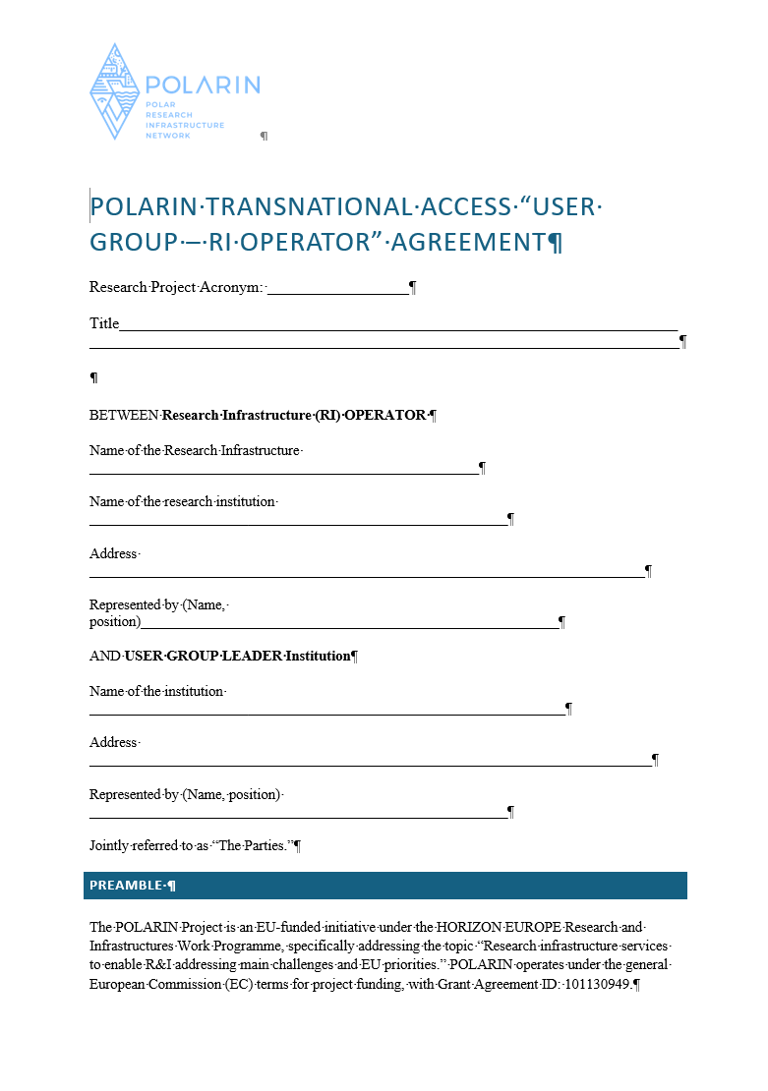
1. Negotiation
Access dates: defined by the RI operator
User Group Leader – POLARIN contract: Mandatory for all User Group Leaders
User Group Leader – RI contract: Voluntary for RI operators
Negotiation
  Access dates
  Signature of user contracts
Defining
Especific conditions applying to the access of this RI:
Mandatory health checks
Firearm licence
Mandatory trainings
Reimbursement of expenses
…
A basic draft has been provided, additional articles can be added depending of the RI needs.

Slide 6



1. Negotiation
Invoicing between POLARIN consortium partners is NOT ALLOWED!
RI Operators MUST NOT invoice POLARIN consortium partners
Scenarios for reimbursement of User Group Leader expenses associated to the access
Negotiation
  Access dates
  Signature of user contracts
  Selection of reimbursement process to UGL
Institution is
NOT PoC
Institution is
PoC
Scenario 1
Scenario 2
User Group Leader
User Group Leader

Slide 7
1. Negotiation
Institution is
NOT PoC
If affiliated with a non-POLARIN institution:
Travel expenses are covered by the UGL and reimbursement processed upon submission of required project report, or
80% of the granted amount can be pre-financed to the USER GROUP LEADER by the RI OPERATOR, with the remaining 20% withheld until final reporting requirements are met, or
The RI operator books all travel arrangements, or
A mix of the above
Scenario 1
Negotiation
  Access dates
  Signature of user contracts
  Selection of reimbursement process to UGL
User Group Leader

Slide 8
1. Negotiation
If UGL affiliated with a POLARIN institution:
(UGL)POLARIN institution covers the travel and shipping expenses
(UGL) POLARIN institution claims expenses from PERIODIC REPORTING and a budget shift from POLARIN Coordinator.
(UGL) POLARIN institution requests a budget shift via the COO (budget will be shifted from operator to (UGL) institution) in the amount of the overall travel expenses.
These travel cost have to be claimed by the (UGL) institution during financial reporting - this is very important!!
Institution is
PoC
Scenario 2
Negotiation
  Access dates
  Signature of user contracts
  Selection of reimbursement process to UGL
User Group Leader

Slide 9
2. Implementation
Prefinancing access costs to RI providers, transferred from coordinator to RI operators
RI costs
Travel/shipment costs associated to the access
Implementation
  Prefinancing transfer to RI operator
  UGL: Travel/ shipment costs associated to the access
User Group leaders must consult the RI operator before arranging their travel/shipment

Slide 10
3. User Group Leader reporting
Maximum 2 months after project implementation
Reporting in TAP
Uploading project report (template to be provided in TAP)
Justification of expenses associated to the access (following regulations from RI operator institutions to proceed with the reimbursement)
User Group Leader reporting
Travel costs
Access report

Slide 11
3. Access provider reporting
Reporting in TAP
Approval of project report
Approval of expenses and access units
Access provider reporting
Approval of access costs

Slide 12
4. Reimbursement of TNA expenses
Reimbursement
  Travel expenses to UGL
  Access costs to RI provider

Slide 13
4. Reimbursement of TNA expenses
Signed user contracts
AWI
RI Operator
Scenario 1
TNA Prefinance Payment
from
cover
reimburse
Institution is
NOT PoC
PI01
Access Costs
Travel Costs
claims
to
Claimed
Claimed
Financial Report
Notes:
TNA prefinance budget
(48,44% of the total unit costs calculated)
will be transferred from COO AWI to the infrastructure (RI) operators
But only to those, whose RI will really be accessed - based on signed user contracts
Szenario 1: PI (User group leader) is NOT from an institution that is part of POLARINs consortium
Travel costs will be reimbursed by the RI Operators
RI Operators reimburse the travel costs incurred for accessing RI to user group leader (PI) based on PIs access report
Reimbursement of those travel costs to the RI Operator will be processed with the regular financial reporting
to be claimed as travel costs

Slide 14

4. Reimbursement of TNA expenses
BUDGET SHIFT
POLARIN consortium member
Scenario 2
Signed user contracts
AWI
RI Operator
TNA Prefinance Payment
reimburse
from
cover
PI02
Travel Costs
claims
Access Costs
Travel Costs
to
Claimed
Claimed
Financial Report
Financial Report of POLARIN consortium member
Notes:
TNA prefinance budget
(48,44% of the total unit costs calculated)
will be transferred from COO AWI to the infrastructure (RI) operators
But only to those, whose RI will really be accessed - based on signed user contracts
Szenario 2: PI (User group leader) is from an institution that is part of POLARINs consortium
Travel costs will be advanced by the institution that is part of the consortium
Reimbursement of those travel costs to the consortium member will be processed with the regular financial reporting
to be claimed as travel costs
Reason and important:
Invoices between beneficiaries are not allowed!
Don’t forget to claim those travel costs when doing the financial report!

Slide 15
4. Reimbursement of TNA expenses
Signed user contracts
AWI
RI Operator
Only those RI Operators get TNA prefinance payment, whose infrastructure will be accessed !
TNA Prefinance Budget = 48,33% of total estimated TNA costs incl. Unit Costs, Travel Costs for Users, Shipment Costs, Other Goods & Services (personnel costs only in few cases)
If your infrastructure will not be accessed at all, the TNA budget has to be returned!
TNA Prefinance Payment
cover
Access Costs
Claimed
Financial Report

Slide 16
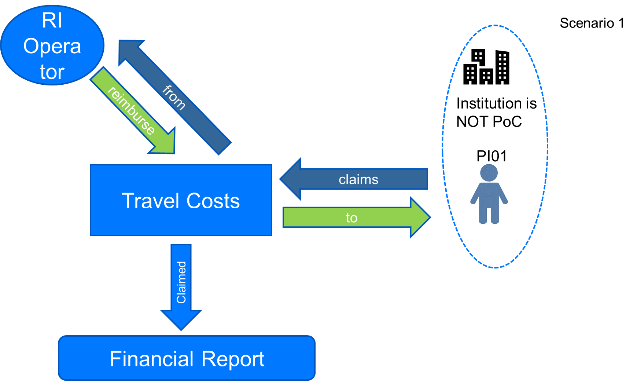
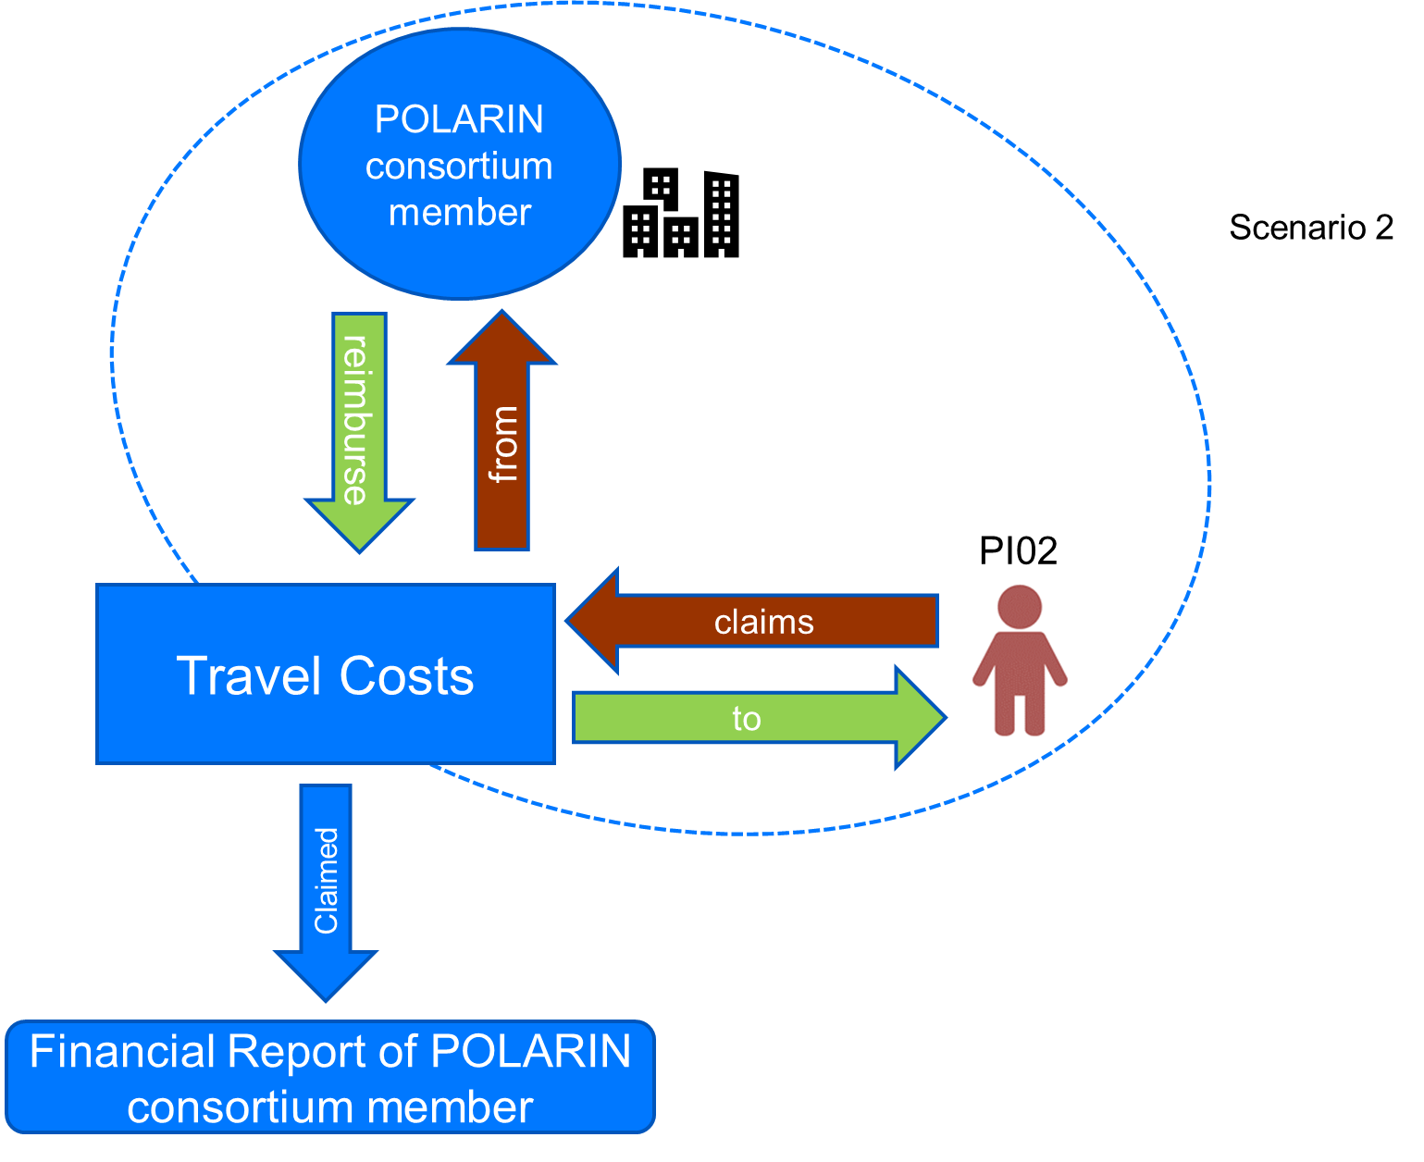
4. Reimbursement of TNA expenses
Scenario 1
Key issue:
Invoicing between POLARIN consortium partners is NOT ALLOWED!
RI Operators MUST NOT invoice POLARIN consortium partners
Contact COO if scenario 2 is applicable!
We will work with “Internal Budget Transfer Requests” shifting budget from RI Operator to the concerning POLARIN partner
Stay in close contact with us to avoid money loss due to non-eligibility!
Scenario 2

Slide 17

Contact Us
Nicole Biebow: Nicole.Biebow@awi.de
Verónica Willmott: Veronica.Willmott@awi.de
Photo credit: Lars Grübner (AWI)

