Slide 1

WP1 – Enabling science for understanding and predicting key processes in polar regions
Marie-Noelle HOUSSAIS
CNRS
www.eu-polarin.eu
POLARIN 2nd General Assembly
1-2 April, 2025

Slide 2










WP1 partners
Task 1.1 co-leads
Task 1.2 co-leads
Task 1.3 lead

Slide 3
1. WP1 objectives
To ensure that TA provision in POLARIN contributes to better understanding of polar processes
Scientific framework definition of call for proposals in terms of overarching scientific challenges
Scientific management of TA provision (general procedure, scientific evaluation of submitted proposals)
Monitoring of the scientific outcome of the POLARIN funded projects (assessment and optimisation)

Slide 4
WP1 Tasks
Task 1.1: Challenge driven call definition and integration (M1-M42) (CNRS, IGOT)
Task 1.2: Scientific evaluation of proposals submitted to POLARIN’s access calls (M1-M48) (OGS, UOULU)
Task 1.3: Optimising the scientific outcome of the access programme (M7-M58) (AU)

Slide 5
Task 1.1 Challenge driven call definition and integration
2. Progress & Achievements (1)
Implementation of a Scientific Liaison Panel
Description of the seven key research challenges to be addressed by the transnational access beneficiaries
Development of a full procedure for TA provision through TA calls for proposals.
First TA call launched on Oct. 4, open till Nov. 28, 2024 : 96 proposals submitted

Slide 6
Task 1.1 Challenge driven call definition and integration (cont.)
Implementation of a Scientific Liaison Panel (SLP) (D1.1)
  21 experts with expertise covering the seven POLARIN overarching topics.
  Duties described by Terms of Reference
  Balanced distribution across topics, gender, countries, POLARIN partnership.

Slide 7
Scientific Liaison Panel: Terms of Reference
SLP membership:
  Expertise relating to the main polar research challenges with good understanding of polar field work practices, including land- and marine-based observations,
  Diversity of research organizations and countries
  Independence with regards to the POLARIN consortium (> 50% of the members being external to the POLARIN consortium)
  Gender equality will be addressed in the panel composition.
SLP assists the consortium in:
  The scientific evaluation of the submitted proposals to TA calla, overseen by the POLARIN Evaluation Office. SLP members act as watchdogs, suggesting external reviewers and collecting reviews, participating to consus meetings and drafting the scientific evaluation statements
  Establishing links between the POLARIN project and the scientific community
  Identifying new research priorities and reviewing the call documentation, providing recommendations when necessary
2
3
2
2
3
6

Slide 8
Scientific Liaison Panel Composition
2
3
3
2
2
3
6

Slide 9
Scientific Liaison Panel Composition (cont.)
2
3
2
2
3
6

Slide 10
Scientific Liaison Panel Composition (cont.)
2
3
2
2
3
6
SLP statistics slightly modified after three SLP members resigned lately

Slide 11
Task 1.1 Challenge driven call definition and integration (cont.)
Description of the seven key research challenges (D1.4) to be addressed through the POLARIN TA call for proposals
  Sea Ice and Polar Oceans in the Climate System
  Polar Ice Sheets, Glaciers and Sea Level:
  Terrestrial Carbon Cycle and Permafrost
  Polar Ecosystems and Biodiversity
  Atmosphere dynamics and chemistry
  Paleoclimate Processes and Variability
  Humans, societies and global changes

Slide 12
Description of the seven key research challenges (cont.)
Inspired from existing European and international science documents (incl. European Polar Research Programme, EU-PolarNet “Identification Report of future research needs for polar research”, SCAR Antarctic Climate Change and the Environment, ICARP III report, IPCC SROCC and AR6, ESA science strategy,…) and observation strategies (SAON, WMO, SOOS, ESA, KEPLER project, …)
Seven research priorities relating to process understanding in the polar regions: marine and terrestrial processes, across all disciplines from natural to social and human sciences, both polar regions
Also considers validation/calibration needs for in-situ observations, modelling and remote sensing

Slide 13
Task 1.1 Challenge driven call definition and integration (cont.)
Development of a full procedure for TA provision
  Process definition
  Call definition
  Procedure for proposal selection
  Project implementation
  Project reporting and publication of results

Slide 14
Task 1.1 Challenge driven call definition and integration (cont.)
Procedure for Provision of Transnational Access (TA)
main objective: to describe in detail the process for provision of TA
Steps involved in the provision of transnational access
call scientific framework and topic definition
proposal
submission
evaluation
logistic preparation and implementation
transnational access field work
reporting
Eligibility Criteria
Terms and Conditions for TA

Slide 15
Procedure for Provision of Transnational Access (TA) (cont.)
Steps involved in the provision of transnational access
  7 key research topics (D1.4)
  Update of the scientific framework (priorities) for each of the subsequent calls for proposals:
    Annual updates of new science priorities identified by major science organisations and networks to the extent that these are relevant to the design of subsequent calls.
    Gap analysis performed on the outcome of POLARIN TA
call scientific framework and topic definition

Slide 16
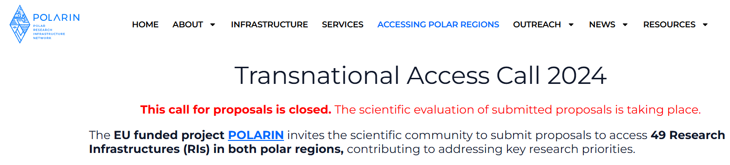
Procedure for Provision of Transnational Access (TA) (cont.)
Steps involved in the provision of transnational access
proposal
submission
POLARIN TAP
POLARIN Transnational Access Platform

Slide 17
Procedure for Provision of Transnational Access (TA) (cont.)
Steps involved in the provision of transnational access
evaluation
Two-step evaluation
Scientific evaluation (D1.3)
Logistic evaluation (D2.1.)
built on the evaluation systems of the previous EU projects EUROFLEETS (I, II and +), ARICE and INTERACT (I-III) and adapted to address the diverse nature of POLARIN’s RIs.

Slide 18
Procedure for Provision of Transnational Access (TA) (cont.)
Steps involved in the provision of transnational access
Finalizing access dates
Preparing necessary documentation (e.g., legal agreements, safety protocols, permits)
Arranging travel and accommodation logistics if applicable
Providing the Data Management Plan by the user group leader
Signing access contracts
logistic preparation and implementation

Slide 19
Procedure for Provision of Transnational Access (TA) (cont.)
Steps involved in the provision of transnational access
This phase aims at maximising the scientific output while ensuring that resources based on multiplatform access (e.g., research stations, vessels, data infrastructures) were optimally utilised and exploited.
implementation: Transnational Access Phase
For Remote Access, the access phase follows up the same stages as for in-person TA

Slide 20
Procedure for Provision of Transnational Access (TA) (cont.)
Steps involved in the provision of transnational access
Project Report by user group leaders detailing the achieved field work, their findings, outcomes, and any challenges encountered.
reporting
RI Implementation report by host research infrastructures in the POLARIN TAP, with feedback on the access provided
Reports summarizing the outcomes and progress of the provision of TA will be submitted to the European Commission

Slide 21
Procedure for Provision of Transnational Access (TA) (cont.)
Eligibility Criteria
General Funding and Access Conditions
Reporting
Terms and Conditions for TA
Data policy and data protection
POLARIN Data Policy concerning TA
Personal Data Protection
Language of Communication

Slide 22
Task 1.2 Scientific evaluation
2. Progress & Achievements (2)
Getting ready for the evaluation process:
Deliverable 1.3. Description of the evaluation process
Informative Webinar for applicants (21st oct. 2024, ~100 participants)
Implementing the scientific evaluation of proposals:
All steps from submission deadline to recommendation to Ris in TAP
(29/11/24- 24/2/25)
Refining the process
Feedback for adjustments to the next call (debriefing on 22.04.25)

Slide 23
Task 1.2 Scientific evaluation
Getting ready for the evaluation process
Deliverable 1.3. Description of the evaluation process, evaluation criteria, code of conduct, and guidelines and templates for external reviewers
  Based on similar projects (EUROFLEETS, ARICE, INTERACT, now AQUARIUS)
  Scientific evaluation process: Role of SLP, external reviewers, watchdog evaluation, Consensus metings, access recommendation.
  Guidelines for reviewers : evaluation criteria, scoring, priorities
  Webinar for applicants on 21st oct. 2024
  Invitation to register as voluntary reviewers
  (58 voluntary reviewers responded to our call between 21 oct 24 and to 3 Jan 25;
  at least 8 not valid. We used several of the others, but many were not suitable)

Slide 24
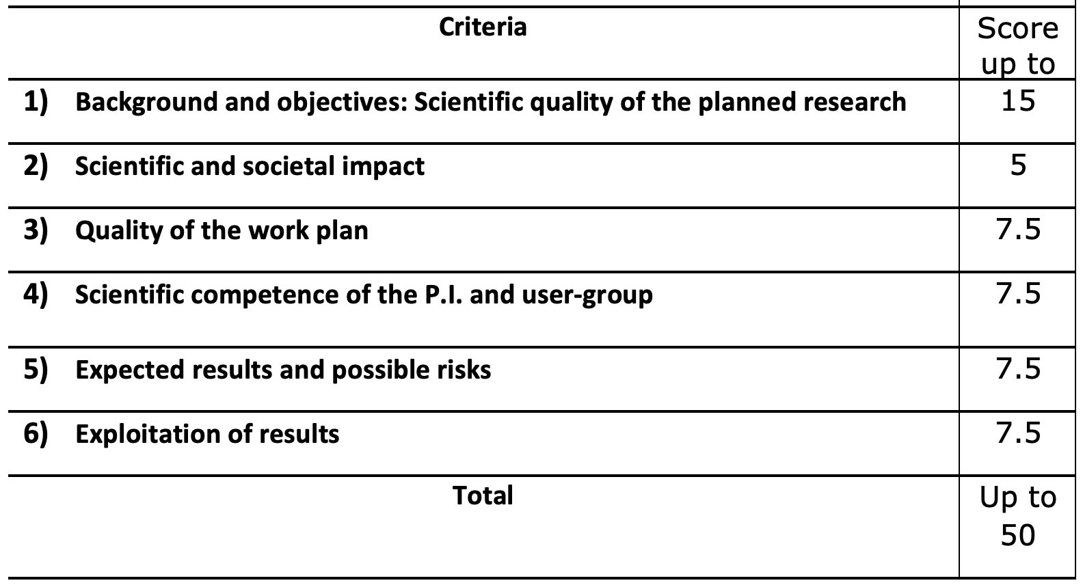
Task 1.2 Scientific evaluation
Getting ready for the evaluation process
Deliverable 1.3. Description of the evaluation process, evaluation criteria, code of conduct, and guidelines and templates for external reviewers

Slide 25
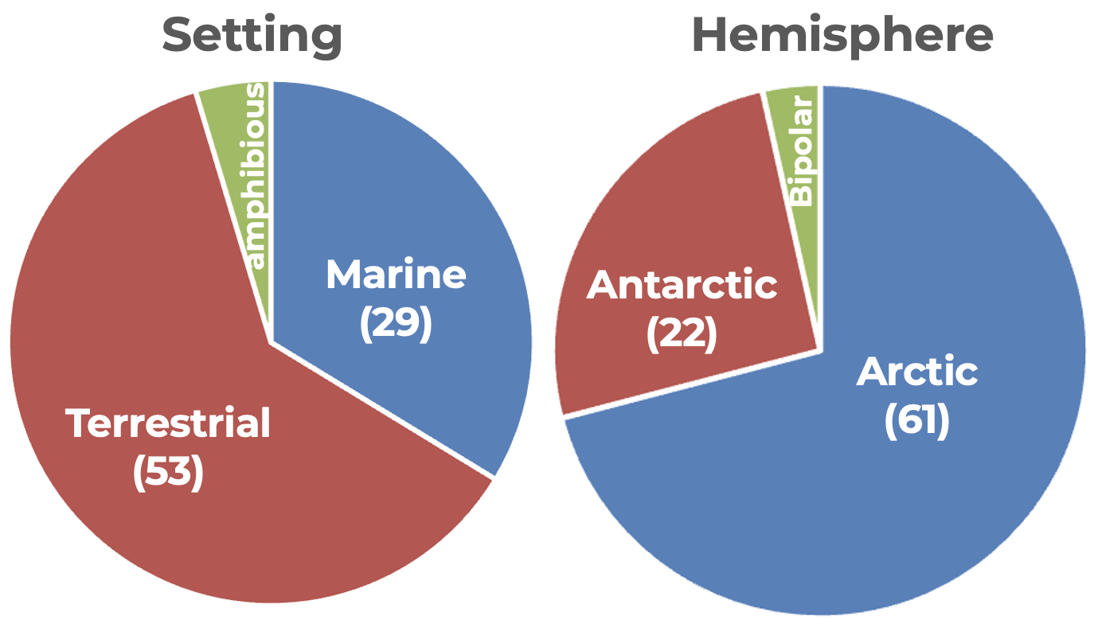
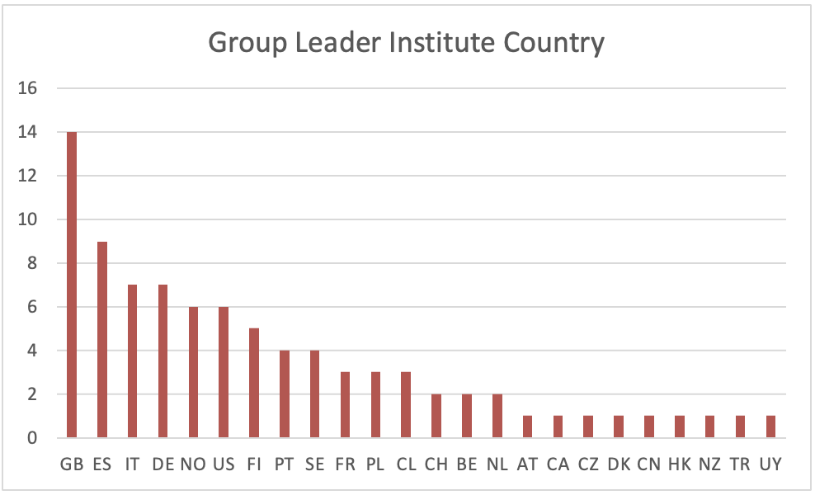
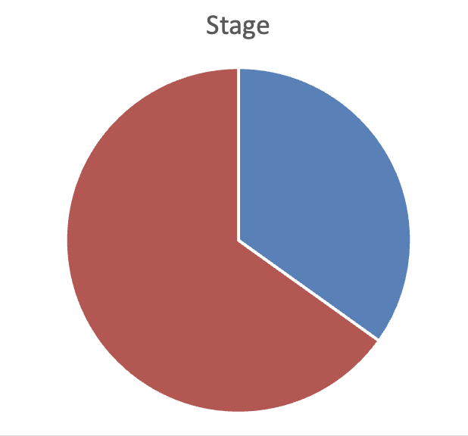
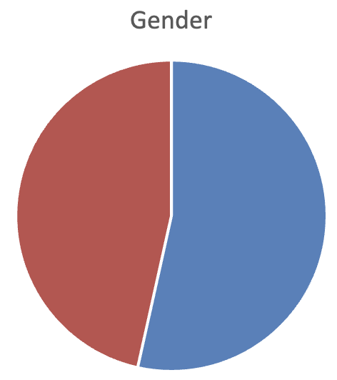
Task 1.2 Scientific evaluation: Proposals
  96 proposals were submitted by the deadline (28 November)
  86 proposals were considered eligible by December 2
  1/3 biology; ∿15 Carbon & Paleo;
  ∿ 10 Sea % Ice; ∿ 5 Atmos. % Human Sc.
Non EU
ECR
Females
Males
non ECR

Slide 26
Task 1.2 Scientific evaluation
Implementing the scientific evaluation of proposals
Eligibility check
External evaluators phase
24 Jan.
Scientific Liaison Panel phase
Logistic evaluation
Evaluation statements
21.2-19.3
Assigment to watchdogs since 18.12
Watchdog statements 27.1.-7.2
Consensus meetings
10.-17.2.
2 Dic.
SCIENTIFIC EVALUATION
24 Feb.
Identification of External reviewers:
  over 1500 mails (from the beginning of December and to last week of January
  over 800 reviewers contacted (about 9 per proposal in average).
  nearly 600 declined or never replied;
  about 220 reviewers accepted (2.5 per proposal in average).
  At the end we got: 44 with 2 reviews; 36 with 3; 4 with 1 review; 2 with 4

Slide 27
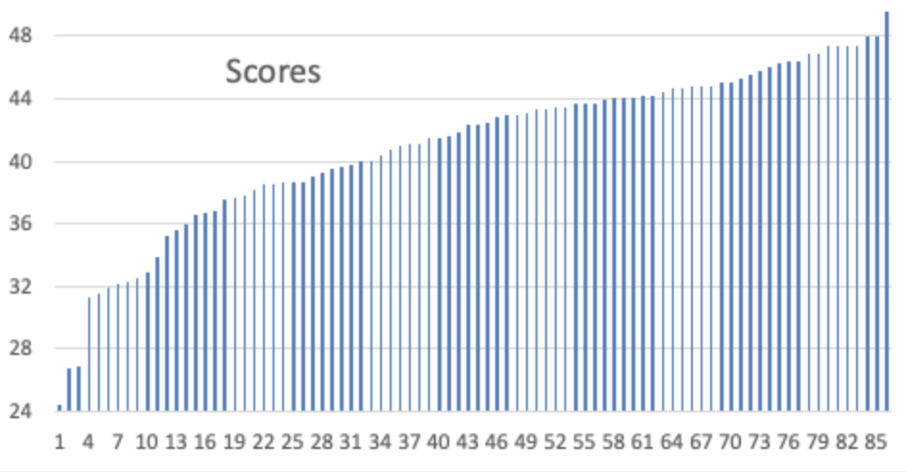
Task 1.2 Scientific evaluation:
Reviews quality and scores are quite variable
We calculated the deviation in the scores per each proposal (by making the difference between the highest and the lowest score), which can be up to >30 points !!!
For several reviewers 40 is a good score. In fact, there are several reviews scored around 40 that contains only positive comments and no shorthcomings are highlighted .
Many reviews are detailed (long comments) and provide a statement for each of the 6 criteria.
However, several are very short and do not follow the scheme
Average of the scores = 41

Slide 28
Task 1.2 Scientific evaluation (cont.)
  Results of the scientific evaluation:
    46 proposals recommended for logistical evaluation. Most recommended proposals scored above a threshold of 40.
    40 proposals rejected (including the 3 proposals asking for remote access to multiple infrastructures)

Slide 29
Task 1.2 Scientific evaluation (cont.)
Refining the process
Feedback for adjustments to the next call (debriefing on 22.04.25)
    All stakeholders will be consulted regarding their feedback (RI operators, SLP, TA applicants etc)
    we will then analyze the feedback, prioritize the suggestions for refinement, decide on the required actions, and implement the refinements to the call, evaluation and access decision process before the next TA Call opens in early September.

Slide 30
Task 1.3 Optimising the scientific outcome of the access programme
2. Progress & Achievements (3)
Preliminary assessment of the tools designed in POLARIN WP4..
Apply graphic products to identify potential observational gaps

Slide 31


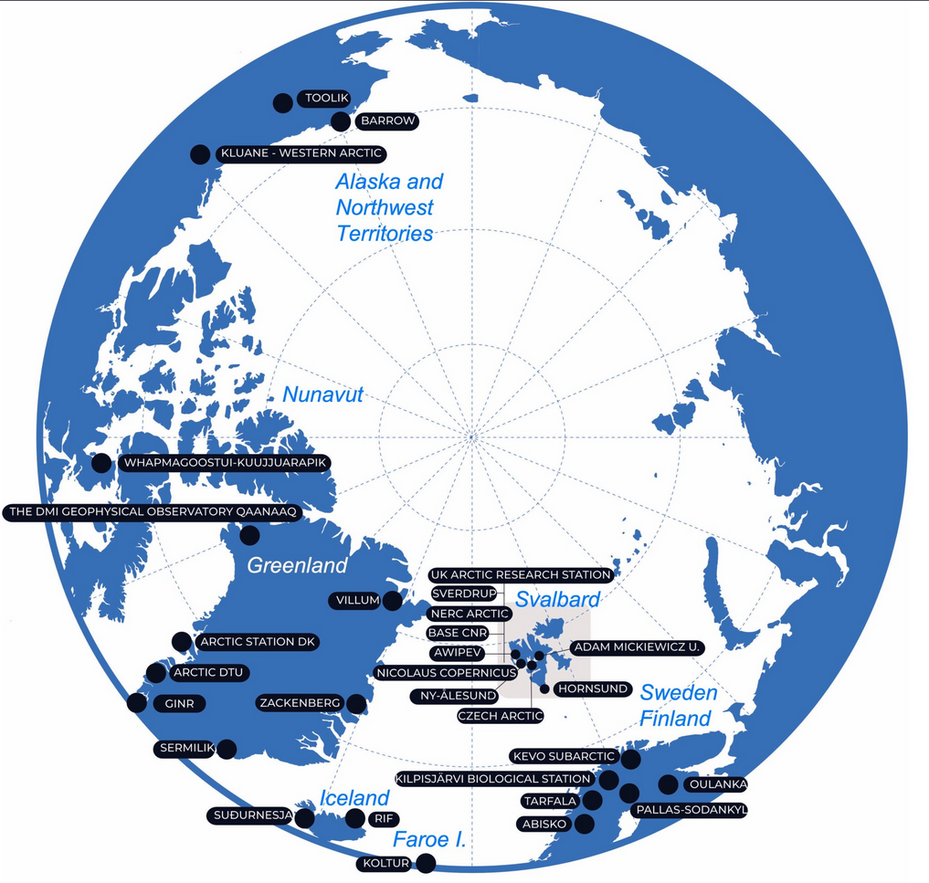
Task 1.3 Optimising the scientific outcome of the access programme (cont.)
Deliverable 1.5
Polar knowledge gaps
and the potential of POLARIN infrastructure in addressing these
POLARIN GA, 1-2 April 2025
Laura Halbach

Slide 32
Aim
to evaluate the representativeness of existing in-situ observation data sets and the potential for POLARIN infrastructures to fill potential observational gaps.
How
Compare values of in-situ observation sites with values of the pan-arctic scale (grid cells) generated by available remote observations, data upscaled products and CMIP6 Earth System Models (ESM).
POLARIN GA, 1-2 April 2025
Laura Halbach

Slide 33
Selected variables
Key variables for the POLARIN themes:
Sea-Ice and Polar Oceans
Sea level, glacier stability and melt
Carbon Balance and permafrost
Polar Ecosystems and biodiversity
Atmosphere dynamics and chemistry
(Paleo)climate processes
Selection of key variables is inspired by Deliverable 1.4 - Overview report of existing science priorities by major Arctic and Antarctic organisations and validation/calibration needs by in-situ observation, remote sensing, and modelling communities.
Variables are also selected based on the available data from remote sensing, data upscaled products and in-situ observations.
POLARIN GA, 1-2 April 2025
Laura Halbach

Slide 34
WP1 – Deliverable 1.5
Data sources:
Remote sensing data are obtained from the ESA Climate Change Initiative https://climate.esa.int/en/data/#/dashboard.
Published Data Upscaling Products
CMIP6 Earth System Models applied using the same unit and geographical coverage.
In-situ data are gathered from existing open access
repositories.
POLARIN GA, 1-2 April 2025
Laura Halbach

Slide 35
Selected variables for developing the tool
Carbon Balance and permafrost
Soil Organic Carbon – kg C m-2
Polar Ecosystems and biodiversity
Above Ground Biomass – kg C m-2
POLARIN GA, 1-2 April 2025
Laura Halbach

Slide 36
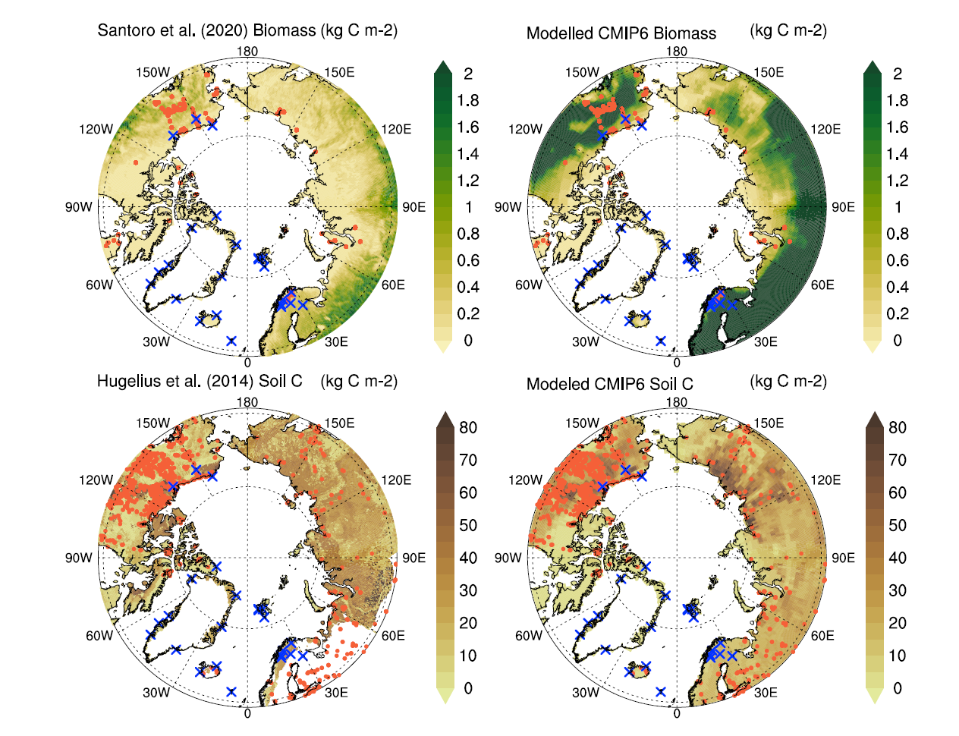
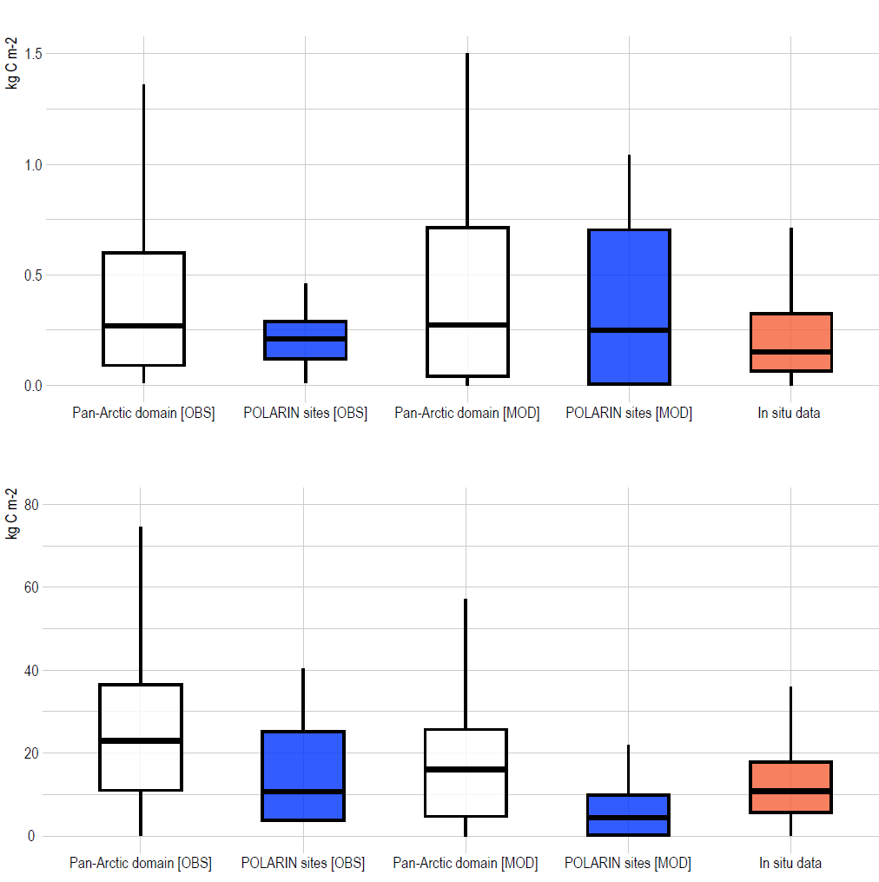
POLARIN research stations
Remote sensing
CMIP6 ESMs
In-situ observing sites
Remote sensing/models
Remote sensing
CMIP6 ESMs
In-situ
BIOMASS
Upscaled model
CMIP6 ESMs
In-situ
SOIL CARBON
Upscaled model
CMIP6 ESMs

Slide 37
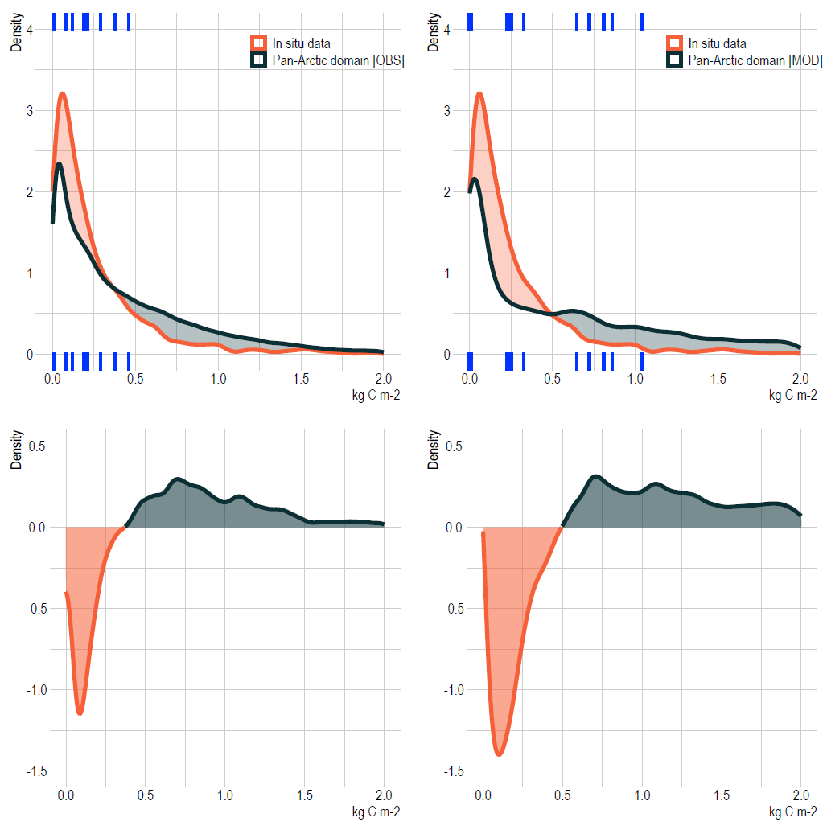
Remote sensing CMIP6 ESM
Above Ground Biomass
In-situ observing sites
Pan-arctic domain
Variable value for POLARIN station
Variable gap - Above Ground Biomass:
Remote sensing > c. 0.325 kgCm⁻²
CMIP6 ESM: > c. 0.5 kgCm⁻²
Stations that can fill a gap identified by:
Remote sensing:
Oulanka Research Station, Pallas-Sodankylä Research Stations
CMIP6 ESMs:
Western Arctic Research Center, Tarfala Research Station, Abisko Scientific Research Station, Oulanka Research Station, Kilpisjärvi Biological Stations, KEVO Research Station, Pallas-Sodankylä Research Stations, Toolik Field Station
POLARIN GA, 1-2 April 2025

Slide 38
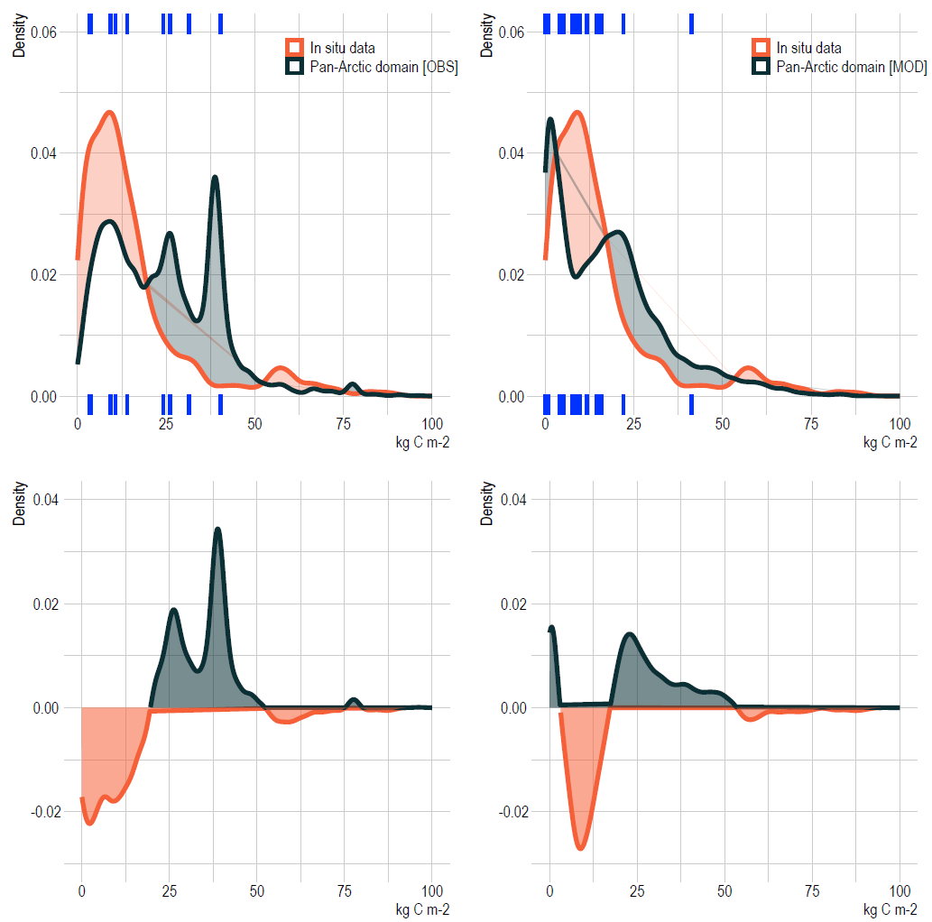
Upscaling product CMIP6 ESM
Soil Organic Carbon
In-situ observing sites
Pan-arctic domain
Variable value for POLARIN station
Variable gap - Soil Organic Carbon:
Data Upscaling Product: c. 20 – 52,5 kg C m-2.
CMIP6 ESM: < 5 kg C m-2 and c. 20 – 52,5 kg C m-2.
Stations that can fill a gap identified by:
Data upscaling Products:
Western Arctic Research Center, Tarfala Research Station, Abisko Scientific Research Station, Kevo Research Station, Arctic Station, Zackenberg Research Station
CMIP6 ESMs:
Western Arctic Research Center, Toolik Field Station
POLARIN GA, 1-2 April 2025

Slide 39
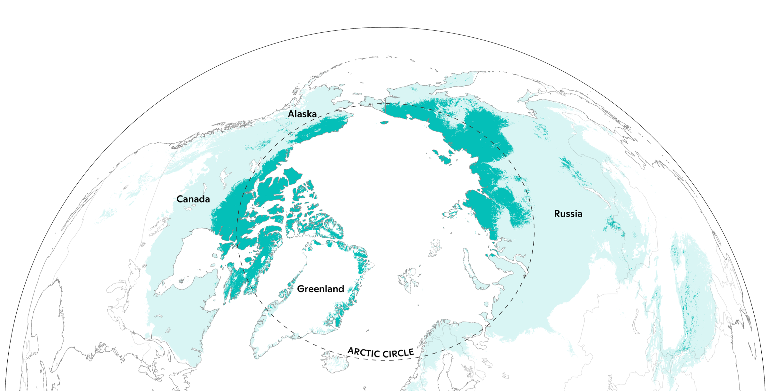
Upcoming tasks/deliverables
The analysis will be applied across other domains
  POLARIN Priorities
  Marine, Atmospheric
  Antarctic
Future perspective
The analytical framework can be scaled-up with
  Any model variables available (atmospheric, terrestrial, marine, ...)
  More CMIP6 ESMs to increase the robustness of the analysis and learn about uncertainties
Our approach can can inform:
  Station managers about ecologically/scientifically significant variables to monitor;
  Researchers about geographical gaps in monitoring efforts;
  Policymakers about geographical gaps in infrastructure and monitoring efforts.
POLARIN GA, 1-2 April 2025

Slide 40
Milestones and deliverables
2. Progress & Achievements (4)
D1.1 (CNRS), M5 Implementation of the SLP with Terms of Reference
D1.2 (IGOT-UL) M6 Report on procedure for provision of TA
D1.3 / M1.1 (OGS) M7 Description of the evaluation process, evaluation criteria, code of conduct, and guidelines and templates for external reviewers
D1.4 / M1.2 (CNRS) M8 Overview report of existing science priorities by major Arctic and Antarctic organisations and validation/calibration needs by in-situ observation, remote sensing and modelling communities

Slide 41
3. Challenges & Opportunities
Scientific Liaison Panel: Very successful in getting people from outside the consortium engaged in the process: highly motivated and involved SLP members, very efficient panel. But some under represented expertise in the panel due to late withdrawal of a few members
Proposal evaluation: Need to maintain a wide range of expertise among reviewers. Identifying external reviewers remains a challenge due to the large number of proposals.
Learning from the experience of the first call: Next calls may be easier to run now that people are acquainted with the technical (TA platform) and scientific aspects of the evaluation procedure. Some refinements to the evaluation procedure currently under discussion (debriefing meetings)

Slide 42
4. Next Steps
Planned activities for the next year
Finalise the assessment of first call for proposals
  Refine tools and graphic products to analyse TA projects for their contribution to the POLARIN key research challenges
  Identify POLARIN infrastructures that have filled geographical or thematic or validation/calibration knowledge gaps

Slide 43
4. Next Steps
Planned activities for the next year (cont.)
Prepare the 2nd call for proposals (to be launched Sept. 2025)
  Refine the scientific focus of the call based on the gap analysis in Task 1.3, the scientific outcome of the 1st call, inputs from SLP members, monitoring of international science strategies
  Complete the SLP expertise by adding 3 new members (non-affiliated to POLARIN partner orgnizations)
  Update the portfolio of available RI for the call. Promote opportunities for access to core repositories and multiple infrastructures (no selected projects from the 1st call).
  Refine some steps of the evaluation procedure : e.g. add a SLP reviewer to the watchdog for each proposal, …
  Implement possible changes in TAP (WP2)

Slide 44
4. Next Steps
Upcoming milestones and deliverables
D1.5 (AU), M12 Polar Knowledge gaps and potential of POLARIN RIs in addressing them → under review
D1.6 / M1.3 (OGS), M18 Selection report of the first call for proposals

Slide 45
5. Collaboration & Key Interactions
Strong coordination with WP2 (TA management)
Ongoing cooperation with WP4 (customised data products)
Need to develop collaborations with WP7 (training activities) for optimised use of POLARIN RI and project data
Need to develop collaboration with WP8 to ensure efficient showcase of POLARIN project outcomes

Slide 46
THANK YOU

