Slide 1






Work Package 4
Improvement of data services and customised data products
Antonio Novellino
ETT

Slide 2
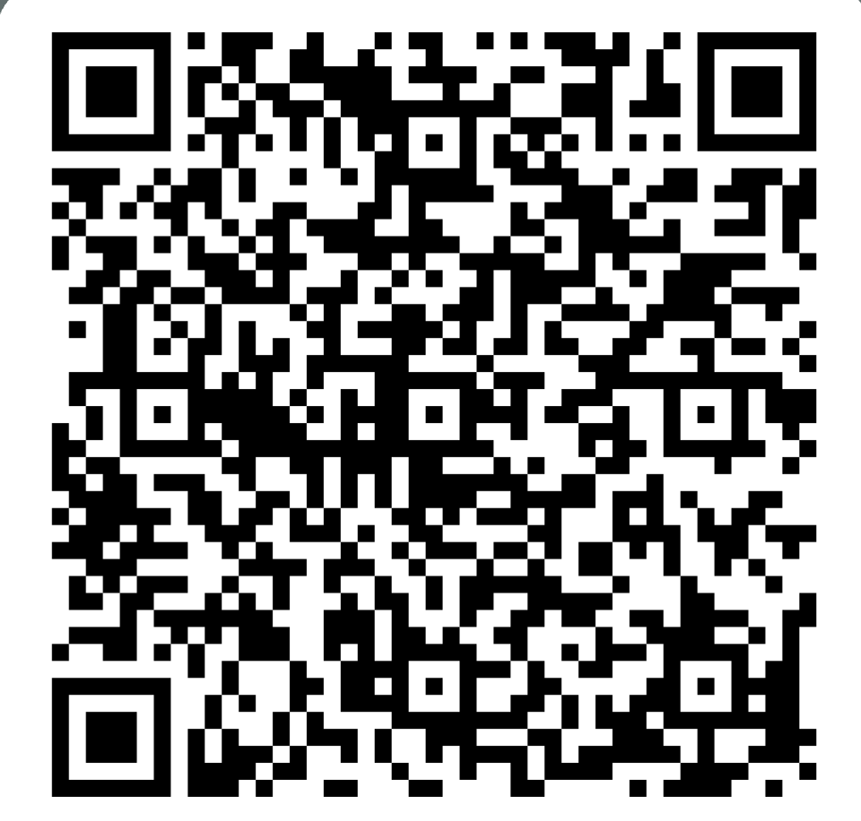
Let’s start with a couple of questions
results
https://forms.office.com/Pages/ResponsePage.aspx?id=1Fbxu_oz7k-G9iz8sTWe8IlXm6hyLctIikfOTbSiTjRUNEYzWTRVSFM3TUpXR0dGTVVOQlY2UlZTVS4u

Slide 3
1. Overview
Objectives
Facilitating the discovery and consumption of data by
1) ensuring databases, datasets and/or data initiatives from polar regions are identifiable
2) facilitating access to them,
3) improving workflows and reducing data Fragmentation,
4) making available tools to facilitate the access of data from multiple providers as well as data integration.

Slide 4
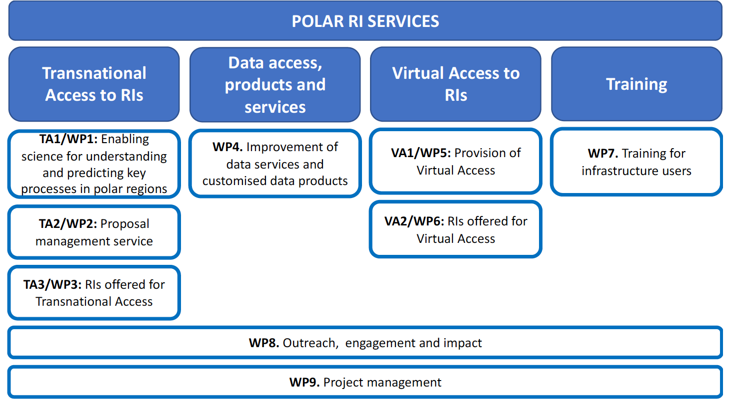
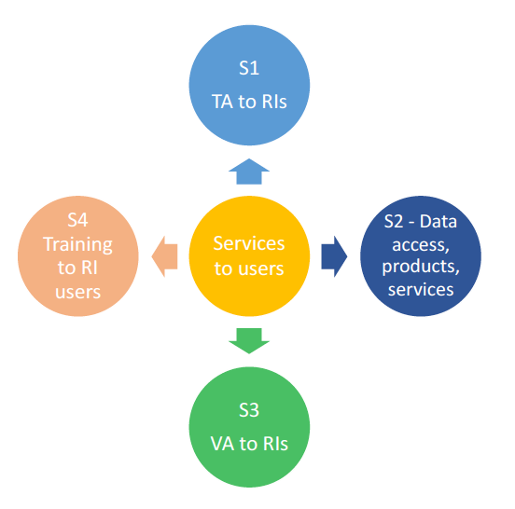
1. Overview
Specific WP4 objectives:
  Establish a web portal with workflow-based access to data for various data consumer communities.
  Provide data products and tools integrating data across data repositories.
  Making available M2M interfaces to include unified VA data catalogue
  Making available services for integration of VA data and for the challenge-driven call definition in TA1/WP1.

Slide 5
Ambition Beyond the State of Art
Data Services
improve access to polar data by harmonising data management standards and workflows covering the complete life cycle of data from acquisition to long-term archiving
[…]
data collected by the different RIs is still fragmented and there is a lack of workflows between data initiatives. […]. POLARIN will concentrate its efforts on improving the data landscape and the consumption of data
Virtual access
access to metadata, data and data services will be offered user-friendly and free of charge to users complying with the RI’s access policy, through a single-entry portal and without selecting them.
[…] data that is currently not publicly available will be made available through the project.
POLARIN will build a single-entry portal harvesting data from different RIs and making it available via the web portal.

Slide 6
1. Overview
Tasks
Task 4.1 Improving access to polar data (ETT, CNR)
to design/implement the Hub. Focus on general users
Task 4.2 Improving polar data availability and interoperability (CNR, AU)
to develop/implement tools services to improve accessibility, interoperability, data integration
Task 4.3 Data products, tools and data services (SIOS, NILU)
to develop/implement data products and services for specific identified topics

Slide 7
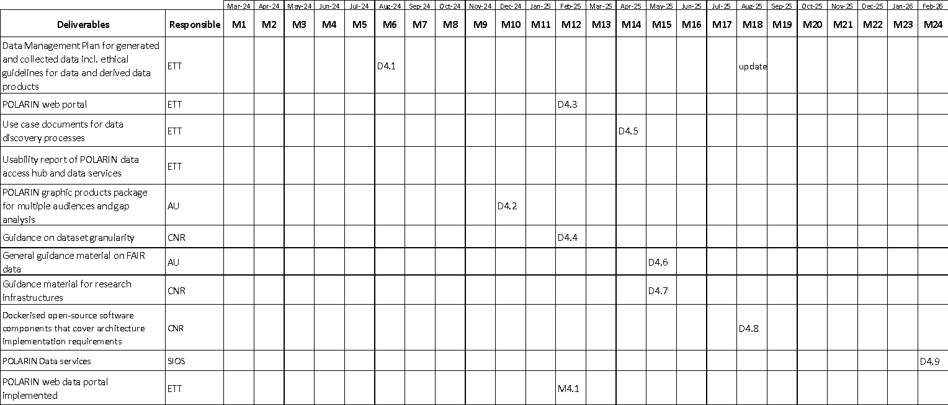
1. Overview

Slide 8
1. Overview
Deliverables
D4.1 – Data Management Plan for generated and collected data incl. ethical guidelines for data and derived data products(*) (ETT)
D4.2 – POLARIN graphic products package for multiple audiences and gap analysis (AU)
D4.3 – POLARIN web data portal (ETT)
D4.3 – POLARIN data portal, preliminary design of the POLARIN Data hub and its features (ETT)
D4.4 – Guidance on dataset granularity (CNR)
M4.1 – POLARIN web data portal implemented (ETT) (April 2025)
D4.5 – (ETT) (April 2025)
D4.6 – General guidance material on FAIR data (AU) (May 2025)
D4.7 – Guidance material for research infrastructures (CNR) (May 2025)
D4.8 - Dockerised open-source software components that cover architecture implementation requirements (CNR) (August 2025)
D4.9 - POLARIN graphic products package for multiple audiences and gap analysis (AU) (Feb 2026)
(out of 15 deliverables)

Slide 9
2. Progress & Achievements
Approach
Data Management Plan
  Data Management Handbook developed
Strategy to populate POLARIN services from polar data landscape
Gap and needs analysis (broad audience)
  partners + RIs (SIOS, INTERACT, ISAFFIK, ACTRIS) + network SAON/IASC, SCADM, SOOS and IARPC, Arctic PASSION, …
Open science developments
  standards, open tools, open sw, …
sharing tools and tools for sharing developments
  ERDDAP, GeoNetwork, …, ZENODO, github
Agile approach (develop, deploy, test, update, …)

Slide 10
2. Data Management Plan
Mandatory Open Science Principles:
Projects must include a DMP from the start and periodically updated
Stronger Emphasis on FAIR Data:
More rigorous application of FAIR principles across projects
Stakeholders for «Ocean» projects:
EMODnet, Copernicus Marine Serevice, EOSC, EU DTO
Data Access and Sharing Obligations:
Open by Default:
Data from Horizon Europe projects need to be openly accessible, unless justified otherwise
(metadata CC0, data CC-BY) –
as open as possible, as closed as necessary
Enhanced Transparency:
Focus on real-time data availability and public access
Security and Ethical Concerns:
Required to justify any restrictions on data access

Slide 11
2. Data management Plan
DMP submitted as a public deliverable (open access and CC-BY)
All partners are committed to DMP → Data (especially new data) should be made available into a trusted repository
sets framework for TA DMP
It’s dynamic and keeps tracking state of art and adopted solutions
Each version provides a snapshot on how the project deals with open data, open science, ethics, resources for implementing data sharing, recommendations

Slide 12
2. DMP and FAIR
Findable: Each dataset is linked to persistent identifiers and detailed metadata, including origin, context, and usage
  Metadata and data are registered in accessible repositories : Zenodo
Accessible: Data is available via standardized, secure protocols, with authentication and authorization measures if needed
  Open Access: Data is published under CC BY licenses, and metadata under CC0
Interoperable: Use of standardized languages and controlled vocabularies (e.g., ISO) to facilitate integration with other resources and cross-project collaboration
Reusable: Data must include comprehensive metadata and detailed documentation to ensure reusability by the scientific community
  Clear licensing and well-documented provenance to ensure reproducibility

Slide 13
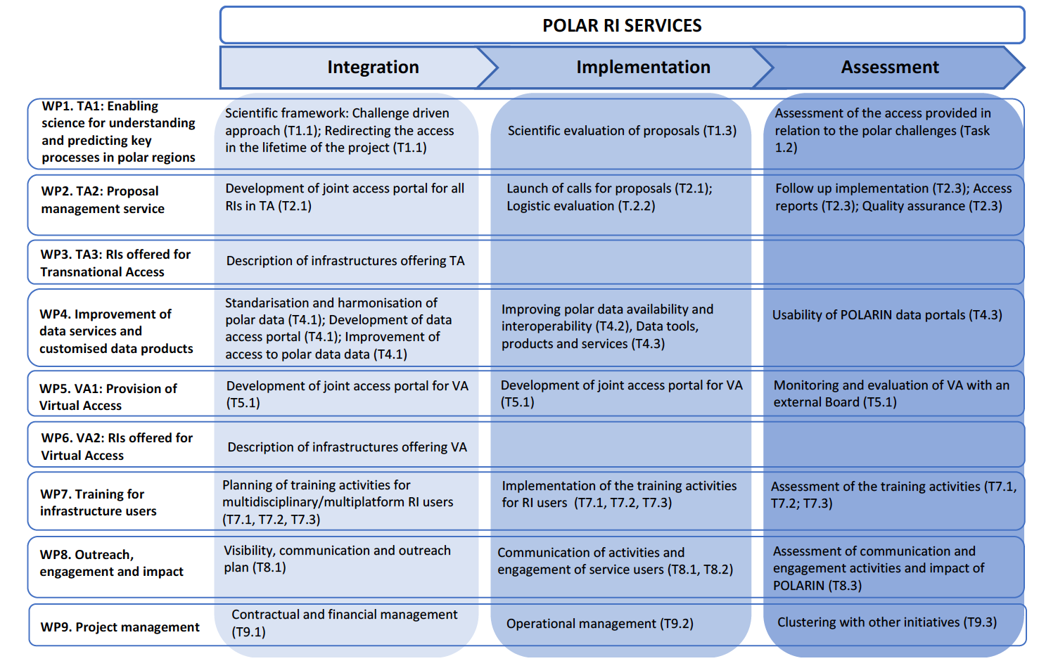

Slide 14
2. Progress & Achievements
POLARIN DATA HUB
Data Catalog
VA
Data access and preview
GeoViewer/ WebGIS*
Data products / Data processing templates
AI tools
Interoperability services – M2M and APIs
RI DBs and Data Repositories
Polar Data Repositories
POLARIN Zenodo*

Slide 15
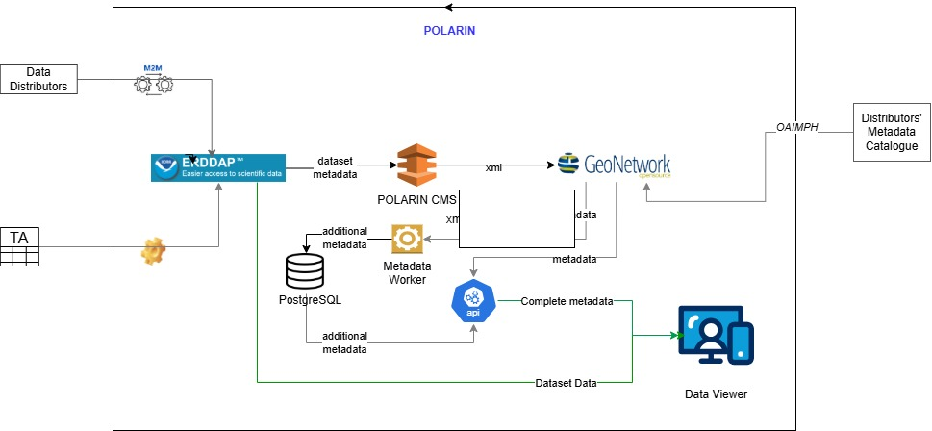
2. Progress & Achievements
POLARIN DATA HUB
1 VM: 49.13.162.149 2.10GHz processing power, 8 cores,
16GB RAM,
running on Ubuntu with 500GB disk

Slide 16
2. Progress & Achievements
DATA CATALOGUE
(meta)data Owner
1. Accesses and collects
(meta)data Publisher
(meta)data Distributor
RI
POLARIN DP
2. Process, analyzes and release

Slide 17
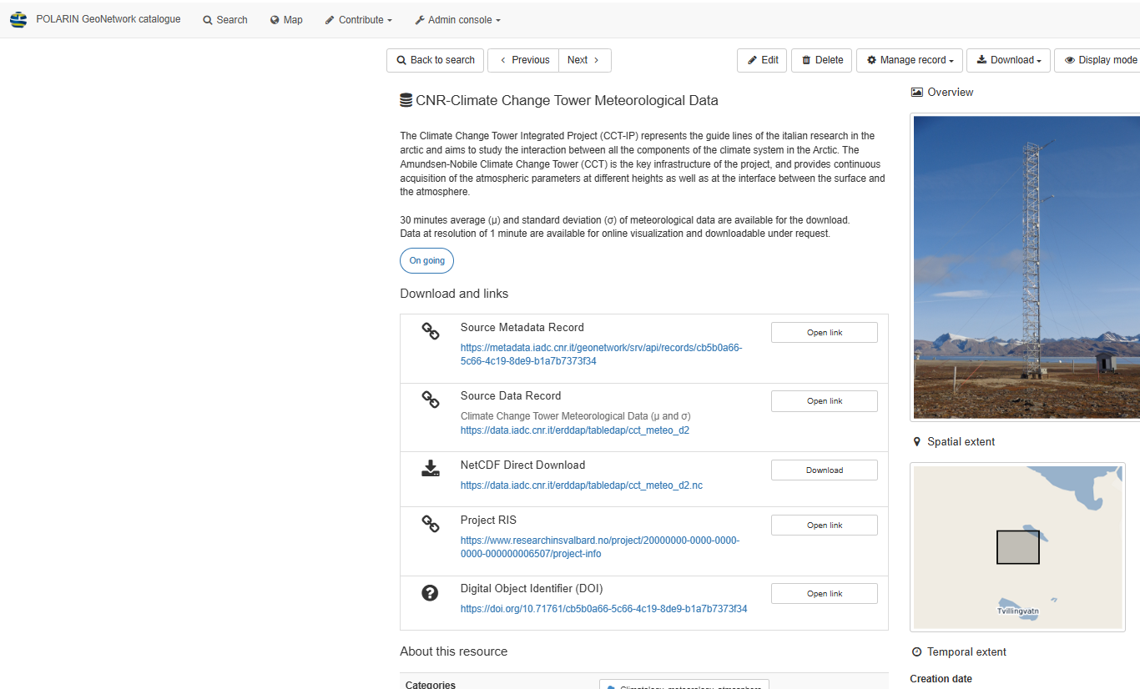
2. Progress & Achievements
DATA CATALOGUE
https://s4polarin.eu/demo/data-catalog
GeoNetWork:
  CNR-IADC (123)
  CNR-NADC (66+308)
  CAFF-ABDS (waiting)
  SIOS-SDMS (waiting)
  INPA/INKODE-IDP (in progress)
  AWI-PANGAEA (in progress)
  H2020-ARICE (287) (primary source PANGAEA)
  NPI-SVERDRUP, NPI-TROLL, NPI-HAAKON (467) (via NPDC)
ERDDAP:
  H2020 ARICE - AWI (203)
  CNR NADC/IADC (12+3+20+2+2)
POLARIN Catalogue
POLARIN Geonetwork*
CNR ISP Geonetwork
https://geonetwork.s4polarin.eu/geonetwork/srv/eng/catalog.search#/home

Slide 18
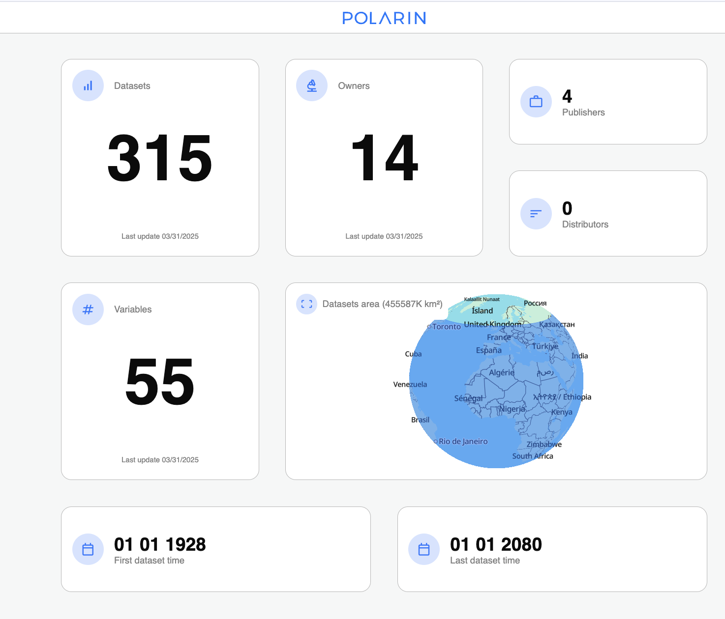
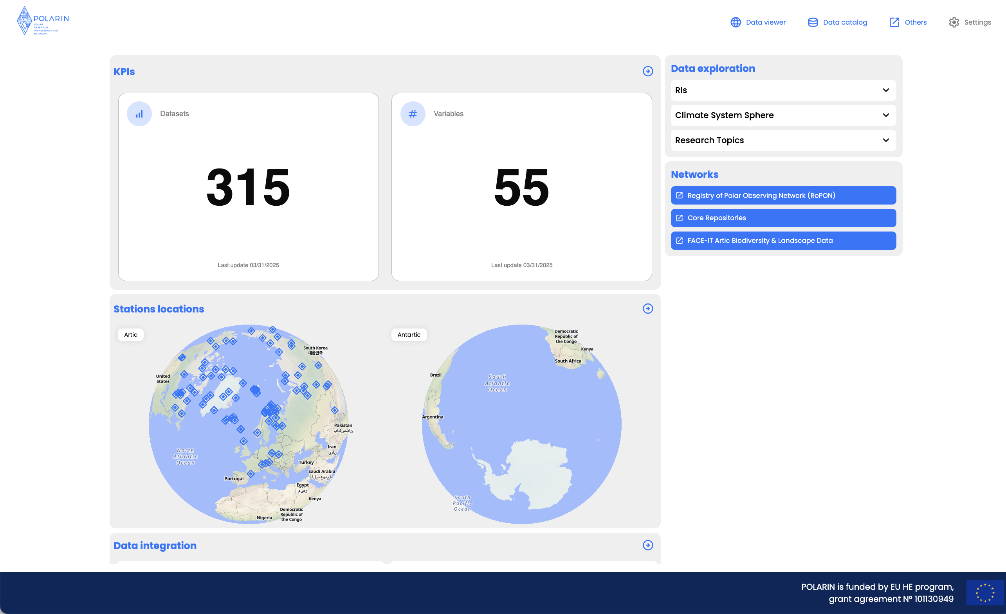
2. Progress & Achievements
DATA ACCESS AND PREVIEW
https://s4polarin.eu/#/

Slide 19
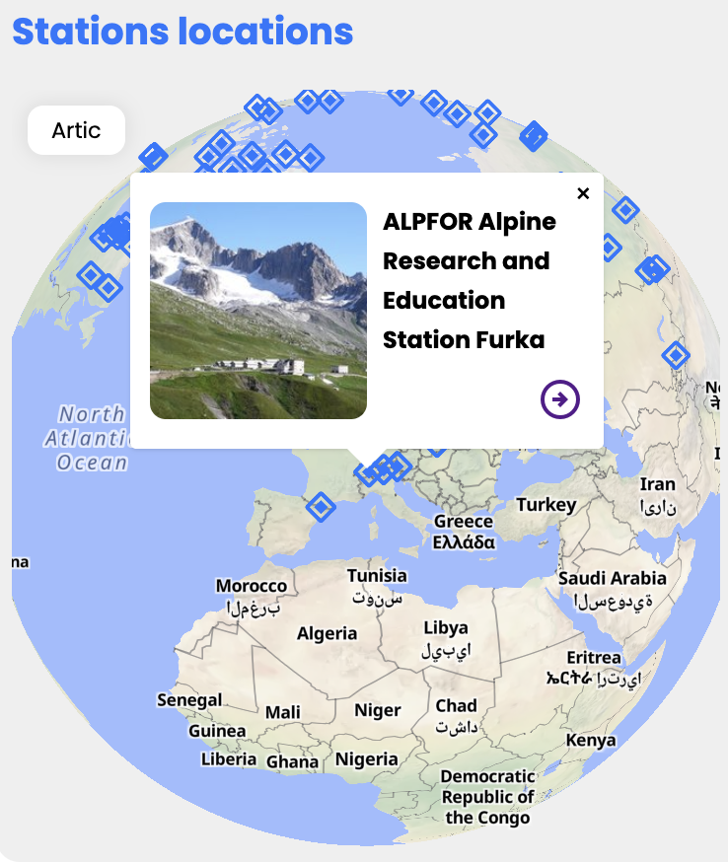
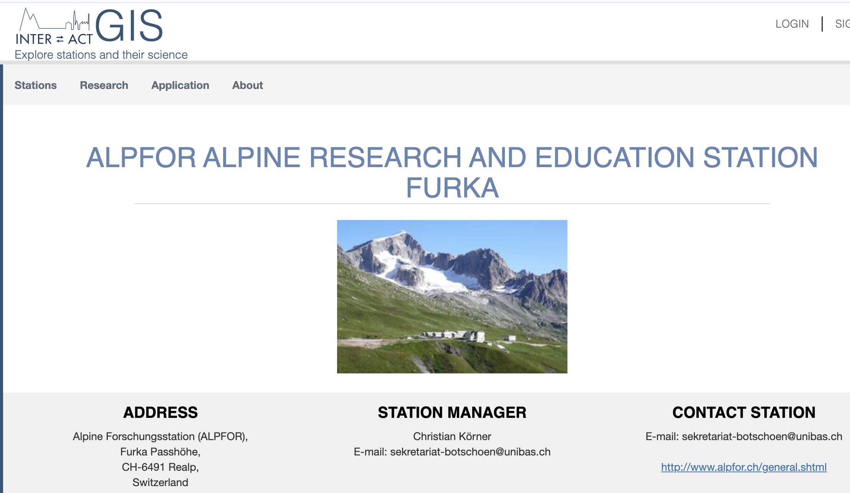
2. Progress & Achievements
DATA ACCESS AND PREVIEW
https://s4polarin.eu/#/

Slide 20
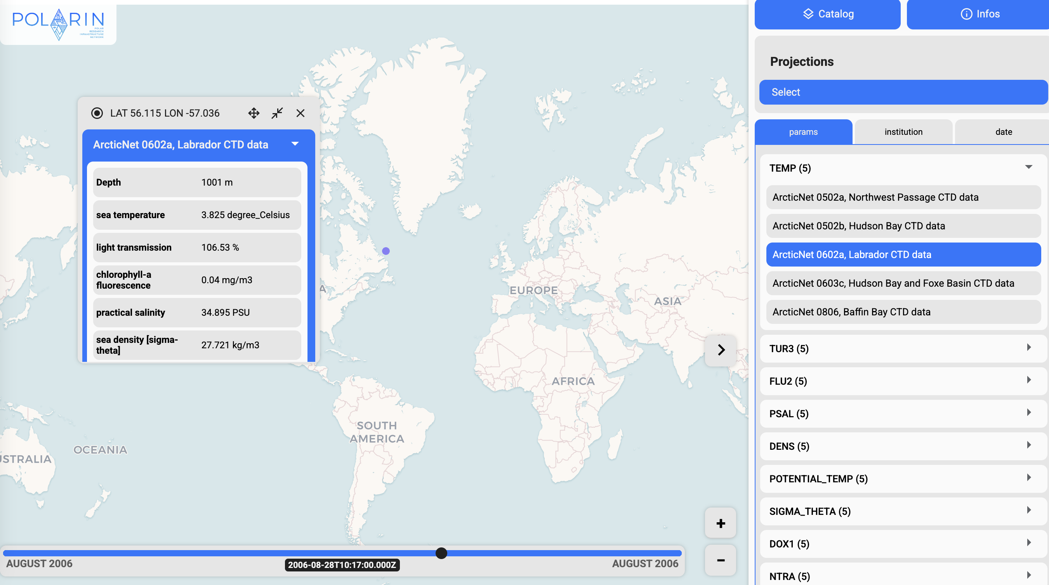
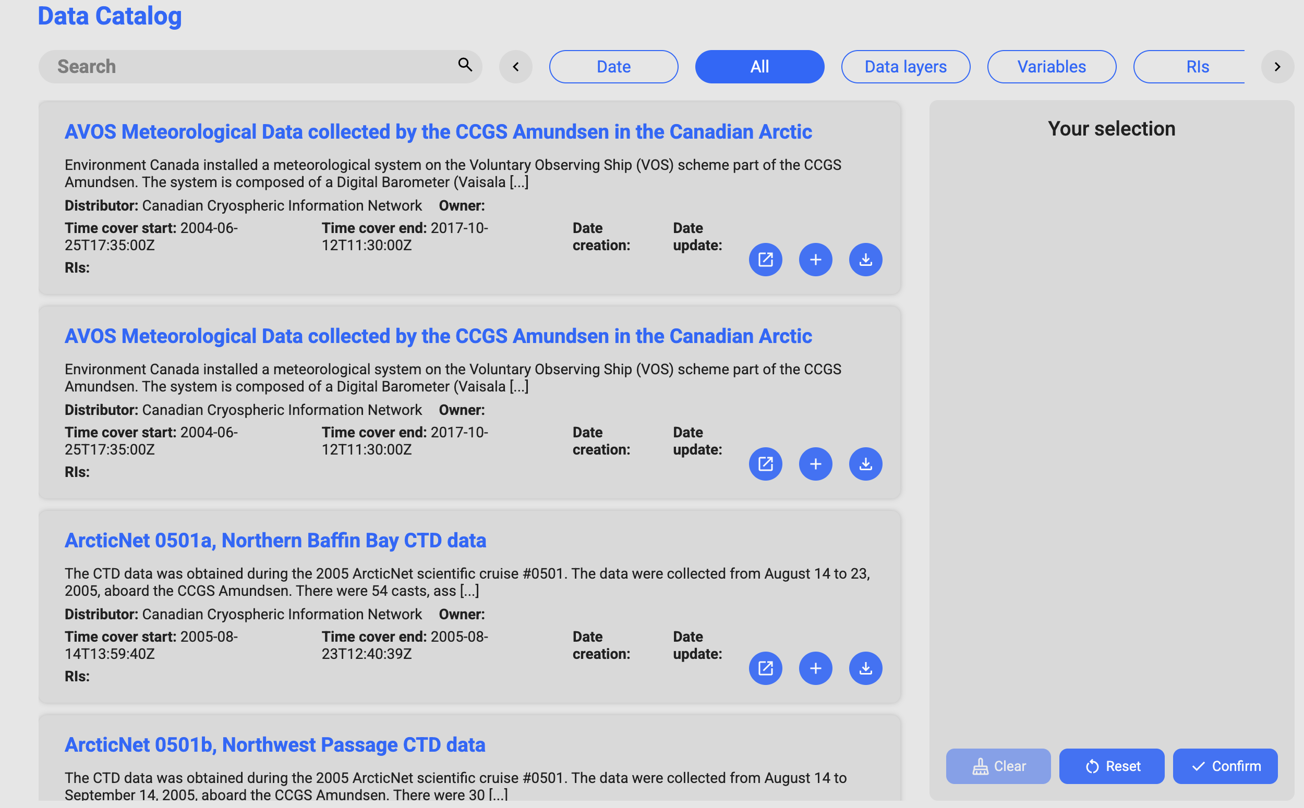
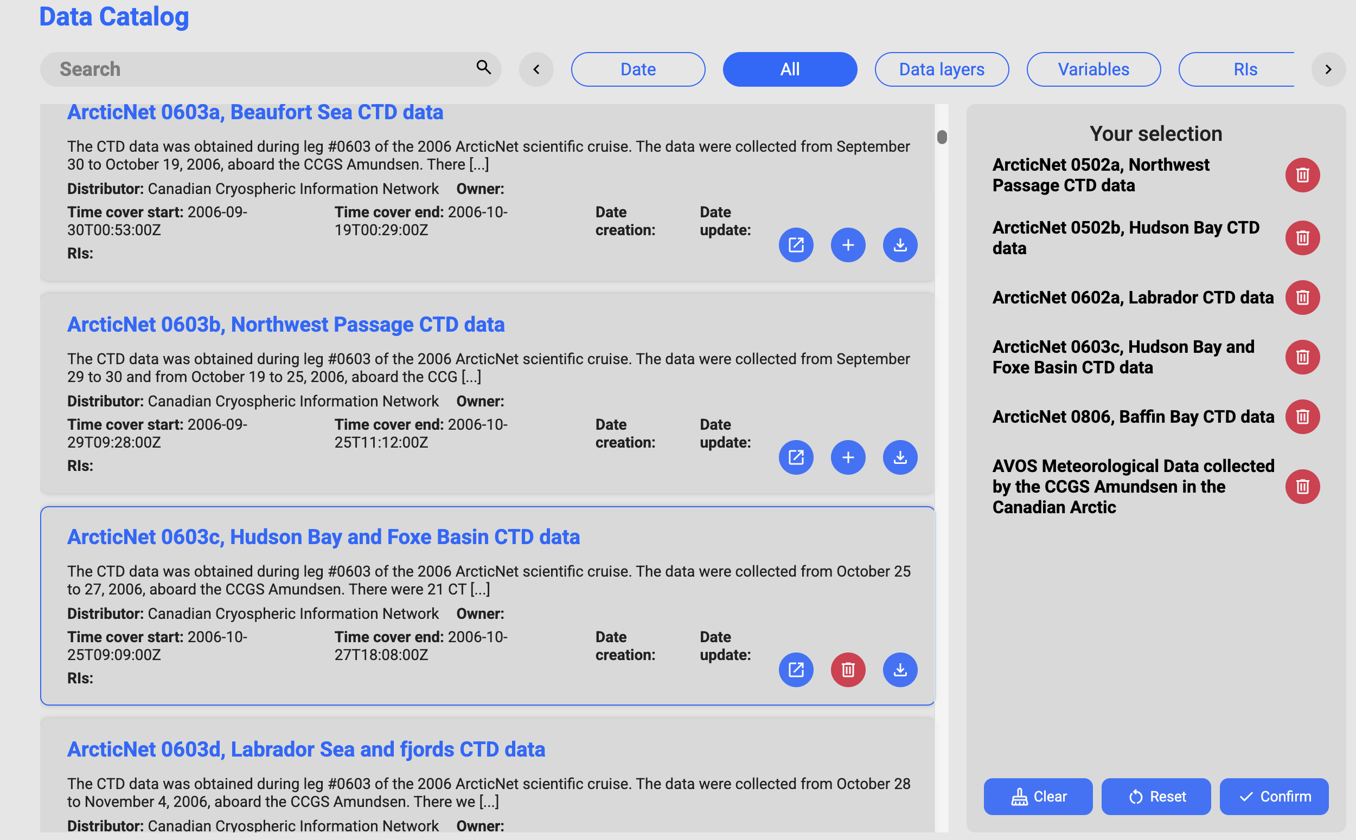
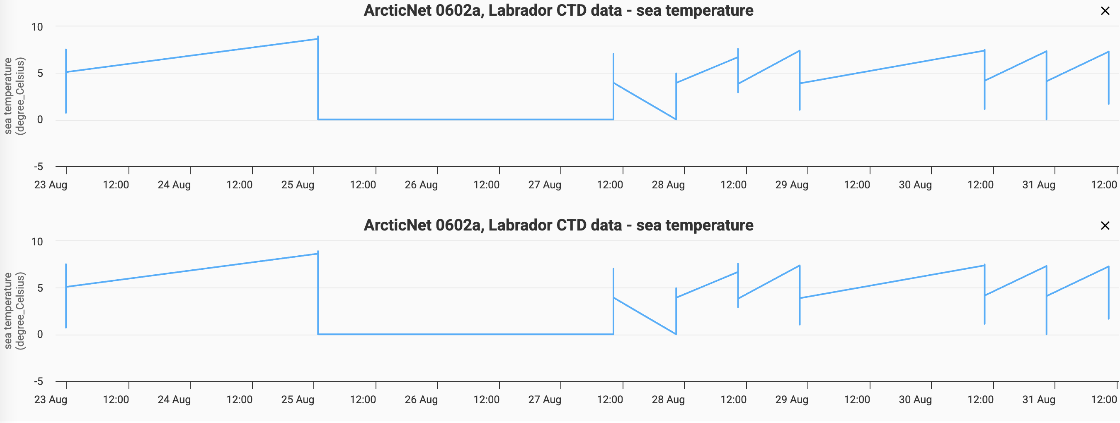
2. Progress & Achievements
DATA ACCESS AND PREVIEW
https://s4polarin.eu/#/

Slide 21
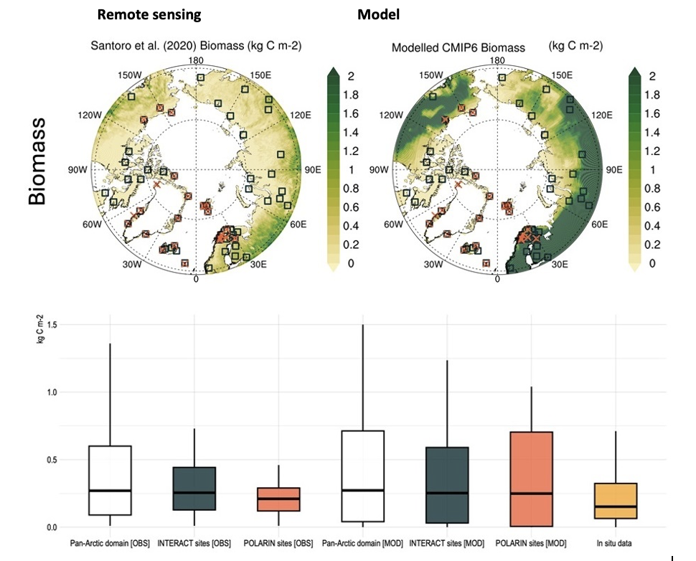
2. Progress & Achievements
DATA PRODUCTS
Vegetation biomass changes can indicate shifts in climate patterns. For example, increased biomass might suggest warming temperatures, which can lead to greening that impact habitat suitability for various species. Vegetation also plays a crucial role in the carbon cycle by absorbing carbon dioxide during photosynthesis. Monitoring biomass helps scientists understand how much carbon is being sequestered in polar regions and how changes in vegetation affect global carbon dynamics.
Variable: Above Ground Biomass - kgCm-2
Key insights: Remote sensing (OBS) and modelling (MOD) show similar average for Above Ground Biomass, but with higher variability in the model data.
POLARIN infrastructure locations (pink) also show similar averages but lower variability. In-situ observations (orange) have lower average and lower variability indicating that the data se could be underrepresented in areas with high Above Ground Biomass

Slide 22
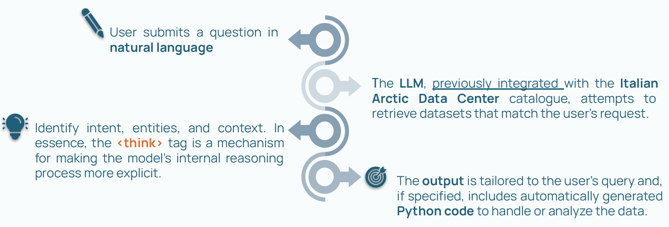
2. Progress & Achievements
AI TOOLS
Natural language query to data retrieval (preliminary res from CNR)
Adapted from: Cavaliere et al., ICARP IV, 2025

Slide 23
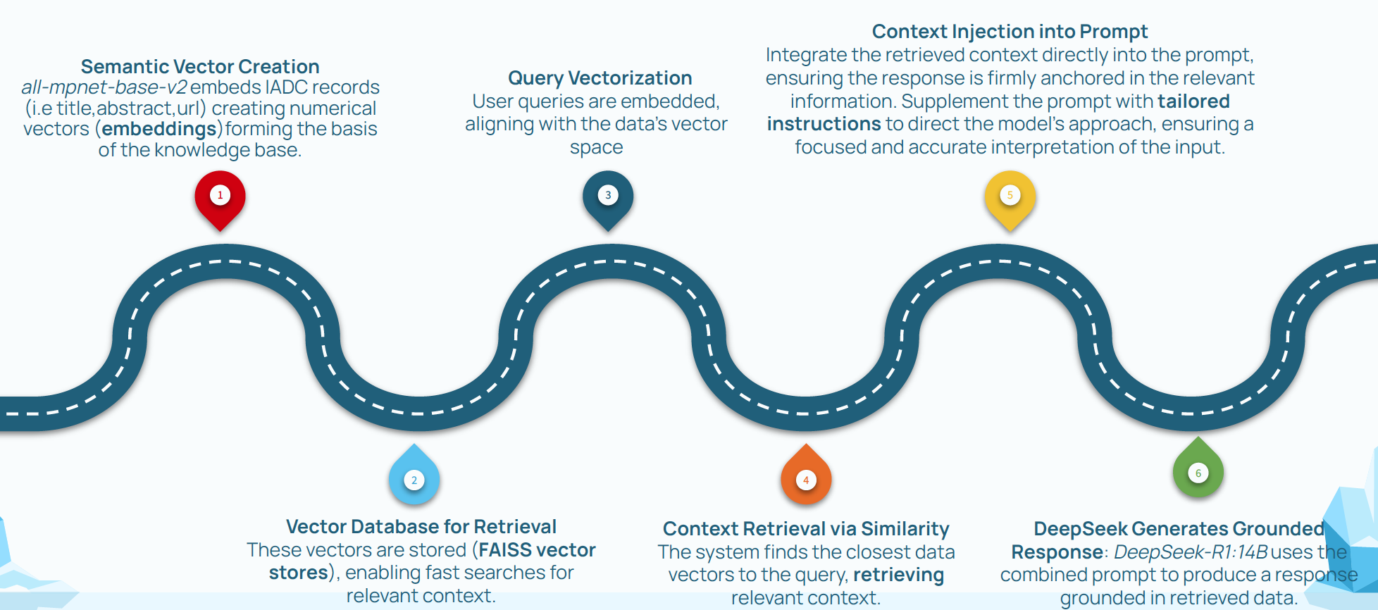
2. Progress & Achievements
AI TOOLS
Roadmap to Retrieval-Augmented Generation (RAG)

Slide 24
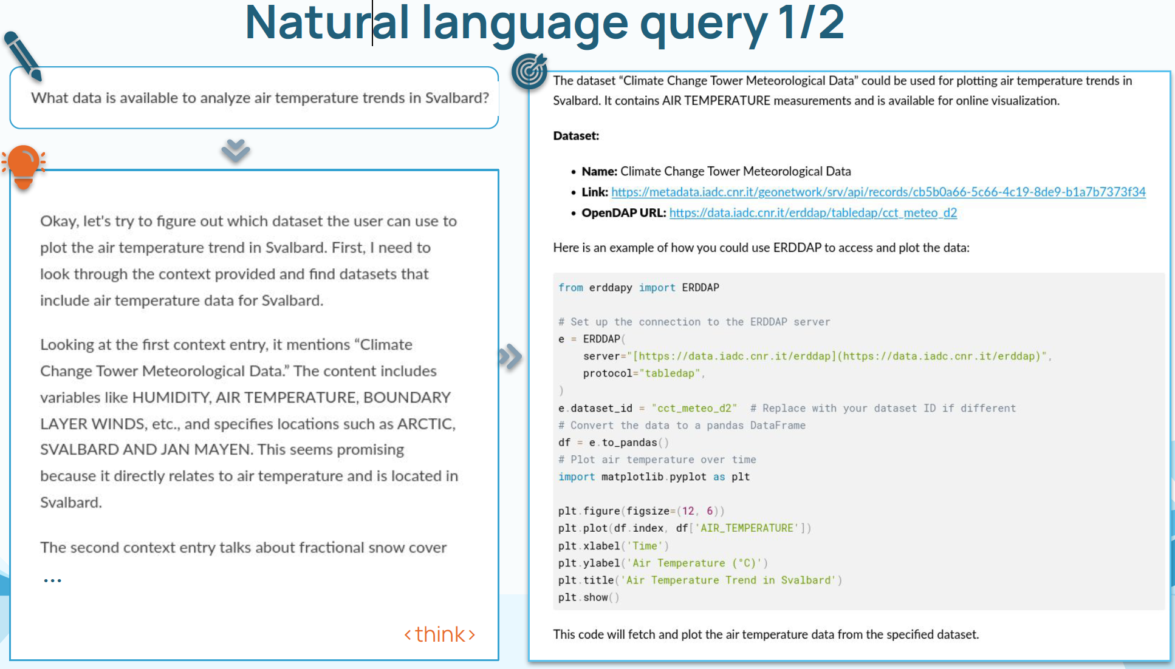
2. Progress & Achievements
AI TOOLS
Roadmap to Retrieval-Augmented Generation (RAG)
Adapted from: Cavaliere et al., ICARP IV, 2025

Slide 25
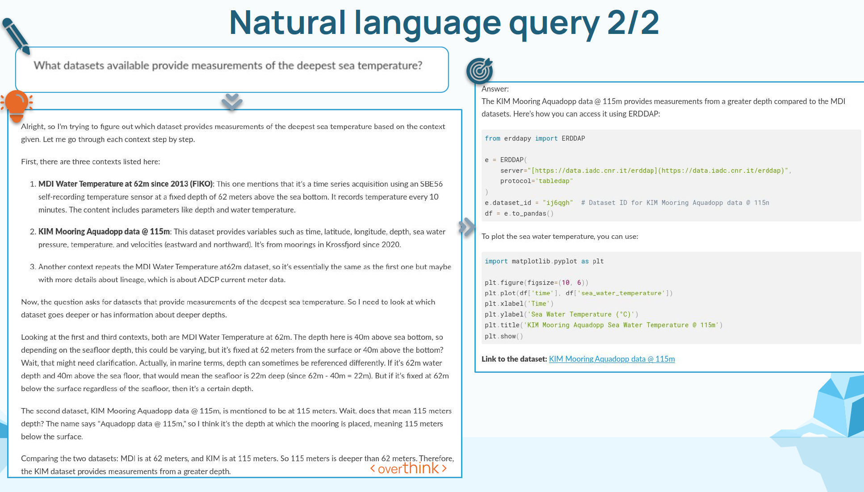
2. Progress & Achievements
AI TOOLS
Roadmap to Retrieval-Augmented Generation (RAG)
Adapted from: Cavaliere et al., ICARP IV, 2025

Slide 26
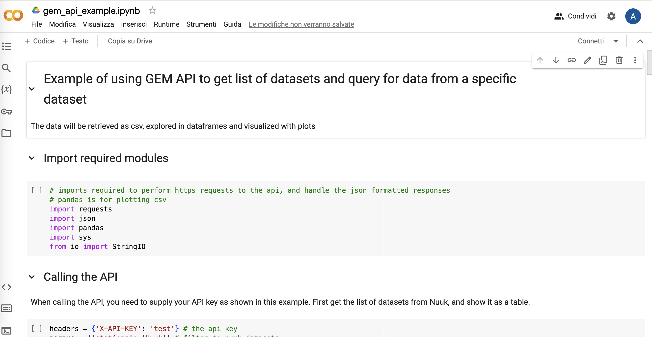
2. Progress & Achievements
DATA PROCESSING TEMPLATES
Jupyler notebooks (not yet available)
Github (currently open to WP4-WP5 only)

Slide 27
2. Progress & Achievements
ZENODO
ZENODO community created (200 Gb)
Guidelines to upload research outputs to ZENODO developed
ZENODO POLARIN community for:
Deliverables* (ZENODO manages versions**)
Official dissemination material (newsletters, policy-brief, …)
TA data projects (if/whenever needed)
Complementary repository for code/cookbook/etc.
* approved – under discussion how/when publish the versions (e.g. DMP)
** https://help.zenodo.org/docs/deposit/manage-versions/

Slide 28
2. ZENODO and CORDIS
CORDIS is a EC tool to access comprehensive nformation about EU RTD + has a page for each EU RTD proj
POLARIN: https://cordis.europa.eu/project/id/101130949
POLARIN outcomes should have a DOI (and should award EU funding)
CORDIS federates information from Open Access Infrastructure for Research in Europe systems
ZENODO is an Open Access Infrastructure for Research in Europe and provides DOI
POLARIN has a community under ZENODO
POLARIN community was awarded as EU Open Research Repository Pilot (up to 200GB per digital item)

Slide 29
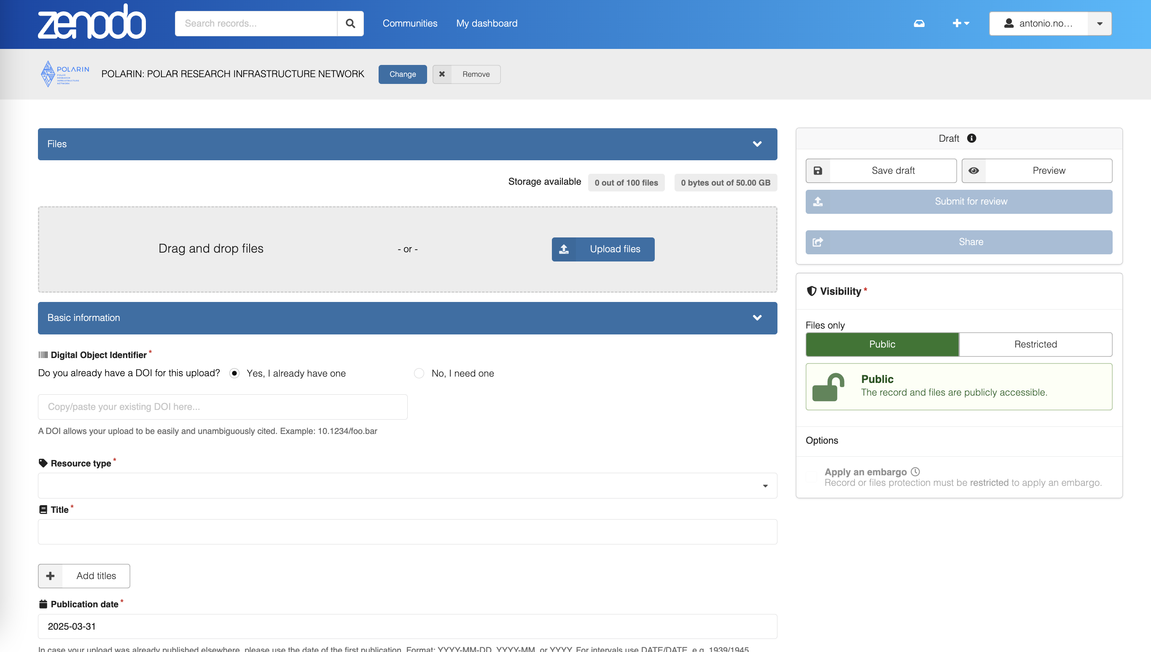
2. How to ZENODO
https://zenodo.org/communities/eu-polarin
if DOI exists add here!

Slide 30
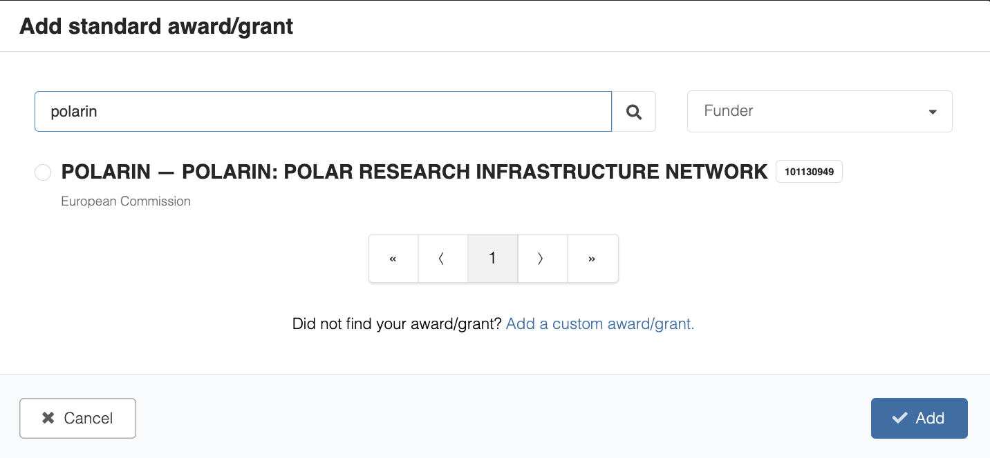
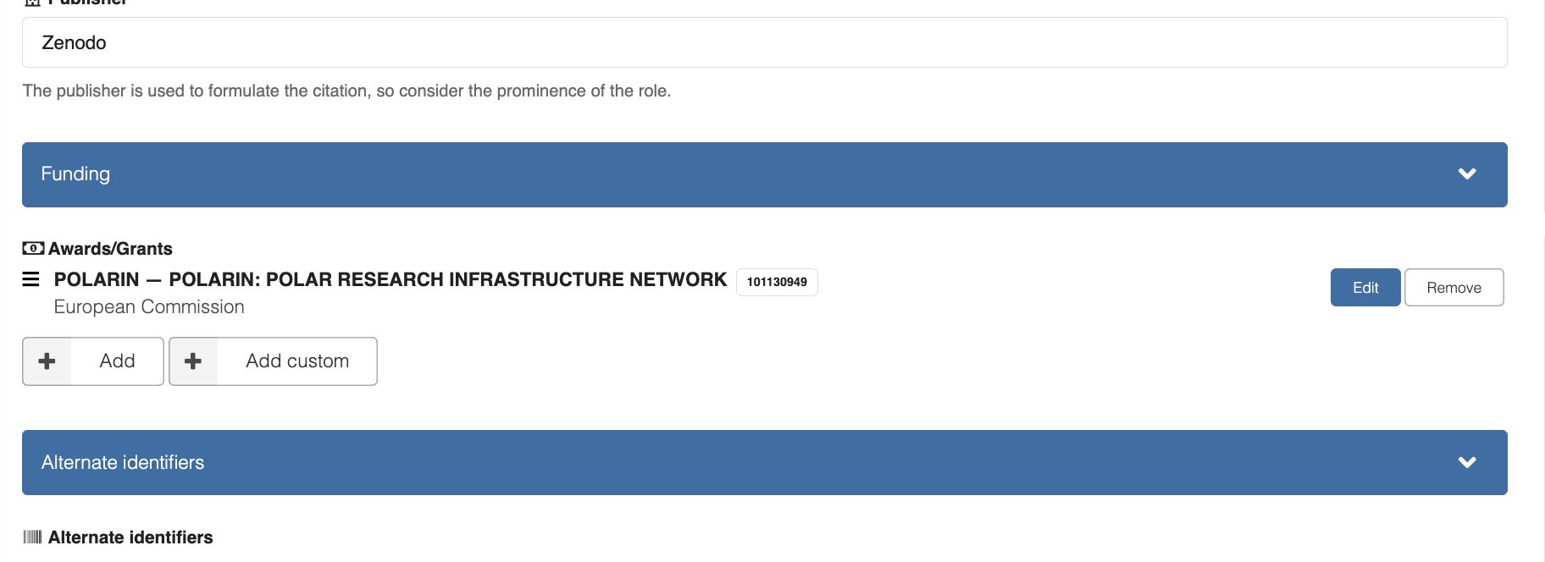
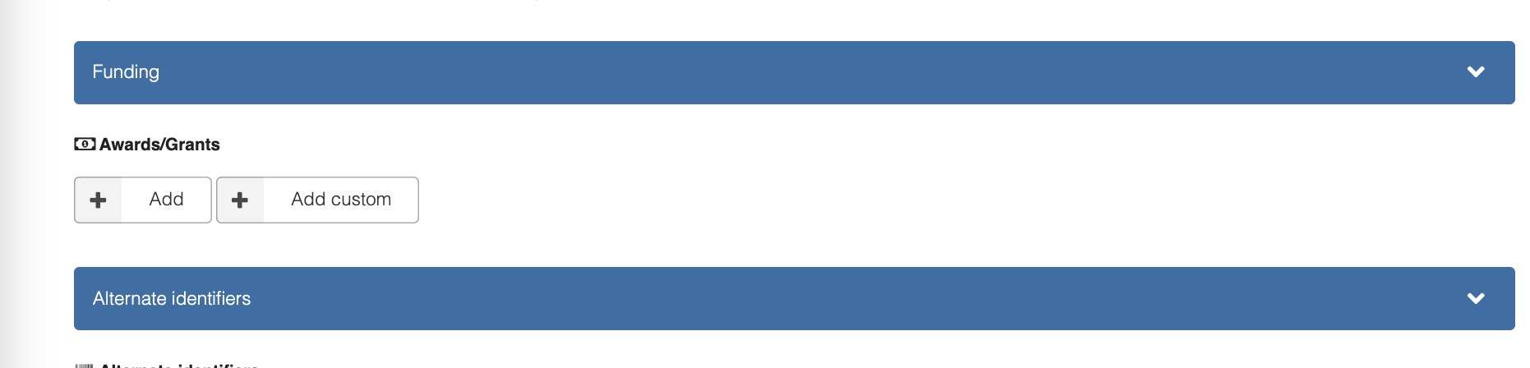
2. How to ZENODO
https://zenodo.org/communities/eu-polarin
id → 101130949!!!
101130949

Slide 31
3. Challenges & Opportunities
(if needed)
Main challenges encountered (framed constructively)
Strategies or solutions to address these
Opportunities for improvement or innovation

Slide 32
3. Challenges & Opportunities
metadata definition and harmonization (not yet finished)
design and developments longer than supposed
new requirements (Commission, Stakeholders, …)

Slide 33
4. Next Steps
Objectives
Build a web portal solution together with WP5
Keep linking data and updating tools
Support WP2 (TA DMP)
Support WP7 training

Slide 34
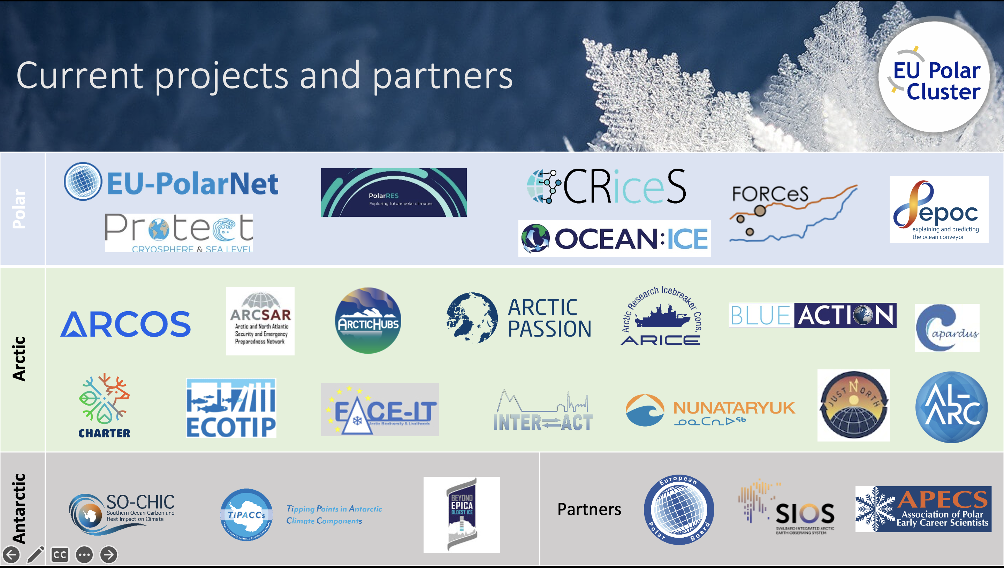
5. Collaboration & Key Interactions
O1: Enabling science for understanding and predicting key processes in polar regions
[…]
Identification of current knowledge gaps
[..]
O2: Provide efficient challenge-driven transnational access (TA) to top level research infrastructures in the polar regions
[…]
Integrated proposal management platform for POLARIN RIs.
Amount of TA to polar RIs
O3: Improvement of data services and data products
[...]
Inventory of databases from polar regions.
Identification of workflows to improve interoperability among databases.
Creation of tools to facilitate the consumption of data.
Customised data products (e.g., atmospheric distribution of black carbon).
Customised data services (e.g., calibration/validation service for earth observation data).
O4: Provide virtual access (VA) to research infrastructures
[…]
A unified semantically consistent virtual data catalogue with machine interfaces.
A web portal providing guidance documentation and a graphical user interface to the virtual data catalogue.
Amount of VA to polar RIs, data infrastructures and data services.
Amount of data downloaded from the POLARIN data hub.
O5: Training for infrastructure users
[...]
Training resources, recordings of online seminars and other training materials.
[…]
O6: Advertise RI services and engage RI users

Slide 35
6. Recap
DMP and deliverables on track
POLARIN DH under development
  Geonetwork: https://geonetwork.s4polarin.eu/geonetwork/
  ERDDAP: erddap.s4polarin.eu/erddap
  ZENODO community: https://zenodo.org/communities/eu-polarin/
  Geooviewer → POLARIN Data Hub: https://s4polarin.eu
need support to keep mapping/listing resources
good level of networking and synergies (intra/extra prj)

Slide 36
6. Discussion Points
IF NEEDED
Open questions or feedback required from the General Assembly
Decisions to be made
Key takeaways for WP members and stakeholders

Slide 37


Contact Us
Antonio Novellino: antonio.novellino@dedagroup.it
Vito Vitale:
vito.vitale@cnr.it

