Slide 1

WP5 – Provision of virtual access
Daan Kivits
SIOS-KC
www.eu-polarin.eu
POLARIN 2nd General Assembly
1-2 April, 2025

Slide 2
1. Objectives
Brief overview of the WP goals, Key areas of focus
Contractual
Financial
Operational
Strategic
Management

Slide 3
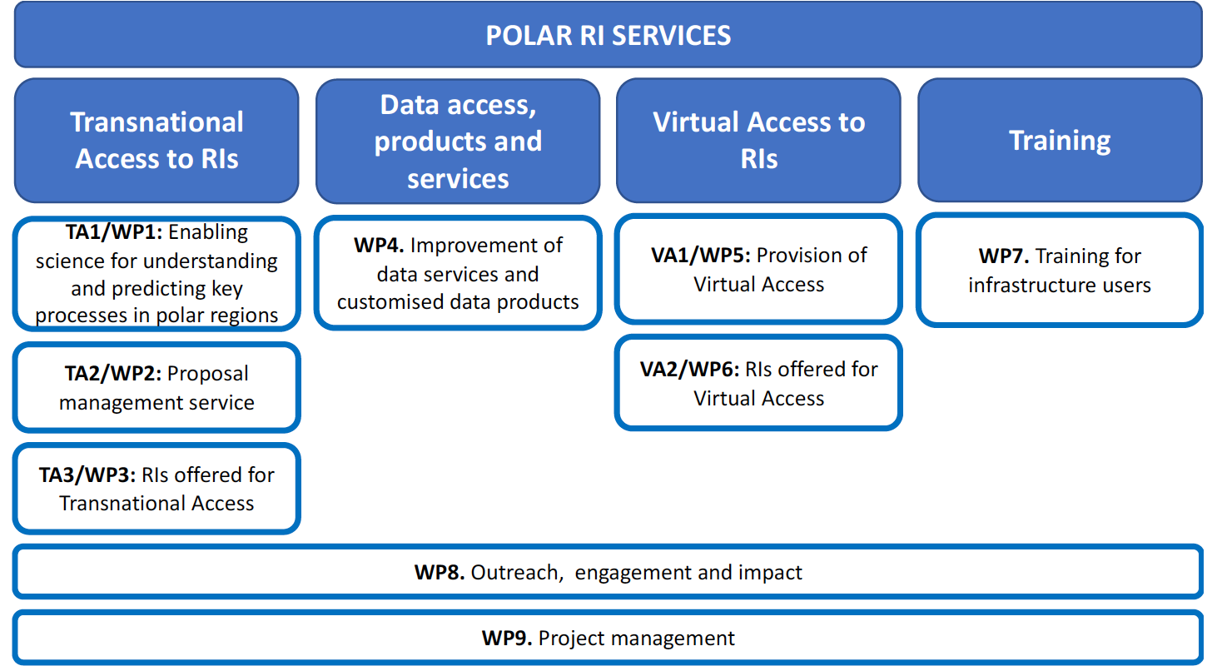
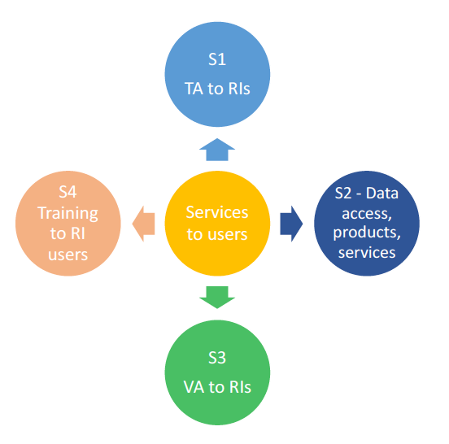
1. Overview

Slide 4
1. Overview
Objectives
Establish a unified virtual data catalogue giving access to data from all POLARIN RIs offering VA
Providing backend functionality for Work Package (WP) 4
Enabling brokering of regional European and Polar data management frameworks at discovery level
Build a web portal solution together with WP4
Monitor the virtual access of connected infrastructures
Address the current status of data availability and interoperability of POLARIN RIs offering VA

Slide 5
1. Overview
Tasks
Task 5.1 Development of a virtual access portal (SIOS, ETT, INKODE) (M1-M24)
Task 5.2 Monitoring and evaluation of the virtual access (CNR, SIOS, INPA) (M13-M60)

Slide 6
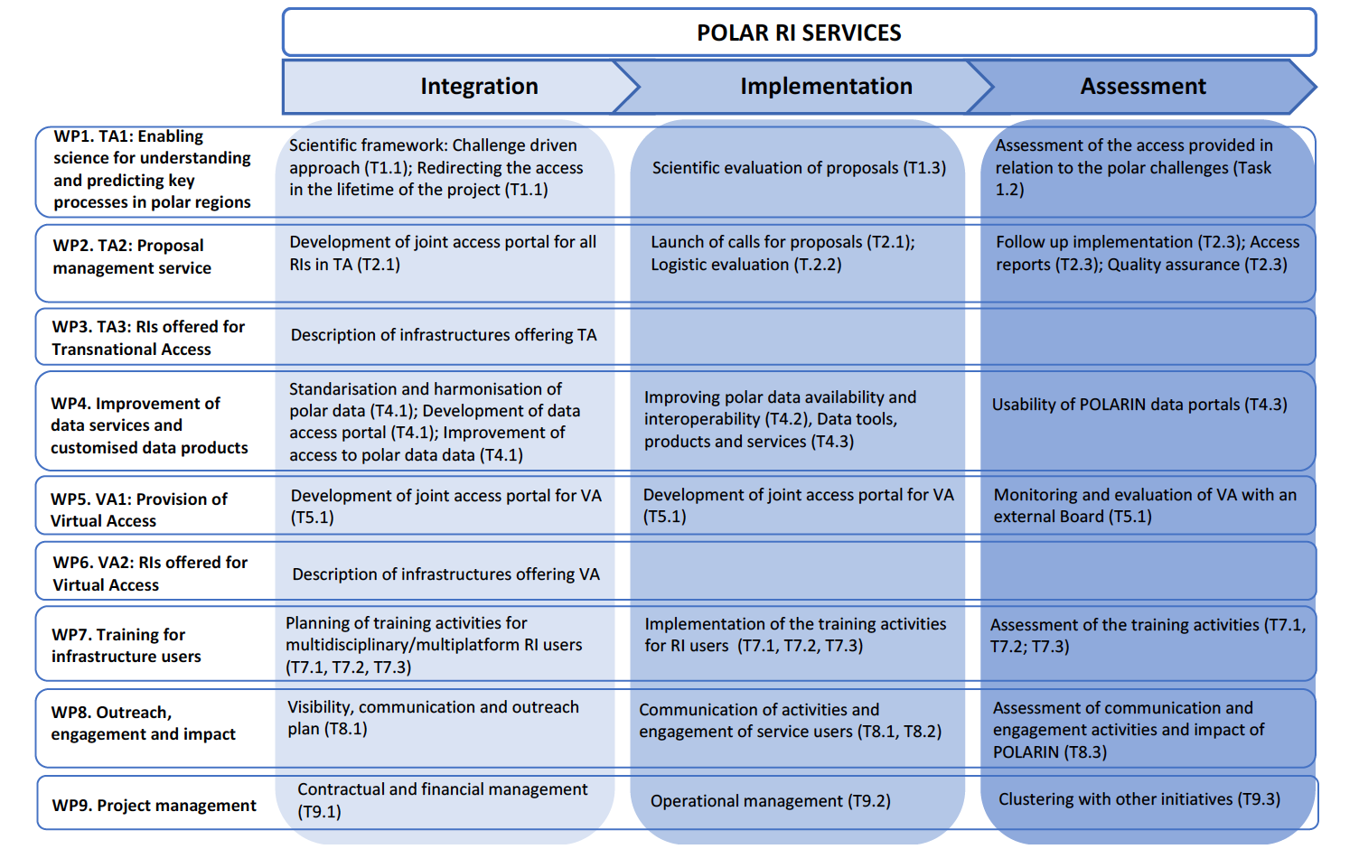
1. Overview

Slide 7
1. Overview
Deliverables
D5.1 – A unified semantically consistent virtual data catalogue with machine interfaces (SIOS) (M12 or March 2025)
D5.2 – POLARIN Data Hub – guidance and interfaces to access to data and virtual data catalogue (ETT) (M18 or September 2025)
D5.3 – VA Assessment Report (I) (CNR) (M24 or March 2026)
D5.4 – VA Assessment Report (II) (CNR) (M40 or July 2027)
D5.5 – VA Assessment Report (III) (CNR) (M55 or October 2028)

Slide 8
1. Overview
Milestones
M10 - Machine interfaces to catalogue established (SIOS) (M14)
M11 - VA portal established (ETT) (M18)

Slide 9
2. Progress & Achievements
Objectives
Establish a unified virtual data catalogue giving access to data from all POLARIN RIs offering VA
Providing backend functionality for Work Package (WP) 4
Enabling brokering of regional European and Polar data management frameworks at discovery level
Build a web portal solution together with WP4
Monitor the virtual access of connected infrastructures
Address the current status of data availability and interoperability of POLARIN RIs offering VA

Slide 10
2. Progress & Achievements
Deliverables and milestones
D5.1 – A unified semantically consistent virtual data catalogue with machine interfaces (SIOS) (M12 or March 2025)
M10 - Machine interfaces to catalogue established (SIOS) (M14 or May 2025)

Slide 11
2. Progress & Achievements
key accomplishments since the last reporting period
Expand as needed in different slides.
Major milestones completed
Any significant outputs (e.g., publications, datasets, tools, reports)

Slide 12
3. Challenges & Opportunities
Different vision between WP4 and WP5 on prioritization of work towards the same end goal: a fully functional POLARIN data hub (D5.2)
Ilkka Matero leaving SIOS-KC (temporary change of WP5 lead to Heikki Lihavainen until position is filled)

Slide 13
3. Challenges & Opportunities
(if needed)
Main challenges encountered (framed constructively)
Strategies or solutions to address these
Opportunities for improvement or innovation

Slide 14
4. Next Steps
Objectives
Build a web portal solution together with WP4
Monitor the virtual access of connected infrastructures
Address the current status of data availability and interoperability of POLARIN RIs offering VA

Slide 15
4. Next Steps
Deliverables and milestones
D5.2 – POLARIN Data Hub – guidance and interfaces to access to data and virtual data catalogue (ETT) (M18 or September 2025)
D5.3 – VA Assessment Report (I) (CNR) (M24 or March 2026)
M11 - VA portal established (ETT) (M18)

Slide 16
4. Next Steps
More concrete
Populate POLARIN metadata catalogue
  Gain understanding of data stewardship of POLARIN RIs: where is the research data published, and what is the data quality?
  Settle on eligibility criteria for data to be relevant to POLARIN
Integrate POLARIN metadata catalogue
  First tests scheduled after POLARIN metadata catalogue has been populated with first metadata entries
Notes:
Eligibility criteria for data to be relevant to POLARIN:
data from VA-providing POLARIN RIs
data with regional and thematic constraints (Arctic/Antarctic, oceanographic/ecological, etc.)
More?

Slide 17
4. Next Steps
Planned activities for the next year
Expected milestones and timeline

Slide 18
5. Collaboration & Key Interactions
Going forward
close collaboration needed with WP4 on linking POLARIN data catalogue (D5.1) to POLARIN data hub (D4.3) to create a fully functional POLARIN data hub (D5.2) that interfaces relevant POLARIN data
close collaboration needed with WP6 to help POLARIN VA providers with making available POLARIN-relevant data
close collaboration needed with WP7 to develop and fact-check any data stewardship training material specific to data management in POLARIN and using the POLARIN web portal

Slide 19
5. Collaboration & Key Interactions
(IF NEEDED)
Coordination with other WPs or external (EU) projects, organisations (ESA)
Dependencies and synergies
Areas where input or collaboration is needed

Slide 20
6. Recap
Well on track to deliver a fully functional POLARIN data hub (D5.2) by September this year (M18)
Collaboration needed with WP4, WP6, and WP7 going forward

Slide 21
6. Discussion Points
IF NEEDED
Open questions or feedback required from the General Assembly
Decisions to be made
Key takeaways for WP members and stakeholders

Slide 22


Contact Us
Daan Kivits: daan.kivits@sios-svalbard.org
Ilkka Matero: ilkka.matero@sios-svalbard.org
Heikki Lihavainen: heikki.lihavainen@sios-svalbard.org

