Slide 1
WP7 – Training for infrastructure users
Morten Rasch^{1,} Michele Rebesco², Axel Schlindwein³ and Daan Kivits⁴
¹University of Copenhagen
²National Institute of Oceanography and Applied Geophysics
³Association of Polar Early-Carreer Scientists
⁴Svalbard Integrated Observing System
www.eu-polarin.eu
POLARIN 2nd General Assembly
1-2 April, 2025

Slide 2
1. Objectives
Develop training material for polar RI users, focusing on the new generation of polar researchers.
Use this material in different online seminars/courses and information packages to secure that research expeditions supported by POLARIN are carried out in a safe, efficient, cost effective, ethical and as environmentally sustainable as possible.
Provide polar RI users with knowledge to manage the data acquired in expeditions to ensure compliance with FAIR principles, to benefit from the available data collections and products, and the digital tools provided by WP4 and VA1/WP5.
Actively engage early career researchers in POLARIN overall, so its impact is carried forward with participants’ careers, past the project period.

Slide 3
1. Objectives
Task 7.1: Training for ECRs and technical personnel to optimally use leading-edge RIs (UiT (APECS), UCPH) (M1-M60)
Task 7.2: Training on data stewardship (OGS, SIOS) (M1-M55)
Task 7.3: Training to perform safe and sustainable polar expeditions (FLPO, UCPH, AU) (M1-M55)

Slide 4
2. Progress & Achievements
Deliverables
D7.1: Online material on data stewardship training, M14, (SIOS).
D7.2: Training material for in-the-field course on polar expedition safety and sustainability, M15, (FLPO). D7.3: Online training material on optimal use of POLARIN RIs, M23, (UCPH).
D7.4: Package of short information material (brochures) on optimal use of POLARIN RIs, M30, (AU).
D7.5: Package of short information material (brochures) on data stewardship, M35, (AU).
D7.6: Assessment of the training on optimal use of POLARIN RI’s and on data stewardship, M53, (OGS).
D7.7: Assessment report of the in-the-field course on polar safety and sustainability, M53, (UCPH).
Milestones
M7.1: First guidelines on the handling of data collected on research expeditions published (M24).
M7.2: First training course (webinar) for POLARIN TA-users on optimal use of POLARIN RI’s accomplished (M30).
M7.3: Field course on safe and sustainable polar expeditions accomplished (M45).

Slide 5
2. Progress & Achievements
Task 7.1
Online training material → D7.3 (due January 26 2026, expected October 2025)
Brochures → deliverable D7.4 due in August 2026 but we are working on having at least two ready for this year’s TA users
Webinar → every year for TA users (First on 12 May 2025)
Task 7.2
Online training on data stewardship → D7.1 on April 2025 (asked to postpone it in Amendment 2 to align with D7.3 (due in January 2026)
Webinar → every year for TA users (First on 12 May)
Task 7.3
Safety training (no relevant updates yet) → D7.2 postponed to June 2026

Slide 6
2. Progress & Achievements
Deliverables
D7.1: Online material on data stewardship training, M14, (SIOS). Applied to postpone to M23 in Amendment 2 to align with D7.3 (due in January 2026)
D7.2: Training material for in-the-field course on polar expedition safety and sustainability, M15, (FLPO). Postponed to June 2026 in Amendment 1.
D7.3: Online training material on optimal use of POLARIN RIs, M23, (UCPH).
D7.4: Package of short information material (brochures) on optimal use of POLARIN RIs, M30, (AU).
D7.5: Package of short information material (brochures) on data stewardship, M35, (AU).
D7.6: Assessment of the training on optimal use of POLARIN RI’s and on data stewardship, M53, (OGS).
D7.7: Assessment report of the in-the-field course on polar safety and sustainability, M53, (UCPH).
Milestones
M7.1: First guidelines on the handling of data collected on research expeditions published (M24). On track!
M7.2: First training course (webinar) for POLARIN TA-users on optimal use of POLARIN RI’s accomplished (M30). We are ahead of schedule with the first webinar scheduled for 12 May 2025.
M7.3: Field course on safe and sustainable polar expeditions accomplished (M45).

Slide 7
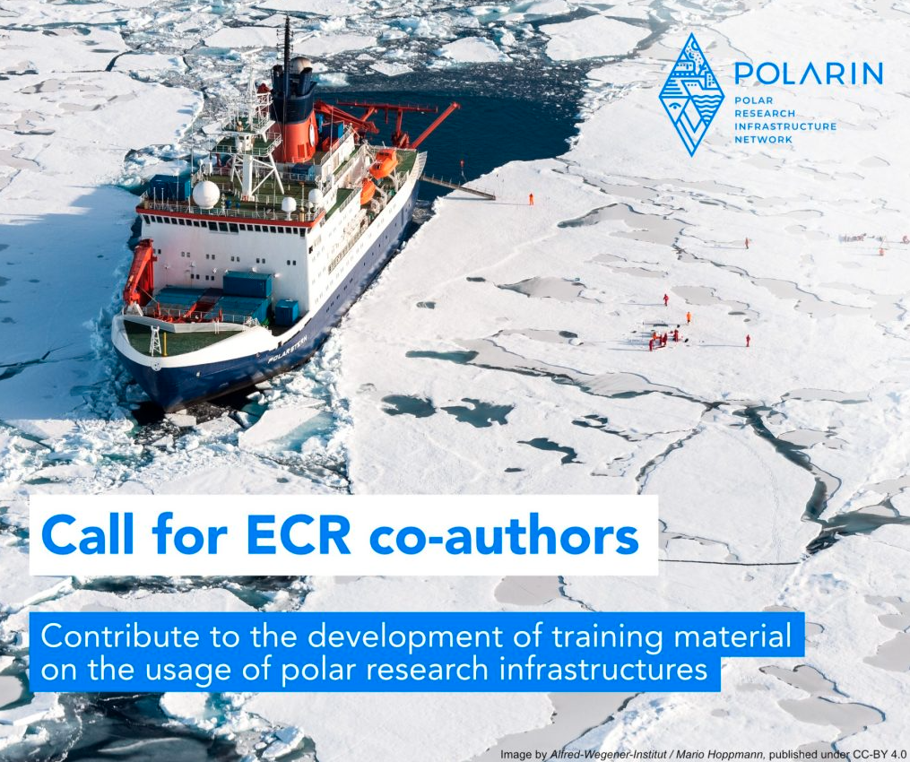
2. Progress & Achievements
Task 7.1 - Online training
Online training platform
→ All online training content will be accessible through one central platform, hosted by APECS, developed in collaboration between tasks 7.1 and 7.2
→ Preliminary data stewardship training has been made available on GitHub. Comprehensive training platform will follow later
Call for ECR co-authors to contribute to training material
→ 70+ applications, selected c. 40 ECRs that work on content in small groups
→ Content will be edited and quality checked by WP7 leadership
Online guidebooks
→ Articles grouped by themes as defined in proposal
→ Expected to be available in October 2025 (deliverable D7.3 due in January 2026)
Issued at the beginning of January 2025

Slide 8
2. Progress & Achievements
Task 7.1 – Brochures (content)
Planning for polar fieldwork → under review by WP7 team
Safety in polar fieldwork → draft in progress
Data Stewardship → under review by WP7 team
Ethics in polar research → planned
Impact of polar research → planned

Slide 9

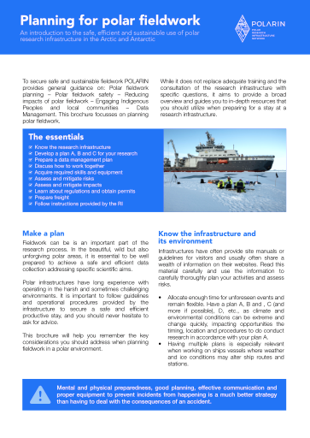
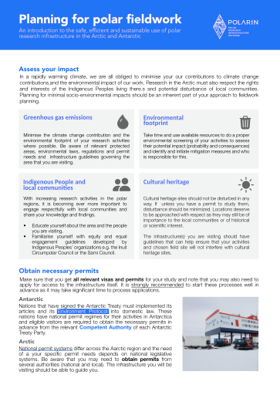

2. Progress & Achievements
Task 7.1 – Brochures (layout)
→ Layout and design of brochures are currently being developed
→ Will be discussed with WP8 and WP9 for review once WP7 has made a final draft (before layout of the actual brochure content)

Slide 10
2. Progress & Achievements
Task 7.1 / 7.2 – Training Webinar
Update
Annual webinars for TA users (also publicly available) covering aspects of planning, safety and data stewardship, including POLARIN specific requirements and coordinated with WP8 (for media guidelines) and WP9 (for POLARIN specific reporting). This year’s webinar is planned for 12 May 2025, 13:00 - 17:00 GMT.
Next steps
Public announcement text and graphic is currently being prepared and will be discussed with WP8 and WP9. WP7 is also coordinating with WP2/3 on how/when to inform the TA users (ideally within
the e-mail to be sent out the first week of April by WP2 to all TA User Groups with invitation
to the WP2 webinar about Agreements and practical arrangements related to granted acsess,
to be held on April 28).

Slide 11
2. Progress & Achievements
Task 7.1 / 7.2 – Training Webinar
Tentative agenda and speakers
Introduction to POLARIN [Veronica - WP9]
Overview of training products made by WP7 [Michele - WP7]
Reporting requirements for POLARIN TA users [Veronica - WP9]
Fieldwork planning [Morten - WP7]
Fieldwork safety [Axel - WP7]
Ethics & collaboration [external speaker, tentative: ELOKA]
Environmental impacts [ECR speaker, tentative: Amy Macfarlane]
Data stewardship (including POLARIN specific content) [Daan - WP7/WP4/WP5]
Media contact guidelines [Eva - WP8]

Slide 12
2. Progress & Achievements
Task 7.2 - Online training on data stewardship
Update
Continuous development of data stewardship training material in the form of Jupyter notebooks, to be made publicly available via GitHub by the end of April (M14), if D7.1 is not postponed according to Amendment 2 (the same goes for other bullets below relating to M14). Well on track for D7.1 and should be ready by the end of April (M14)
Next steps
Make the GitHub repository publicly available when training material repository is ready (by M14)
Write D7.1 deliverable report (by M14)
Get ECR’s involved in collaborative development of data stewardship training material (until M22)
Transfer data stewardship training material on GitHub to POLARIN training platform (by M22)

Slide 13
3. Challenges & Opportunities
Very limited feedback from research infrastructures in survey on existing training material issued in summer 2024 and with deadline in September.
Overwhelmingly high interest among Association of Polar Early-Career Scientists (APECS) members to voluntarily contribute to preparation of training material.
The Arctic Youth Network's (AYN) has contacted us as interested volunteers to contribute on research ethics in studies involving indigenous peoples.

Slide 14
4. Next Steps
First seminar (webinar) on planning, safety, data stewardship etc. will be held on 12 May 2025, 13:00 - 17:00 GMT.
To be announced very soon!
You are all welcome to join!

Slide 15
5. Collaboration & Key Interactions
Within POLARIN:
WP4/5 mainly through Daan Kivits (Task 7.2) with regard to data stewardship
With WP8 concerning layout of brochures.
Outside POLARIN:
With Arctic Youth Network’s and many other potential contributors to training materials.

Slide 16
6. Discussion Points
- Time schedule (e.g. postponement of D7.1 to align with D7.3)
- Announcement of the first training webinar to all TA User Groups
- Layout of the brochures (if any suggestion)
- Content of the training material
- Contributions to the creation of the training material (if any additional volunteers)

Slide 17


Contact Us
Morten Rasch:
mras@ign.ku.dk
Michele Rebesco:
mrebesco@ogs.it

