Slide 1

WP8 – Outreach, Engagement and Impact
Engagement
Outreach
Communication
Eva Horovcakova on behalf of WP8
European Polar Board
www.eu-polarin.eu
POLARIN 2nd General Assembly
1-2 April, 2025
WP8 members: AWI ULUND AU EPB NASC IGOT-UL INACH

Slide 2
1. Objectives
Outreach
Communication
Engagement
Notes:
The main objective of WP8 is the communication and outreach of POLARIN’s services and outcomes to users and other target groups. Efficient communication is crucial to the success of engaging identified target groups with the services of POLARIN WP8 will To ensure that communication, outreach and engagement are efficient, WP8 will assess its activities throughout the POLARIN project.
WP8 will:
- Ensure there is efficient communication to POLARIN target groups by implementing communication tools developed in Task 8.1.
- Engage (potential) RI users with POLARIN services with several outreach methods (such as promotional materials developed in Task 8.1, online seminars (Task 8.2) and sustaining contact with RI users (Task 8.3).
- Assess the communication, outreach, and engagement activities, implement a POLARIN Publications Repository which contains publications linked to POLARIN services, and assess the impact of POLARIN on multiple stakeholders.

Slide 3
2. Tasks
Visibility and communication of POLARIN (T8.1)
(EPB, INACH, IGOT-UL)
Engagement of Service Users and Ambassadors (T8.2) (EPB, IGOT-UL, INACH)
Evaluation of the communication and engagement activities and the impact of POLARIN (T8.3).
(EPB, IGOT-UL)
Notes:
Task 8.1 Visibility and communication of POLARIN (EPB, INACH, IGOT-UL) (M1-M60)
The objective of Task 8.1 is to create a high visibility of the POLARIN project and to set up and implement channels for efficient communication of POLARIN. To achieve this, Task 8.1 will develop communication tools such as a website, social media channels, and dedicated groups on the Catalyst Platform and will map potential service users (in synergy with the development of the POLARIN Communication, Dissemination and Engagement Plan in Task 8.2). To ensure visibility for POLARIN from the beginning of the project, Task 8.1 will develop promotional materials such as press releases, a video, flyers, and roll-ups to share with POLARIN target groups. Task 8.1 will develop a professional lay-out for POLARIN communication, outreach, and engagement to ensure
POLARIN communication is consistently recognisable. WP8 will continuously connect with other POLARIN WPs throughout the lifespan of the project to ensure all POLARIN services are communicated effectively with identified POLARIN target groups.
Task 8.1 will:
Implement the tools for effective communication, develop promotional materials, set up media channels (website, social media, regular newsletters etc.), collect content updates and maintain them throughout the project.
Develop consistent templates (for all media) and lay-outs for POLARIN communications activities (through a Brand Identity Package, including the logo, colour template, etc).
Set up promotional materials (press releases, promotion video, flyers, roll-ups etc.) to communicate and promote the services of POLARIN
Task 8.2 Engagement of Service Users and Ambassadors (EPB, IGOT-UL, INACH) (M1-M60)
The objective of Task 8.2 is to engage (potential) RI users with POLARIN services. This task will develop and implement Communication, Dissemination and Engagement Plan, that will:
Specify the target groups for communicating about various POLARIN tools and services,
Link communication tools to target groups, and to ensure that POLARIN RI users apply these tools to share their research most effectively,
Outline when and how potential service users can be engaged with POLARIN tools and services.
Task 8.2 will organise an online seminar series to engage potential POLARIN users, with each seminar planned around the POLARIN calls. The online seminar series will start with an introductory seminar to introduce POLARIN and attract potential service users. Further seminars will be organised around each planned call for proposals and will highlight the stories of successful users. A final concluding online seminar will ensure all the achievements of POLARIN are showcased and highlighted, including those of the POLARIN Ambassadors. Task 8.2 will work with POLARIN users to produce content that could be utilised for communication (e.g., blogs, videos or photos as relevant from research expeditions) in the second half of the project. The main aim of this content is to showcase experiences of past POLARIN users, and to attract potential applicants for using POLARIN
services. To ensure material delivered by POLARIN users can be used for outreach and engagement, Task 8.2 will also set up clear instructive guidelines that will be disseminated to POLARIN users. This task will also set up “POLARIN Ambassadors”, a selected subset of physical TA users. Contact with POLARIN Ambassadors will be maintained as required (using for example a Catalyst Platform group dedicated to POLARIN Ambassadors) to facilitate exchange of experiences of using POLARIN services.
Task 8.2 will:
Develop and implement a communication, dissemination and engagement plan, ensuring the most effective communication to and engagement of service users.
Organise an online seminar series highlighting POLARIN Service Users’ (and Ambassadors’) success stories: “POLARIN Stories”,
Provide guidelines and templates for the appropriate communication tools, to ensure that POLARIN participants can efficiently use and share their research,
Set up and maintain continued contact with POLARIN Ambassadors as required to facilitate exchange of experiences of using POLARIN services, with each Ambassador producing one communication product (either blog, vlog, photo series, or any other communication product as chosen by the Ambassador).
Task 8.3 Evaluation of the communication and engagement activities and the impact of POLARIN (EPB, IGOT-UL) (M13-M60)
The main objective of Task 8.3 is to assess and evaluate the impact of all engagement, outreach, and
communication activities from POLARIN, including those of users, and Ambassadors, in close cooperation with Task 8.1 and 8.2, and other WPs. The assessments will ensure that engagement, outreach, and communication will be conducted in a most effective manner throughout the project. Task 8.3 will also create the POLARIN Publication Repository (publications by POLARIN users). Task 8.3 will closely work with Task 8.2, and all WPs, connecting with POLARIN service users to ensure all publications associated with POLARIN service users will be added to the POLARIN Publication Repository. Task 8.3 will also develop a strategy to find a suitable location/host/place for the POLARIN repository after the project is completed.
Task 8.3 will:
Assess and evaluate the impact of POLARIN engagement, dissemination and communication activities,
Set up and maintain the POLARIN publications repository, ensuring open access to publications, and ensure availability after project is completed.

Slide 4
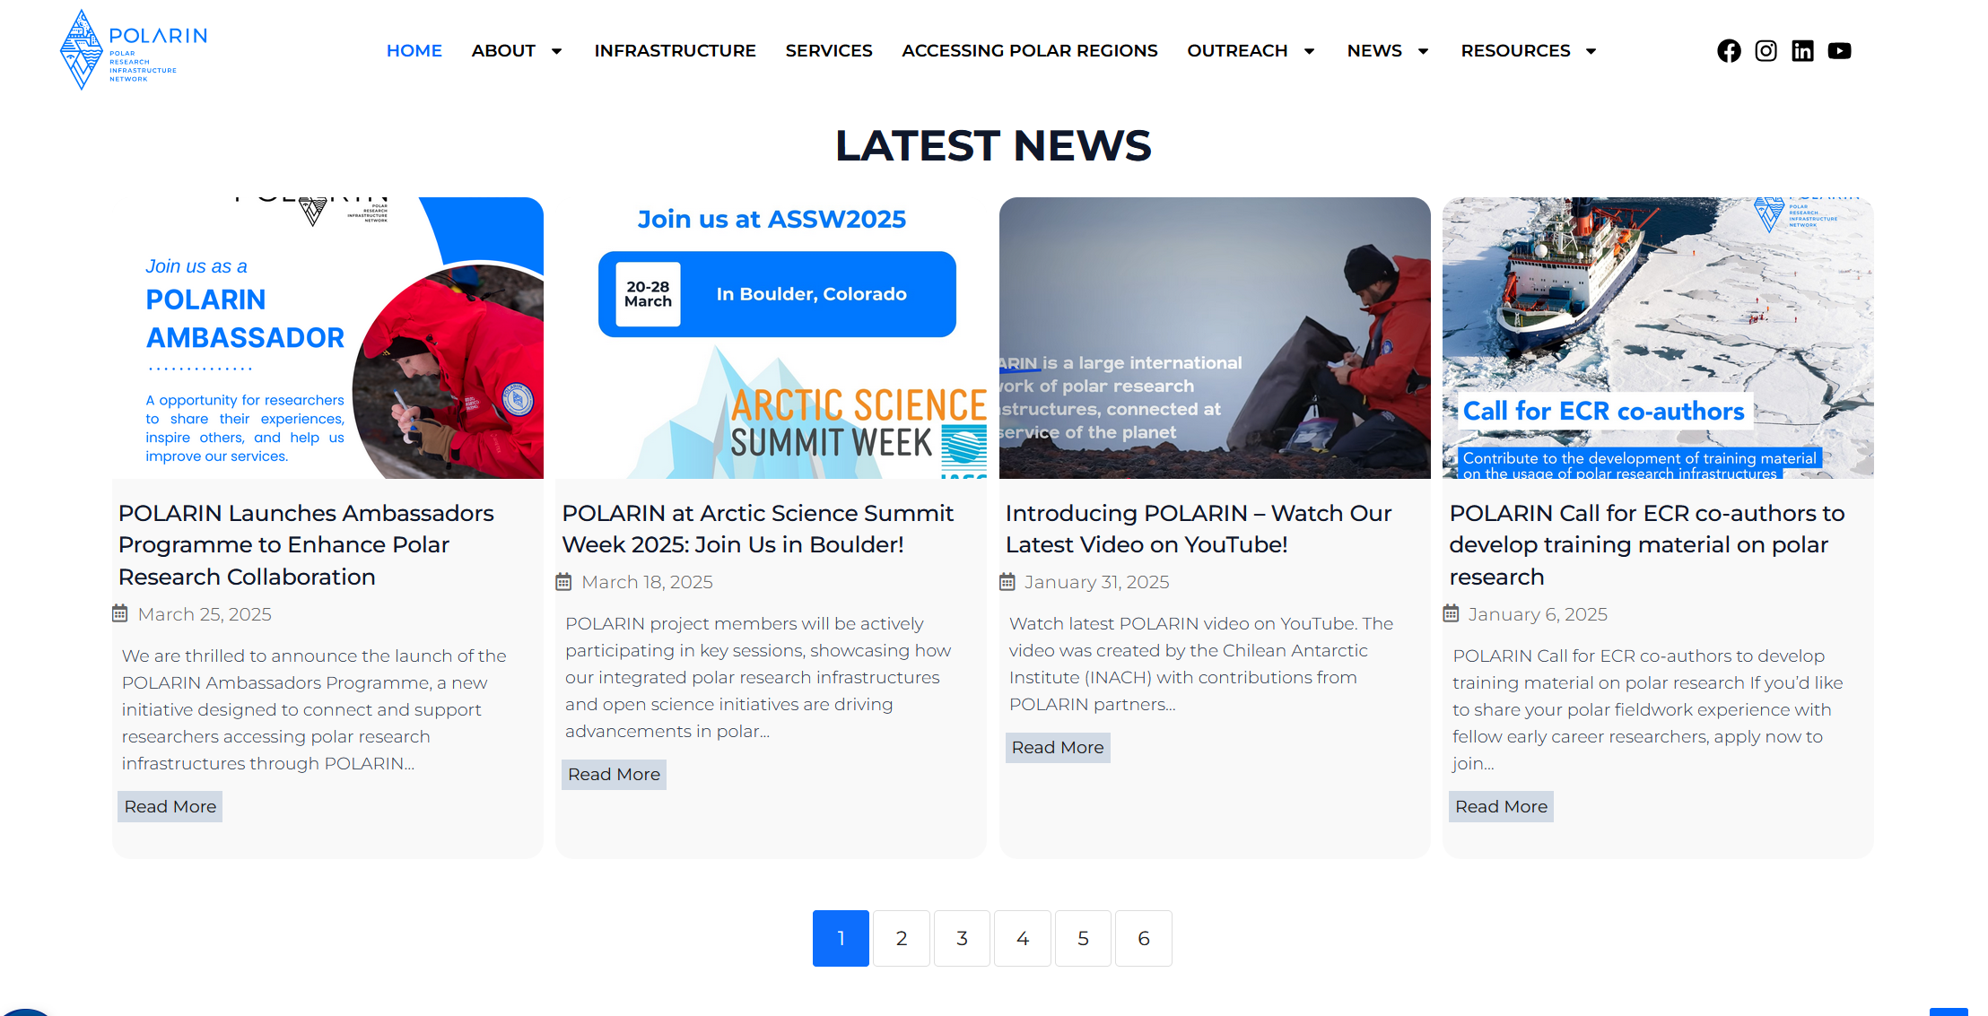
2. Progress & Achievements
Deliverable | Name | Submitted
D8.1 | Implement POLARIN website and social media channels (IGOT-UL) | April 2024
D8.2 | Brand Identity and guidelines package (logos, general lay-out etc.) (INACH) | April 2024
D8.3 | POLARIN promotional materials (press releases, promotion video, flyers, roll-ups etc.) (AWI) | May 2024
D8.4 | POLARIN Communication, dissemination, and engagement plan (EPB) | June 2024
D8.5 | Content Creation Guidelines (short video tutorials) for POLARIN service users to support outreach and engagement (EPB) | October 2024

Slide 5
POLARIN website www.eu-polarin.eu
Impressions
132K

Slide 6
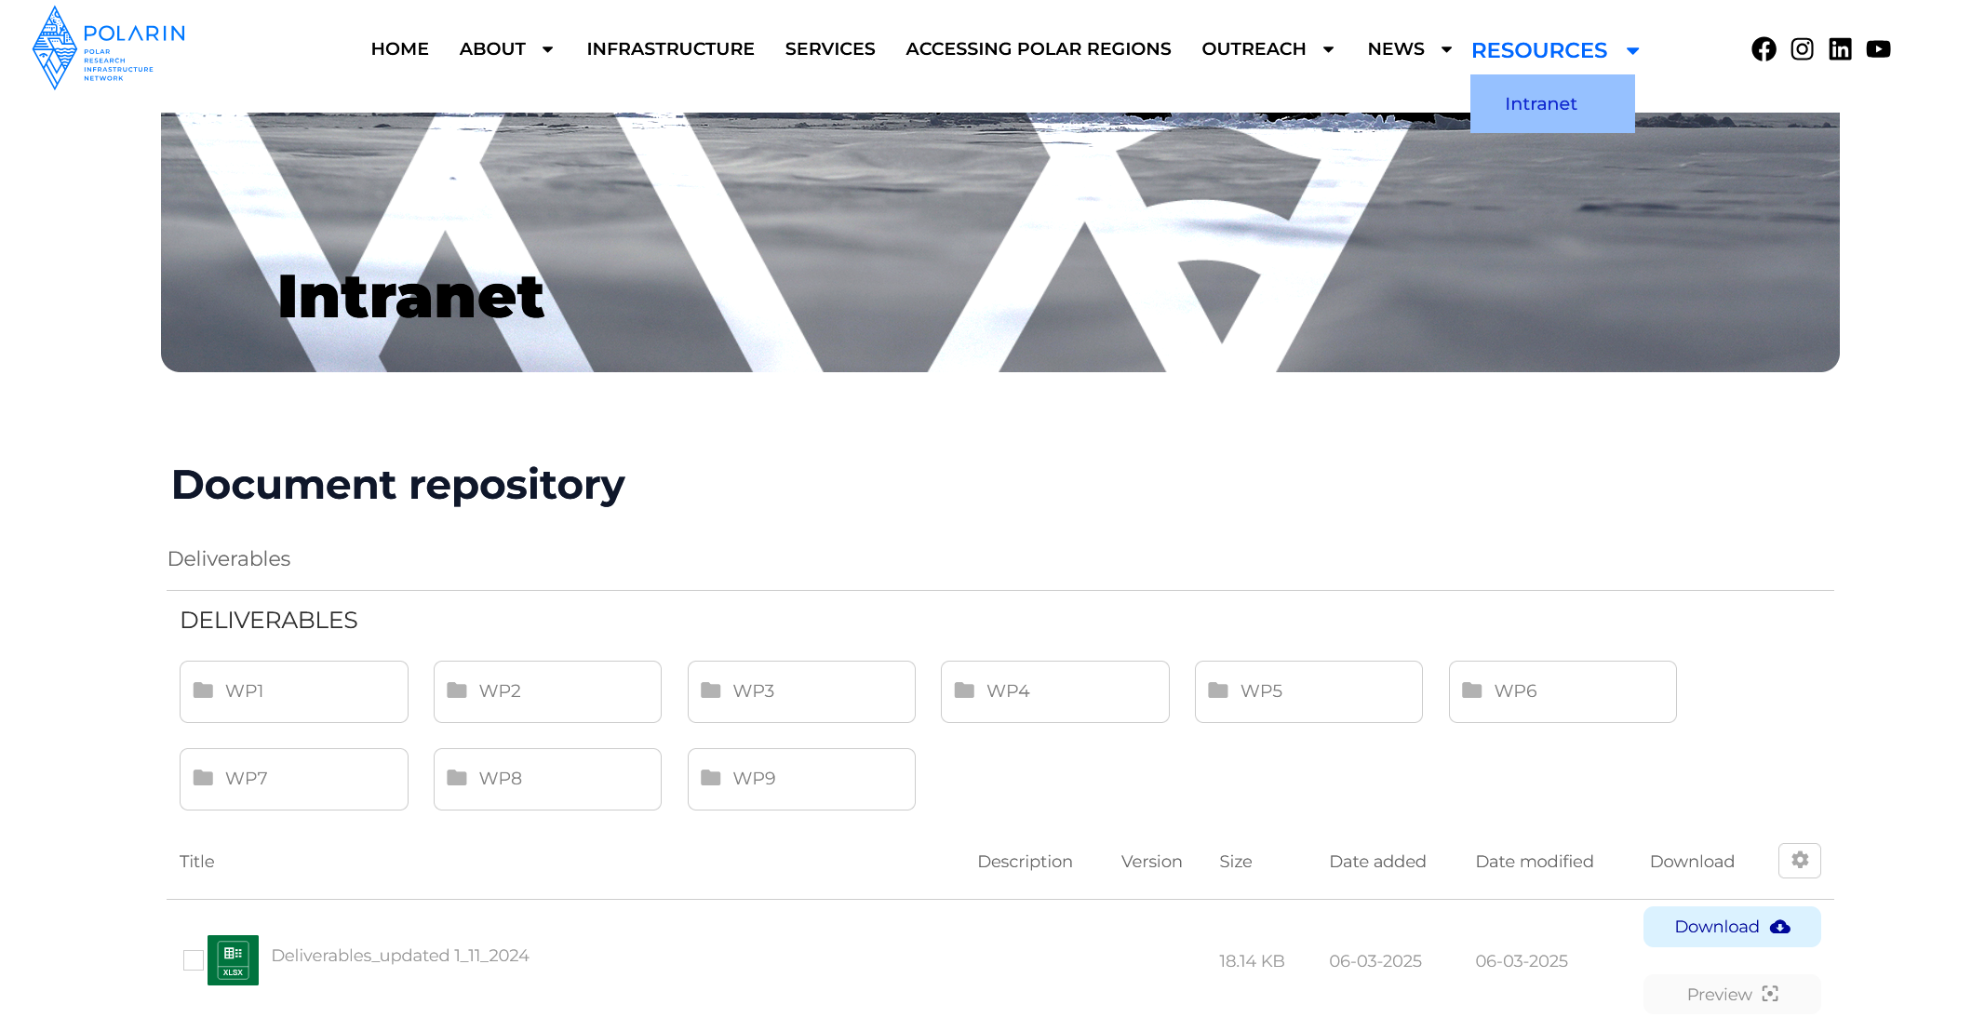
POLARIN website
Intranet
Impressions
132K
Notes:
Includes deliverables, POLARIN Consortium documents (Financial documents, Grant agreement), design materials (logos, templates) and Collaborative files - Communication and dissemination activities

Slide 7






POLARIN
Social media and Newsletter
POLARIN
Polarin
@eu.polarin
POLARIN EU
675
82
365
100+
Followers
Followers
Followers
2 videos - views
Impressions
132K
Notes:
Social Media Impact: Increased engagement and visibility online
Public Outreach: Expanded awareness through website updates, newsletters, and outreach activities

Slide 8
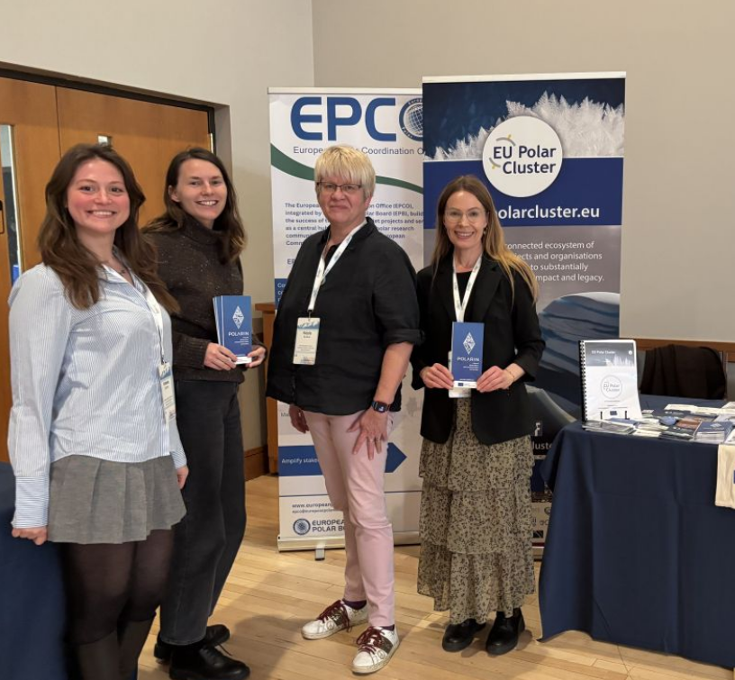
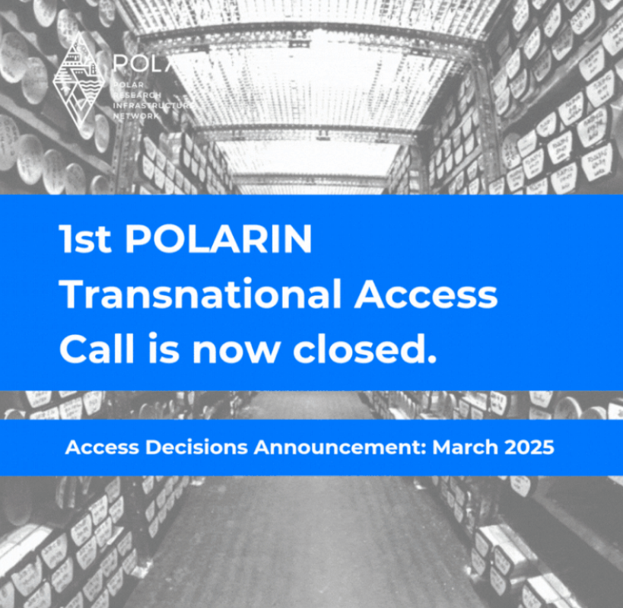
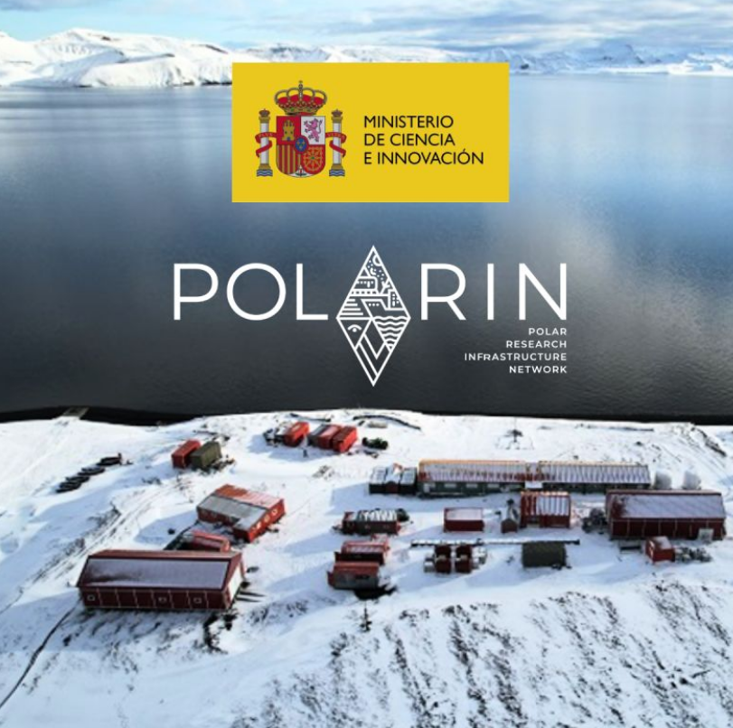

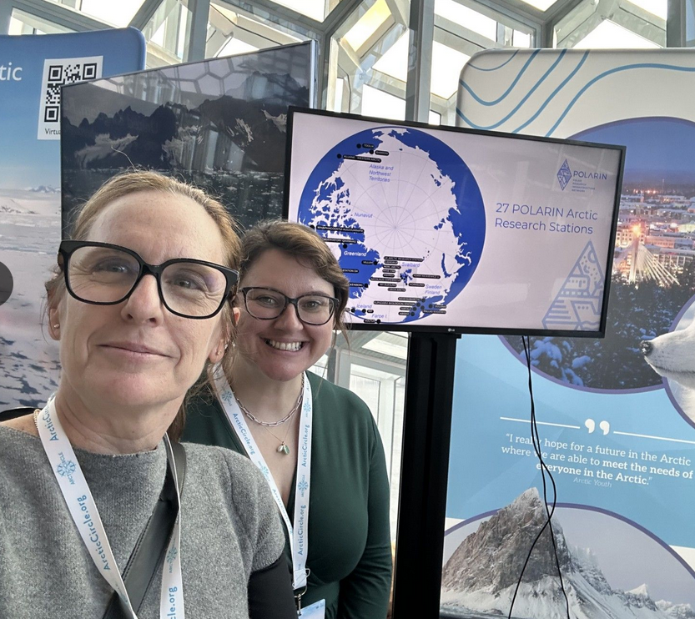
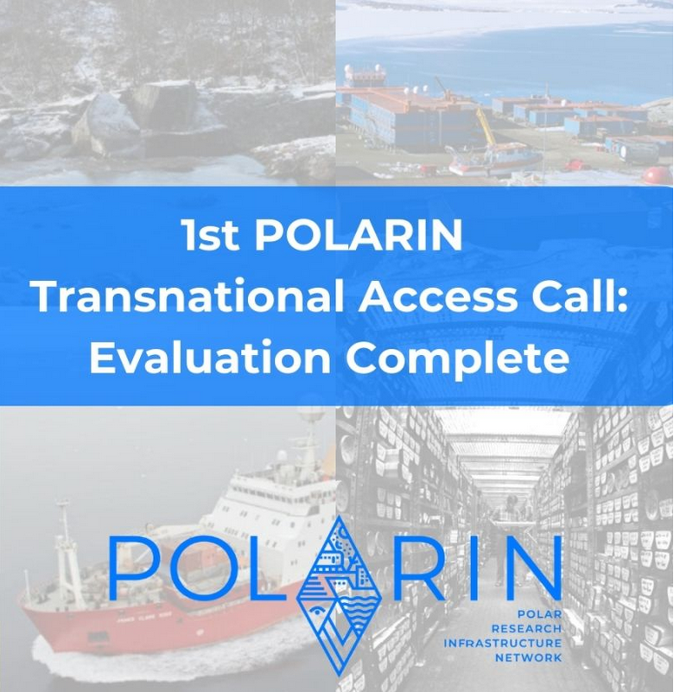

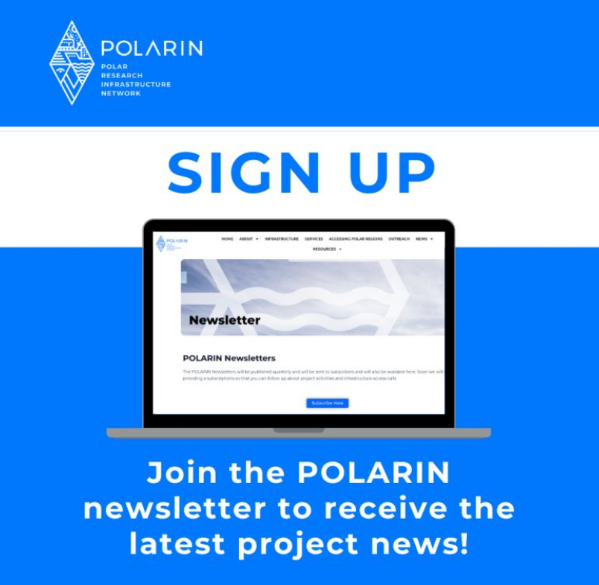
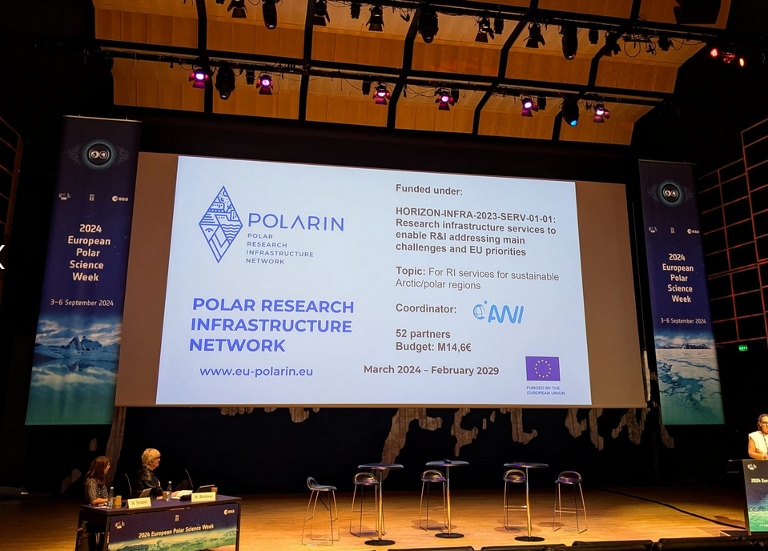
POLARIN
Social media campaigns
POLARIN
Polarin
@eu.polarin
675
82
365
Followers
Followers
Followers
Notes:
Social Media Impact: Increased engagement and visibility online
Public Outreach: Expanded awareness through website updates, newsletters, and outreach activities

Slide 9
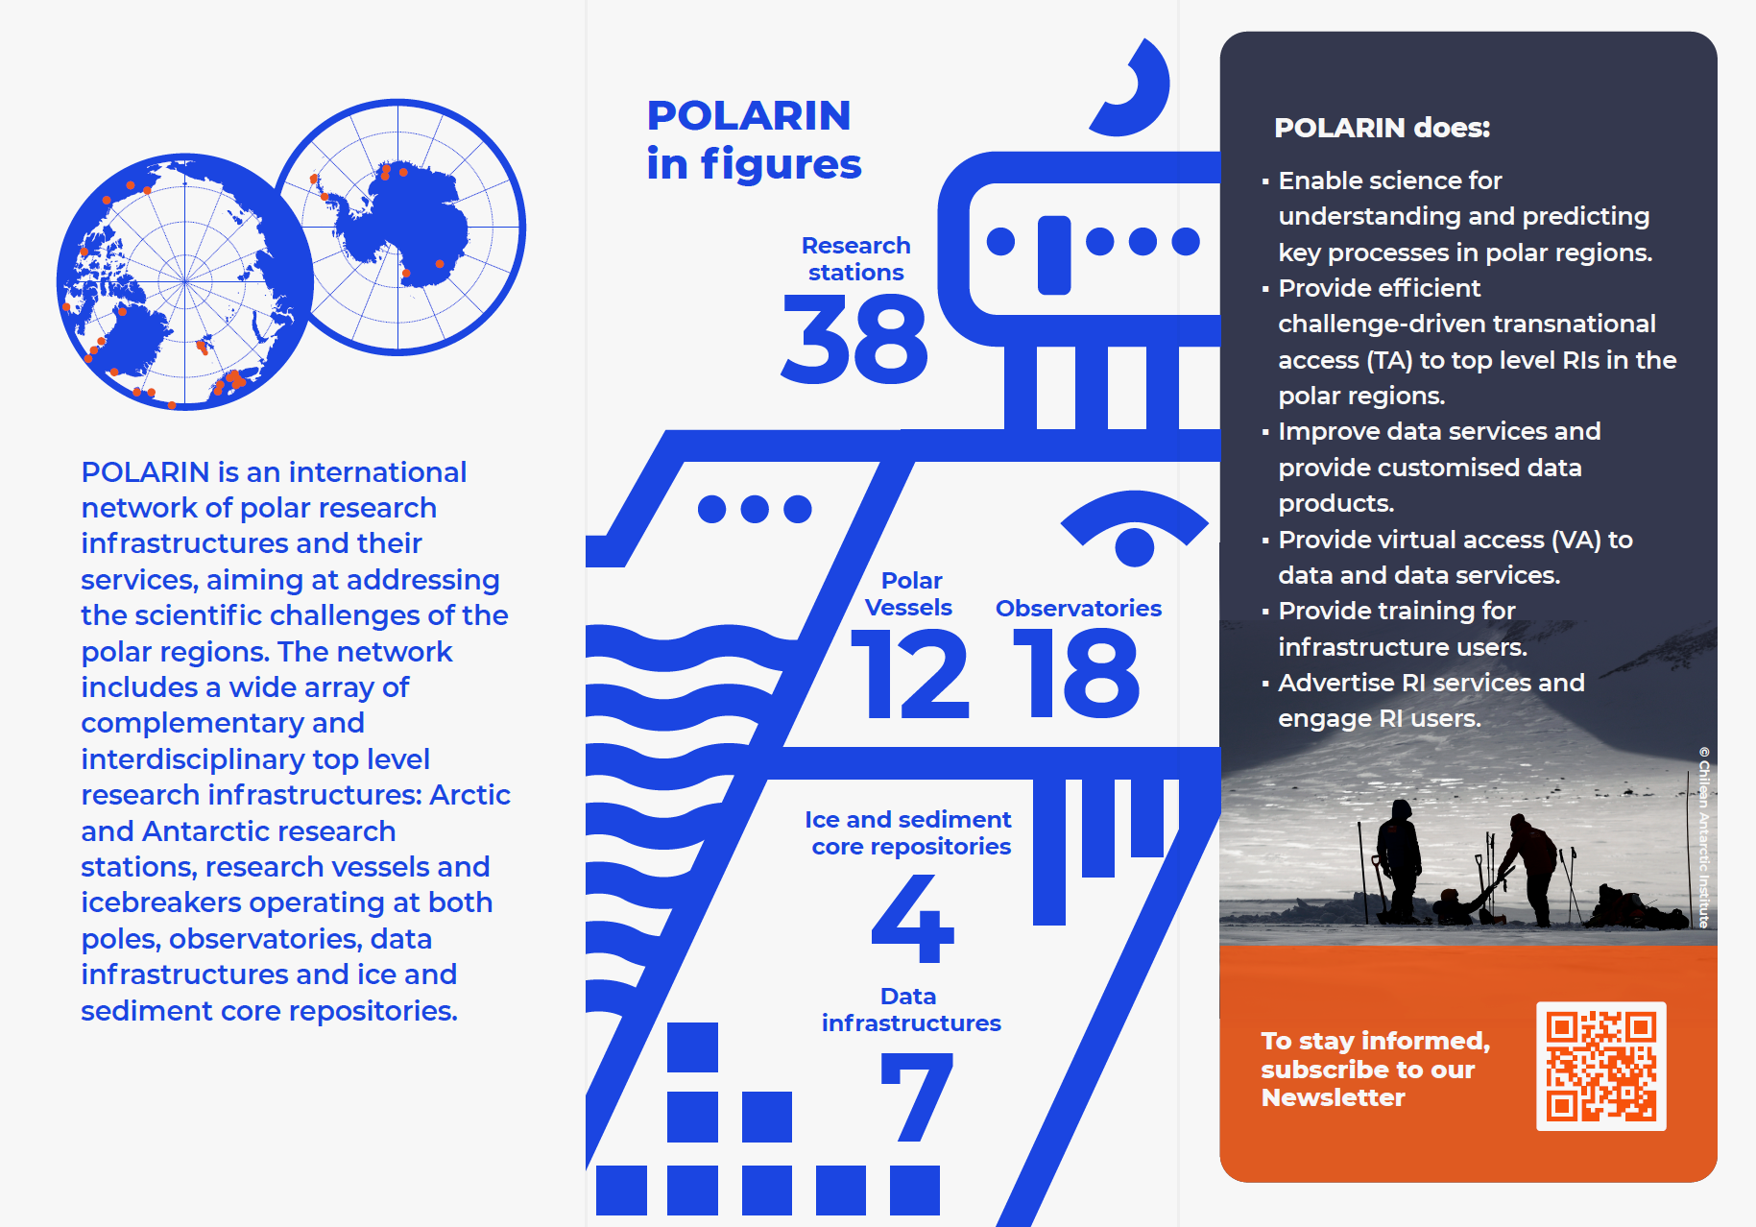
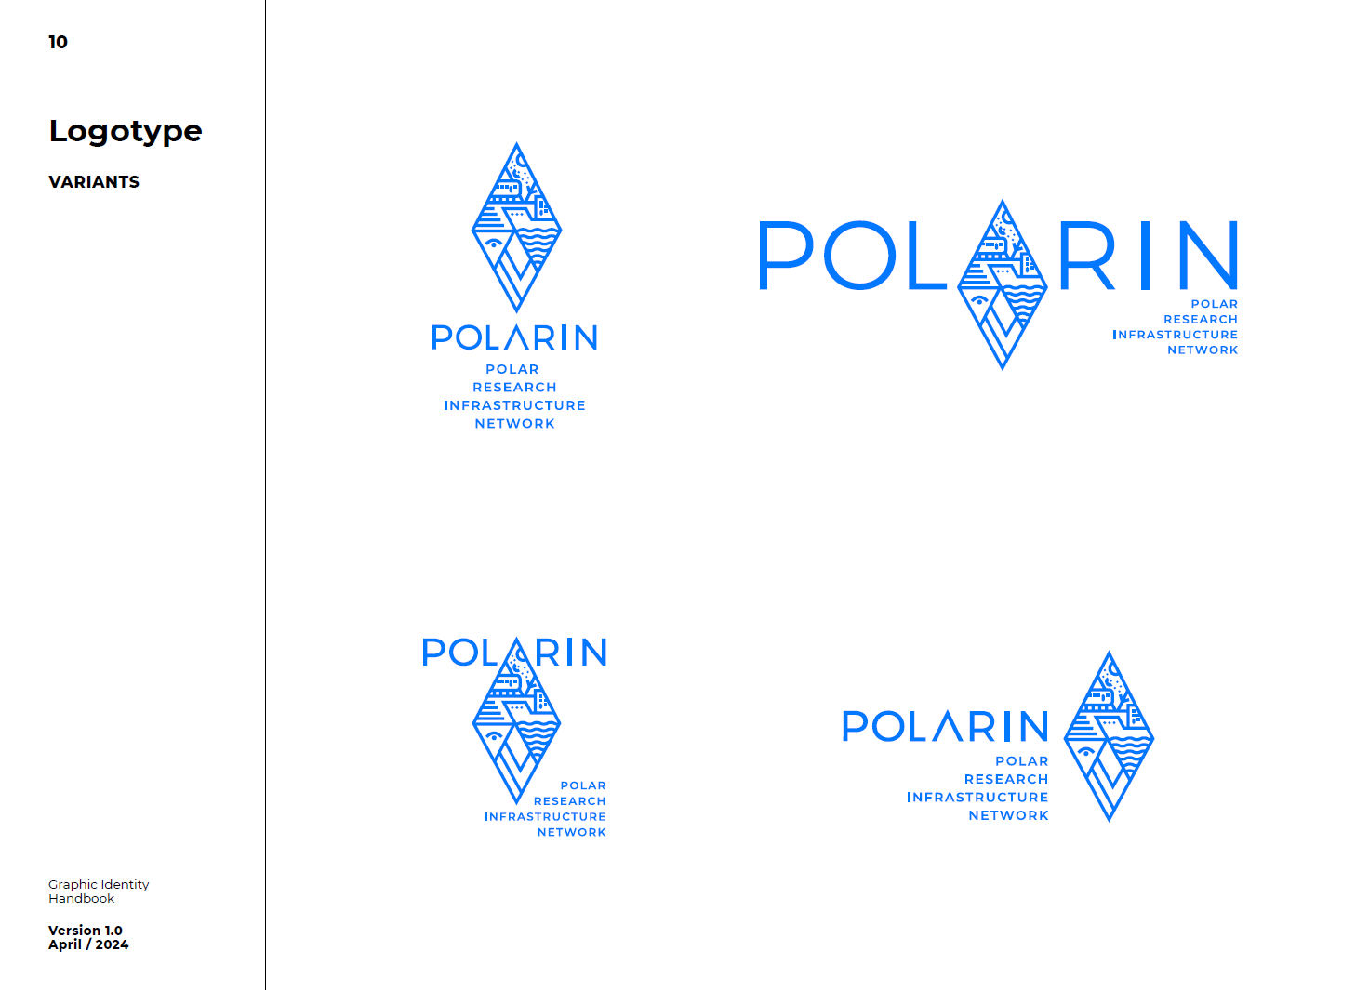
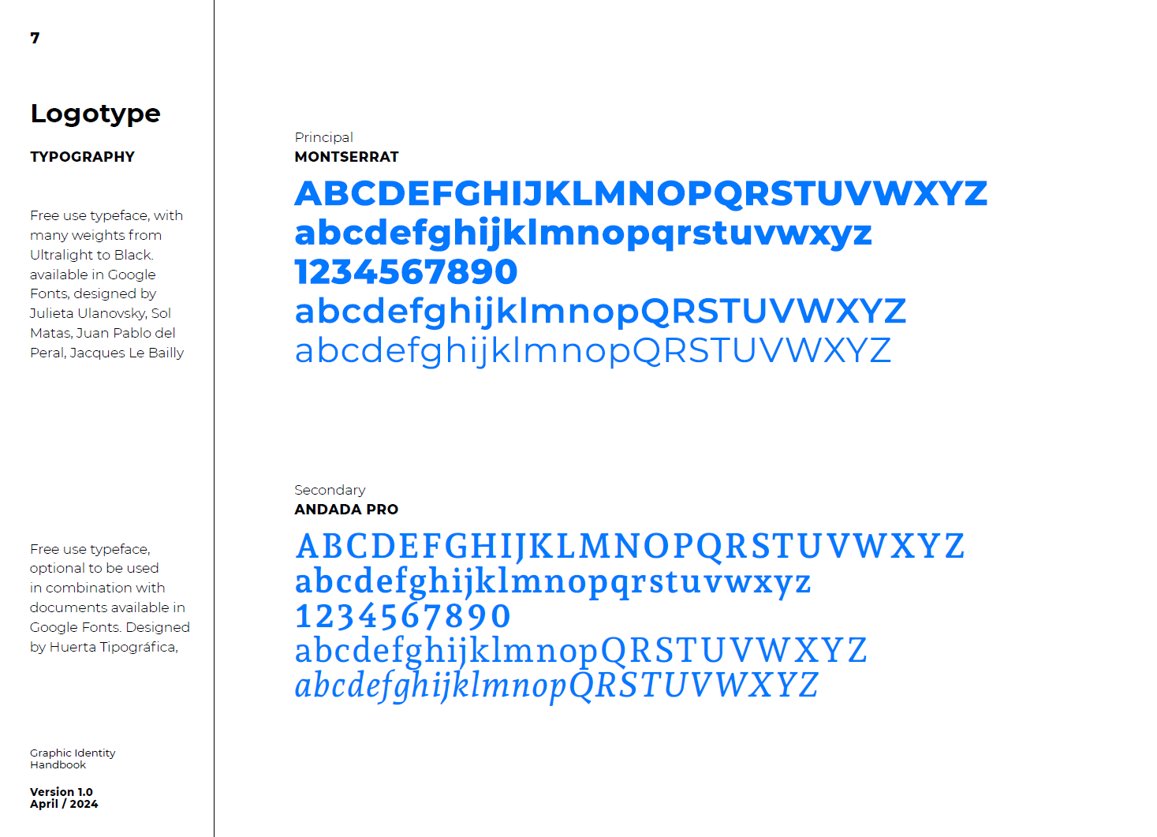
Brand Identity and guidelines package

Slide 10
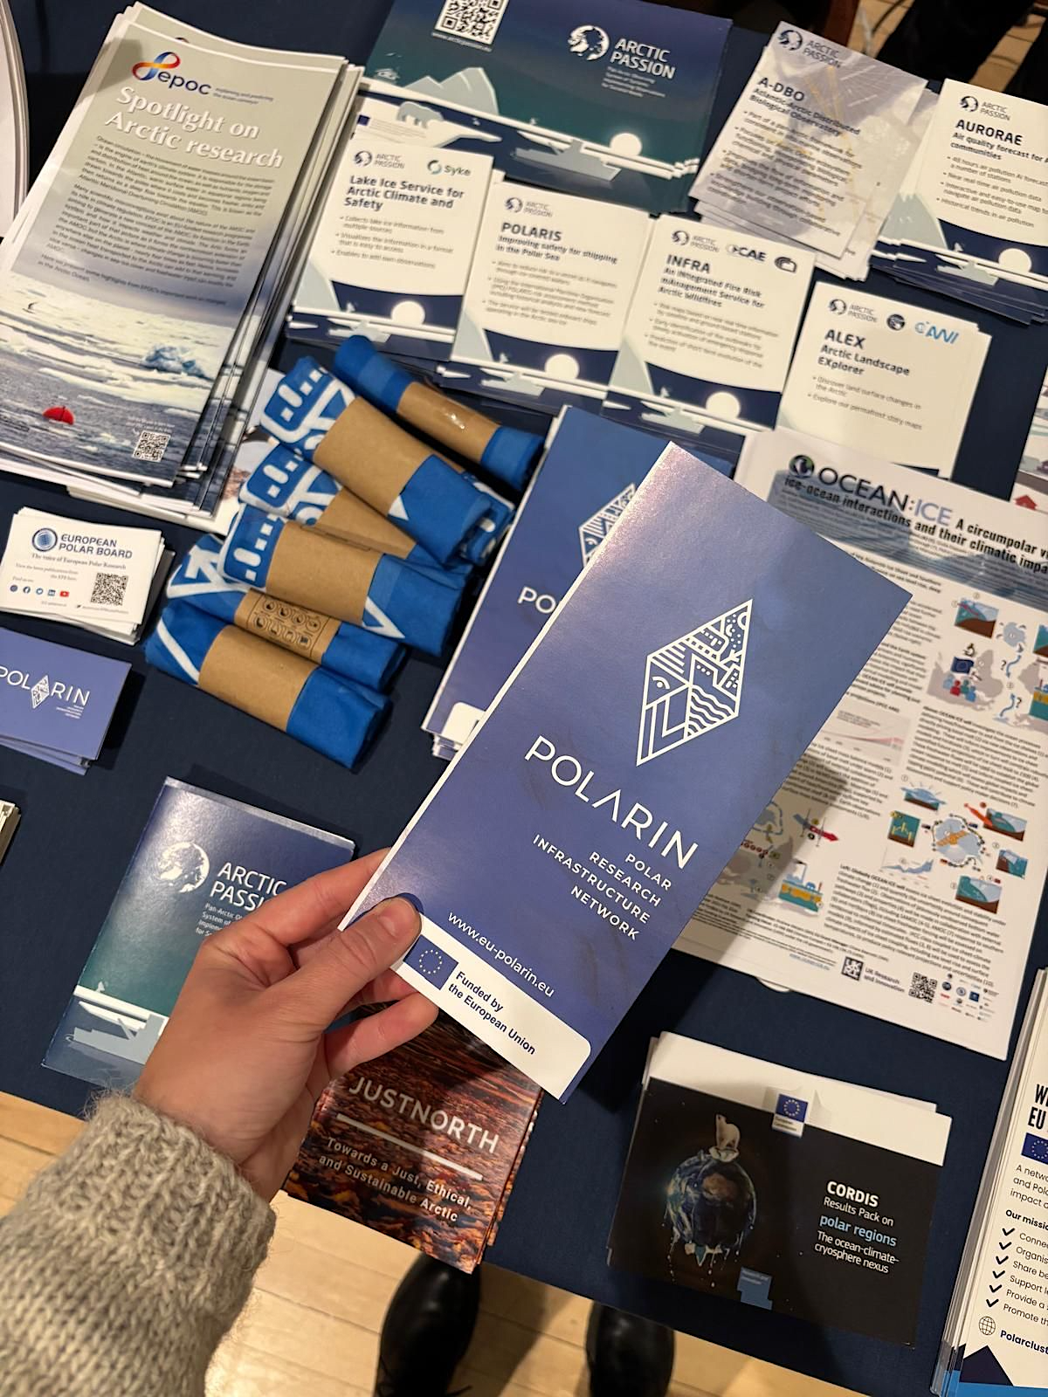
POLARIN promotional materials

Slide 11




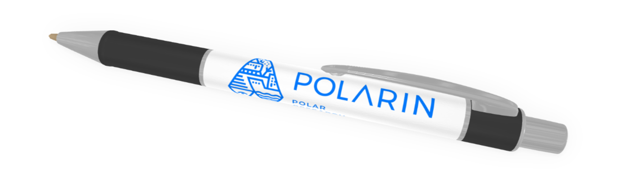
POLARIN
promotional materials

Slide 12
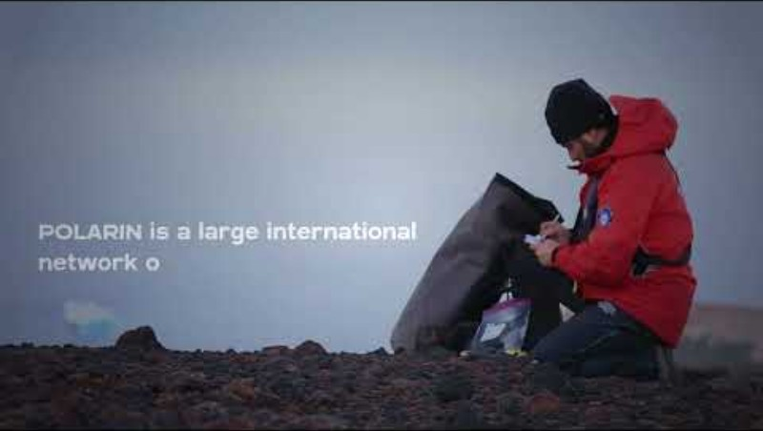
POLARIN Video
(available on YouTube channel)

Slide 13
POLARIN Communication, dissemination, and engagement plan
Includes:
Main Objectives
Target audiences
Communications Channels and Tools
Communication activities and events
Notes:
CO1: To promote the project throughout the full lifespan of the project,
CO2: To actively advertise POLARIN’s services: TA to RIs, VA to data, data tools, data services and data products, and training opportunities.
CO3: To inform and reach out to society and show the activities performed, and the use and benefits the project will have for citizens.
CO4: To contribute to evidence-based policy-making.
CO5: To support internal communication.
Target audiences: Scientific community, Early career researchers, National polar programmes and research institutions, Funded (polar) projects or projects that need polar data, Technicians and engineers, Multilateral and international organisations
Other target groups: POLARIN consortium members, User groups, Research infrastructure operators, International agreements and international partnerships, Policy and decision makers, Maritime industry, Media, Civil society, Educators
Communication channels and tools: Corporate identity (logo, templates), Website, Internal website (reports, deliverables), Social Media, Newsletter, Flyers, brochures, posters, rollups on demand, Press releases, Videos, Formal email, Guidelines, Publications from service users
Communication activities and events: Consortium meetings (WP9), Clustering with other initiatives (WP8/WP9), Scientific and non-scientific events (all), Promotion of project results, Outreach beyond Europe, Translations of outreach activities (e.g., social media posts) into native languages of consortium partners, Dedicated outreach to Ukraine

Slide 14
Content Creation Guidelines for POLARIN service users to support outreach and engagement
Part of Ambassadors Programme
Aim: Help POLARIN service users (future POLARIN Ambassadors) to produce consistent, engaging and high-quality content
Included: Content types, ideas and tools for content creation, visual, platform-specific, legal and ethical guidelines, video and photo creation best practices.
Notes:
Content Creation Guidelines that were created for the POLARIN service users (selected applicants) as part of the POLARIN Ambassadors programme following the Communication, dissemination, and engagement plan (D8.4).
The aim of the guidelines included in this document is to help POLARIN service users / POLARIN Ambassadors to produce consistent, engaging and high-quality content aligning with the project and adhering with legal and ethical standards and so help to promote the project.
What is included: Content types, ideas and tools for content creation, visual, platform-specific, legal and ethical guidelines, video and photo creation best practices. The guidelines also provide information about content submission, privacy policy and contact information

Slide 15

Ambassadors Programme
Aim: A space for researchers to share their experiences, inspire others, and help us improve our services
building a vibrant, collaborative network of POLARIN service users
Next steps: Selected applicants (1st POLARIN call) to receive a package including Content Creation Guidelines & Submission form
Notes:
The POLARIN Ambassadors Programme offers a space for researchers to share their experiences, inspire others, and help us improve our services. Whether through photos, videos, articles, or other formats, your contributions will help guide future users and build a vibrant, collaborative network of POLARIN service users.
In addition, the programme is dedicated to supporting early-career researchers by giving them a platform to showcase their work and share their experiences beyond the limits of traditional academic publications.

Slide 16

3. Challenges & Opportunities
Sustained engagement and impact measurement
Receiving input from all partners (and future POLARIN Ambassadors)
Keeping track of partners’ activities (Communication and exploitation tracker)

Slide 17
4. Next Steps
Ambassadors programme preparation
Upcoming events preparation
Ongoing communication, dissemination, and continuous improvements
Monitoring partners' activities through the Communication and Exploitation Tracker
D8.6 Assessment of communications, outreach and engagement activities to date, and update of the Communication, dissemination, and engagement plan (February 2026)
Notes:
Ambassadors programme – preparation - webinars input, establishing the package for Ambassadors, building the network

Slide 18
5. Collaboration & Key Interactions
All WPs – Input for communication and dissemination
WP2 & WP7 – preparation of upcoming webinars

Slide 19
6. Discussion Points
What are your ideas for effective internal and external communication of POLARIN?
What types of external communication approaches do you think would be most successful in enhancing the project's legacy?
How do you envision the POLARIN Ambassadors Programme contributing to the project's outreach and impact, and what enhancements would you propose to maximize its effectiveness?

Slide 20
WPs networking
- Consortium meetings
- Reporting and showcasing project’s work
Outreach
Webpage
Social media posts
Videos
Webinars
Internal Communication & Mission Sharing
Scientific and non-scientific events
International fora
Clustering with other initiatives
Meetings
Exhibition Booths
Real-world examples of project outcomes
Knowledge transfer
Oral Communication & Dissemination
Content & Outreach Materials
Engagement Events
External communication (in-person)
External communication (online)
POLARIN Ambassadors
Project Impact
& Legacy

Slide 21

Contact Us
Eva Horovcakova: ehorovcakova@europeanpolarboard.org
European Polar Board: secretariat@europeanpolarboard.org
POLARIN General requests:
polarin_info@listserv.dfn.de

