Slide 1

WP9 – Project Management
Verónica Willmott
www.eu-polarin.eu
POLARIN 2nd General Assembly
1-2 April, 2025

Slide 2
1. Objectives
Contractual
Financial
Operational
Strategic
Management

Slide 3
2. Tasks
Conduct the contractual and financial management of the project (T9.1) (AWI)
Guarantee effective operational and strategic management and integrate all consortium partners (T9.2) (AWI)
Ensure appropriate links with relevant European and international initiatives (T9.3). (EPB, AWI)

Slide 4
Submission of deliverables
19 deliverables submitted to date
7 deliverables submitted in time or ahead of time
12 deliverables submitted late
- 7 deliverables submitted <1 month late
- 5 submited >1 month late

Slide 5
Submission of deliverables – process
At the latest 1st week in the Month due date
Deliverable owner
Steering Board
Approval/rejection
1 Week
Submission by Project Manager (deadline)
Project manager
Approval/review
WP leader
Approval/review

Slide 6
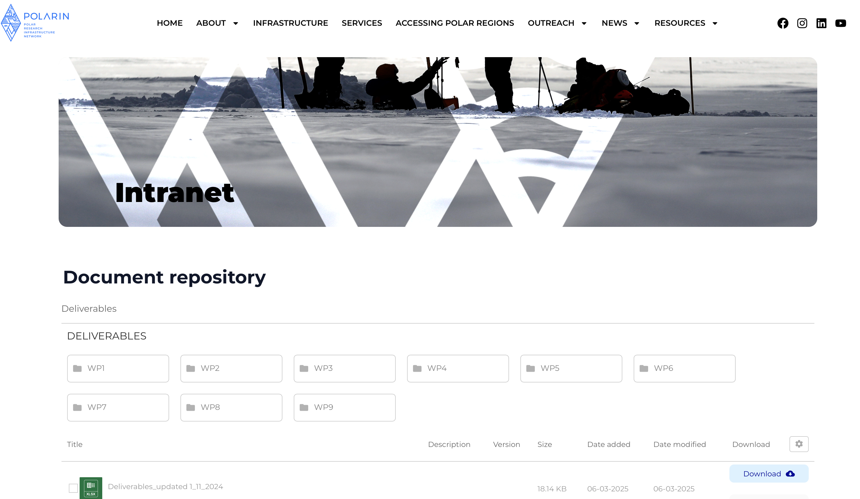
Intranet

Slide 7
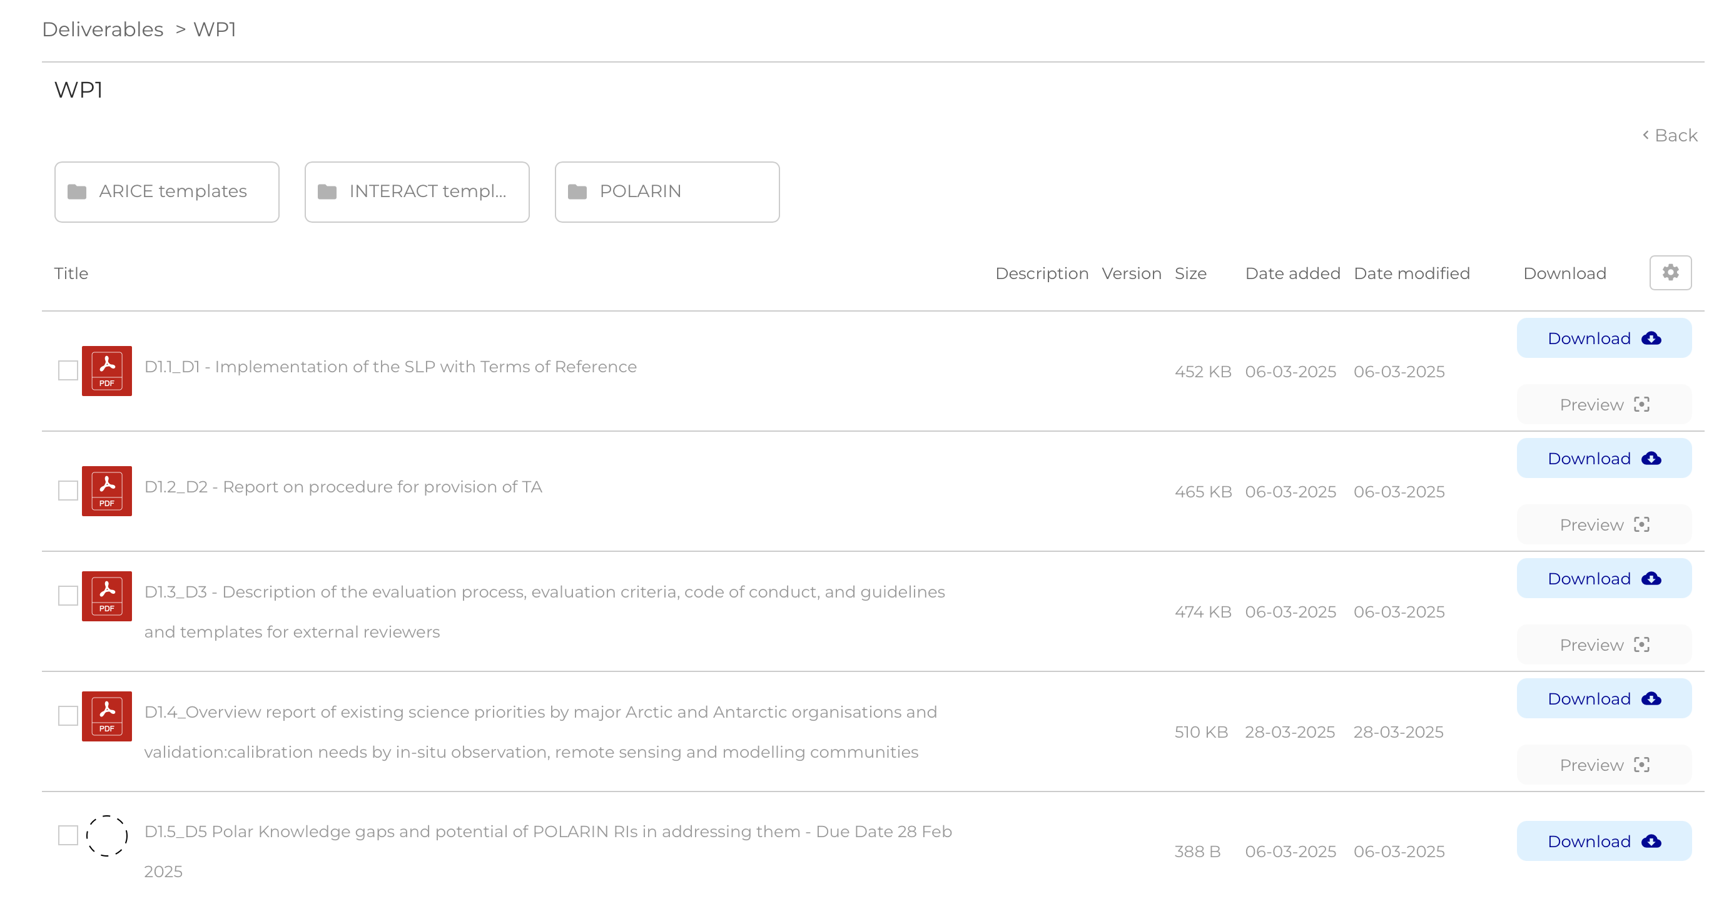
Intranet

Slide 8
3. Progress & Achievements
✅ 1st project amendment
To include INACH, FLPO, SAVN as partners
✅ Ongoing support for consortium operations & strategic coordination
Advisory Board
SLP implementation, contracts, reimbursements
RI user contracts
Follow up and support of WPs
Supporting links with EU Polar Cluster, relevant EU funded projects, ESA and relevant initiatives (e.g. Antarctica InSync)

Slide 9






4. Progress & Achievements
In progress: Joint Consortium Agreement in compliance with GDPR
In preparation: 2nd Project Amendment
ULUND – Leaving the consortium
EPB change of legal entity
New partners:
UMEÅ: modification of the INTERACT GIS, subcontracting not possible
ICARP & TÜBITAK MAM: Networking
BGR: offering free access to NAPA repository (rock samples) free of charge
JAMSTEC: as Associated Partner, offering free access to MIRAI II.

Slide 10
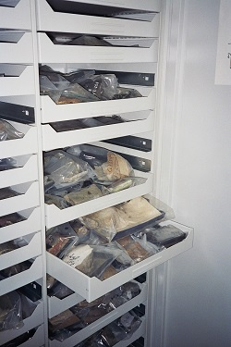
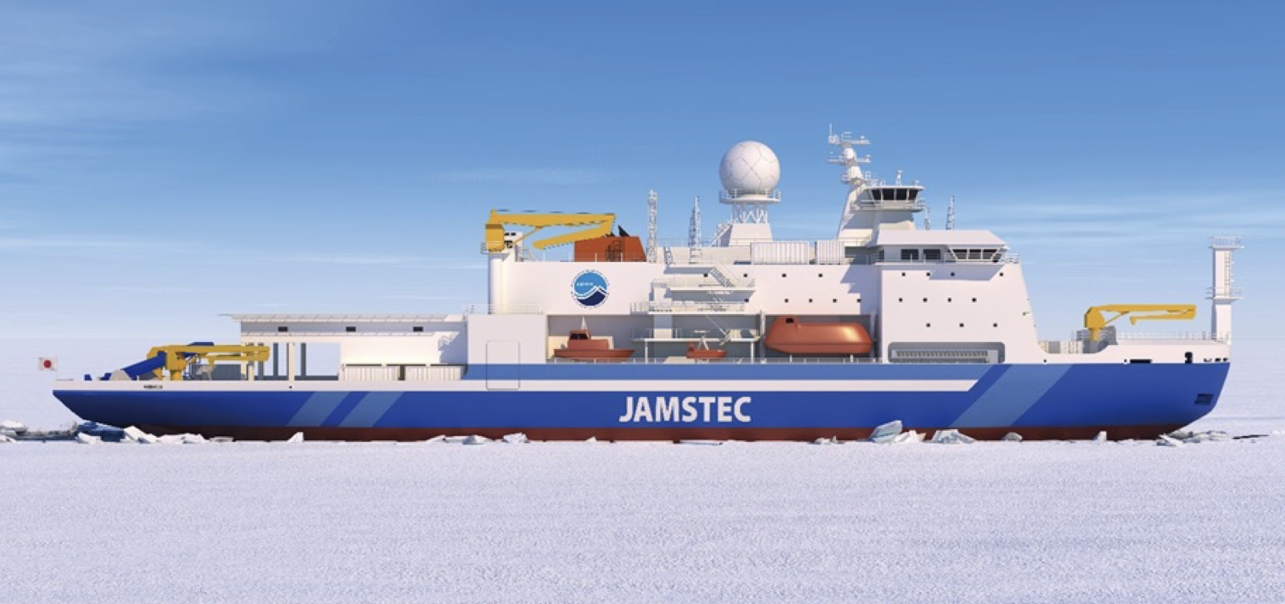


5. Challenges & Opportunities
High interest in POLARIN
Growing consortium
Increasing access to RIs
Large scale initiatives
Mirai II and NAPA repository
Joint/ parallel calls for proposals
?
Interest from other funding agencies/projects to launch parallel calls

Slide 11
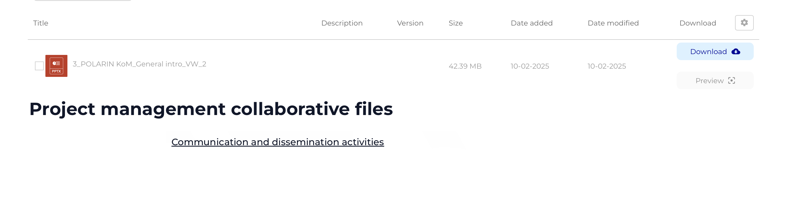
6. Next Steps
Input needed for continuous reporting
  Communication/dissemination activities tracker (intranet)

Slide 12
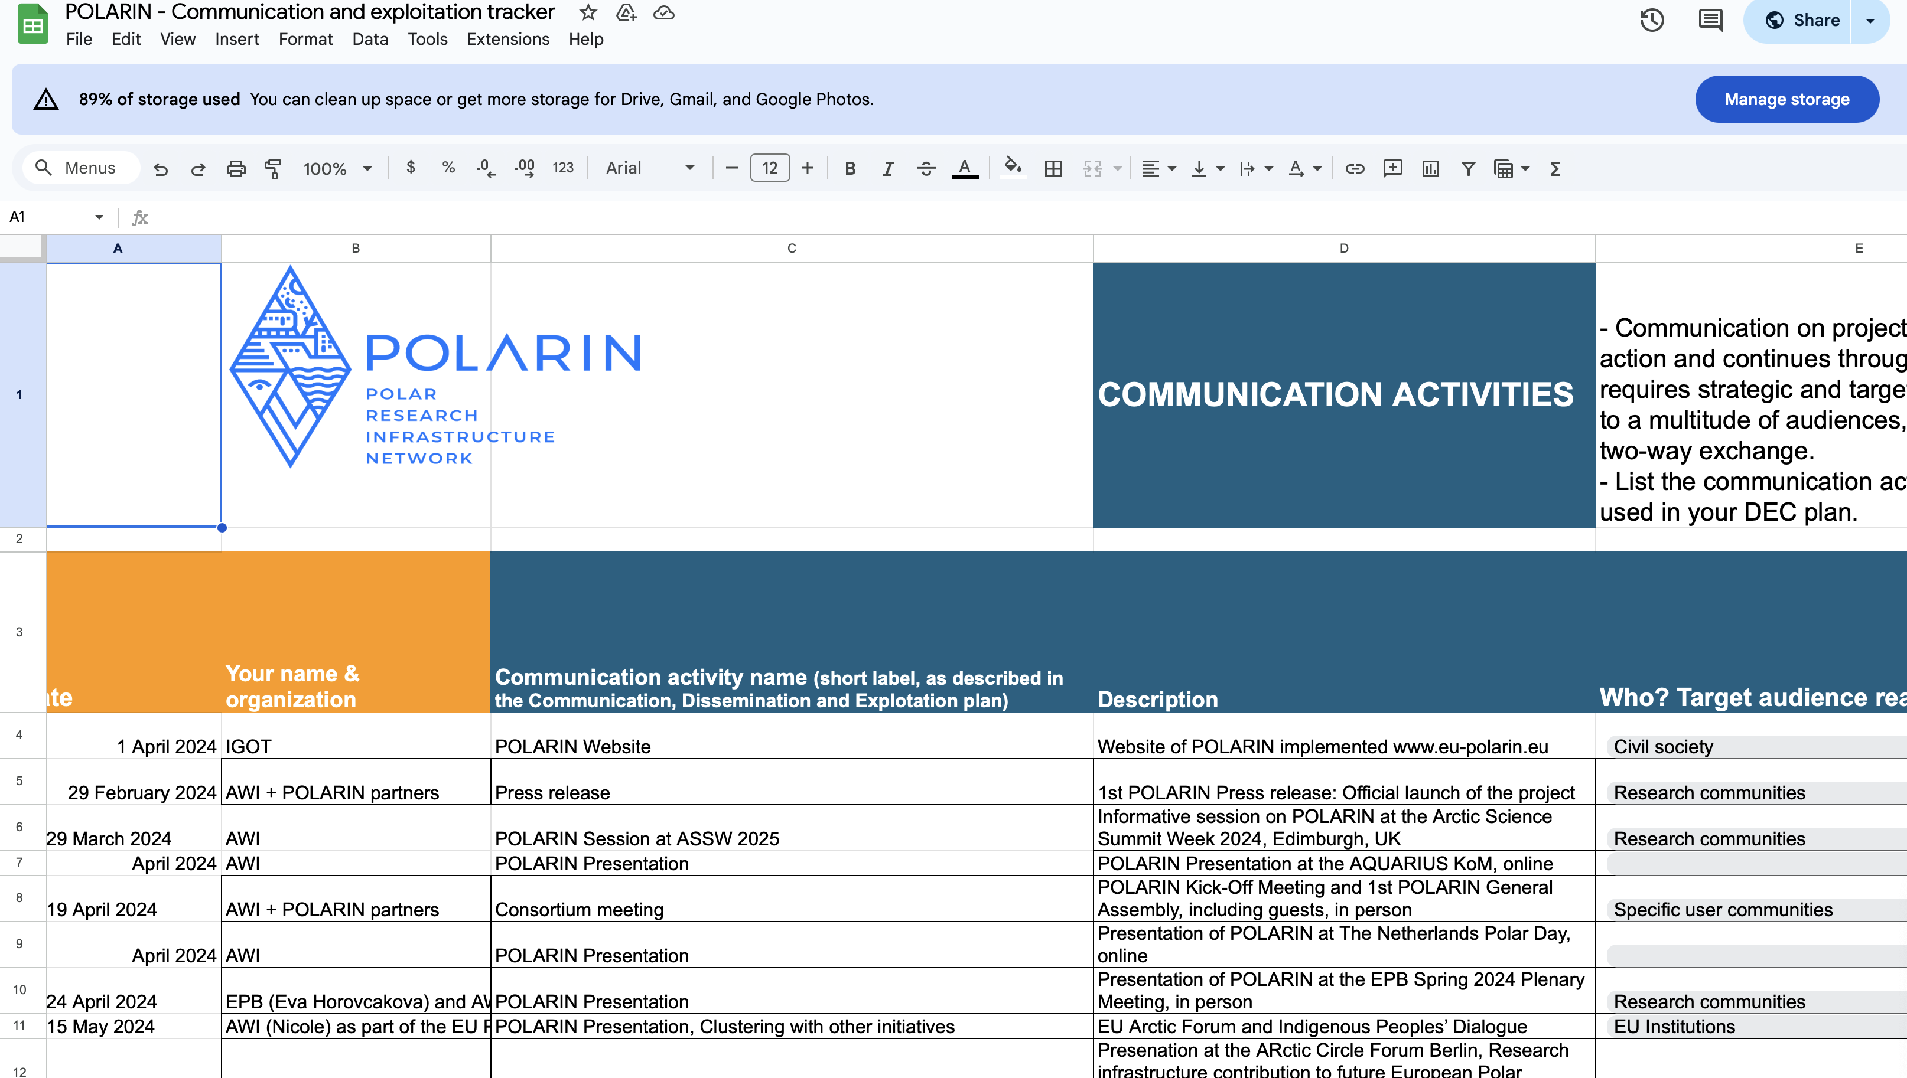
6. Next Steps

Slide 13
6. Next Steps
Project Amendment #2
Input needed for continuous reporting
  Communication/dissemination activities tracker (intranet)
Periodic Reporting in September 2025
  Reporting period 1st March 2024 to 31st August 2025
    SCIENTIFIC REPORT – WP leaders with contribution from WP partners.
      Template for input to be circulated early in September to WP leaders.
      Up-to-date communications tracker – In intranet!!
    FINANCIAL REPORT – ALL PARTNERS
Organisation of GA2026 in person including Mid Term Retreat

Slide 14
7. Discussion Points
Formal approval of new partner inclusion in Amendment #2
New partners:
UMEÅ: further development of INTERACT GIS, to accommodate POLARIN RIs. Subcontracting not possible
ICARP & TÜBITAK MAM: Networking
BGR: offering free access to NAPA repository (rock samples) free of charge
JAMSTEC: as Associated Partner, offering free access to MIRAI II.

Slide 15


Contact Us
Nicole Biebow: Nicole.Biebow@awi.de
Verónica Willmott: Veronica.Willmott@awi.de
Photo credit: Lars Grübner (AWI)

